Slide 1

Taking a systems approach to high-risk opioid prescribing
Reflections and learning - introduction
Gill Gookey, Medicines Safety Lead Pharmacist, Gill.gookey@nottingham.ac.uk

Slide 2
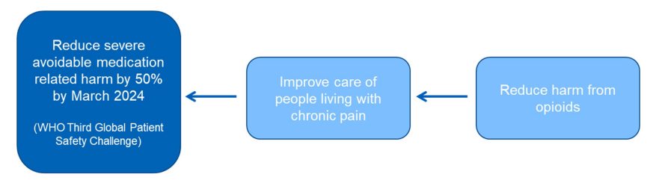
Medicines Safety Improvement Programme 22/23
System approach to change at an ICS level – testing in one ICS in the EM (JUCD)
Cross EM support – Data, upskilling, and shared learning

Slide 3
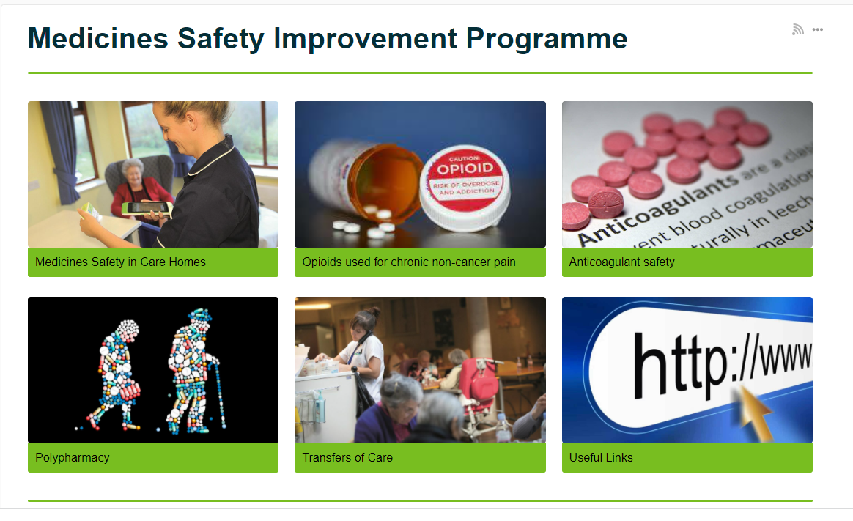
National Resources
https://future.nhs.uk/MedicinesSafetyImprovement

Slide 4
MedSIP opioids - 5 themes
Prevent initiation
Prevent initiation of opioids for inappropriate indications
De-escalate
Find chronic use
Treat (Taper & Support)
Sustain
Ensure opioids are not
Identify patients taking opioids long term (>3 months) for non-cancer pain and review to identify potentially inappropriate use
Support deprescribing of potentially inappropriate opioids with appropriate support for patients that includes non-pharmacological support)
Ensure changes to prescribing and the support available to patients are long-term
continued for longer than clinically appropriate
Used at higher dose than clinically necessary

Slide 5
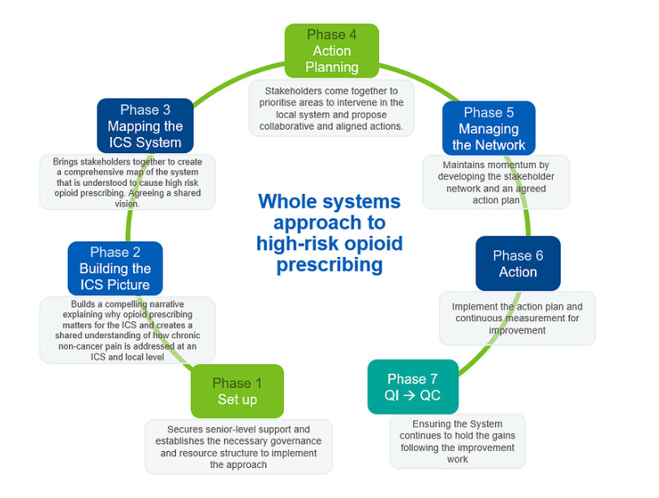
Proposed Change cycle
Notes:
Describe where we are with Derbyshire currently and offer to share again after the action planning in July

Slide 6

Local Resources
https://emahsn.org.uk/our-work/patient-safety/medicines-safety-improvement-programme
Sign up to the EMAHSN Medicines newsletter to keep up-to date on local events

