Slide 1

Taking a systems approach to high-risk opioid prescribing
Reflections and learning – Phase four
Gill Gookey, Medicines Safety Lead Pharmacist, Gill.gookey@nottingham.ac.uk

Slide 2
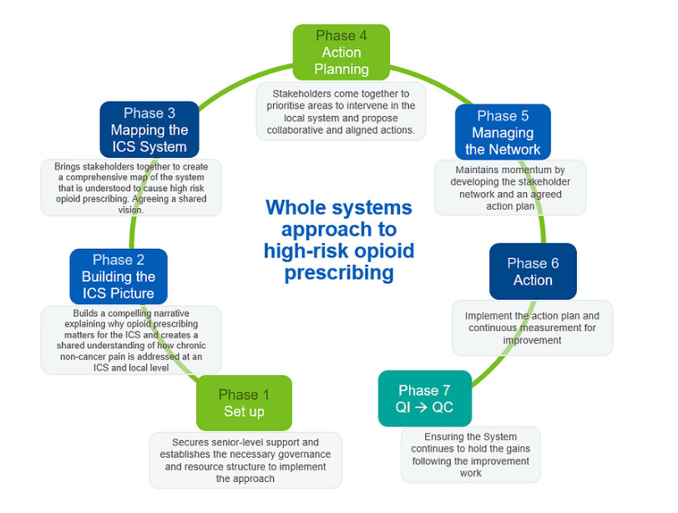
We are here

Slide 3
Phase Four
Phase four
Stakeholders come together to prioritise areas to intervene in the local system and propose collaborative and aligned action

Slide 4
What happened before the action planning event
Planned a 3hrs 15min online event
Selected invites to stakeholders with decision making ability from all services scoped and people with lived experience.
Pre-reading sent out in advance included:
Abridged scoping report
Prescribing data set
Links to videos sharing lived experience
Allocated attendees to breakout rooms based on location
Recruited a facilitator and scribe to each breakout room and trained them
Try to have one person with lived experience per room

Slide 5
Agenda for the day
No. | Time (mins) | Finish time | Item
1 | 5 | 9:20 | Introduction and background to programme
2 | 15 | 9:35 | What are the risks with opioids?
3 | 15 | 9:50 | The programme so far
4 | 30 | 10:20 | Group work: Identifying the issues Each group collates issues, then chooses their top three priority issues.
 | 10 | 10:30 | Break
5 | 15 | 10:45 | Voting: Identifying the issues Top three issues are collated from each group . Then each attendee votes for their personal top three issues which will be the focus for the rest of the event.
7 | 45 | 11:30 | Group work: Identifying the solutions Focussing on the three priority issues, groups identify solutions for each issue, then prioritise their top three solutions for each issue (one must be a short-term goal).
 | 10 | 11:40 | Break
8 | 15 | 11:55 | Voting: Identifying the solutions Top three solutions from each group are collated, then each attendee votes on their top three solutions for each issue (one must be a short-term goal).
9 | 25 | 12:20 | Group work: Identifying the actions How can you or your organisation help with the on-going work for the three chosen issues and solutions?
10 | 10 | 12:30 | Next steps and close

Slide 6
What digital tools and skills did we use at the event?
Event registration
Eventbrite
Asked to register or nominate an attendee
Asked to provide details including locality
Webinar platform
MS Teams
Voting
Slido
Interactive whiteboard
Google Jamboard
In event communication
WhatsApp group
Post event communications
SurveyMonkey
Carefully choose people by their skills to provide:
Hosting
Strong IT skills to run the webinar event
Facilitators and scribes
Back office collation of priorities from breakout rooms for voting
Presenting

Slide 7
What went well (yellow boxes are key learning)
– phase four
Wide stakeholder group including lived experience of chronic pain
Focused event with time limited decision making
Summary documents sent in advance as pre-reading
Excellent webinar support (complex event so REALLY needed)
Live voting (Slido worked well for this)
Weekly planning meetings on the lead up to the event
Multiple breakout rooms supported by facilitator and scribe
Action pledging was useful (but see next slide)
Pre-event training for facilitators and scribes including use of Jamboard and check-in before event on day.
Scene setting and including the patient voice (we used a video clip)

Slide 8
What did we learn for next time – phase four
Early agreement regarding sharing prescribing data to services and public
Share expectation of pre-reading early, title the email to highlight and send a reminder
Scribes have different IT set ups, so check Jamboard sharing possible at pre-meeting
Ensure facilitators are familiar with the programme (they must read the pre-reading)
Consider how to maximise action pledging on the day
Plan the next steps after the event earlier e.g. post-event communications, twitter
Think about the next phases early – this is not the finishing line. What will the network look like?

Slide 9
Key outcomes to achieve – phase four
Ensure all attendees have had the opportunity to be listened to and input on decisions
That involve more than one organisation
Three possible solutions for each issue
That include a short term goal
Pledges from organisations and individuals to support action and working groups
Share the programme and its aims widely
Gather enthusiasm
Maintain input from people with lived experience of chronic pain into working groups
Agreed (three) issues to work:
Have enough information to create an action plan for the system

