Slide 1

Taking a systems approach to high-risk opioid prescribing
Reflections and learning – Phase two and three
Gill Gookey, Medicines Safety Lead Pharmacist, Gill.gookey@nottingham.ac.uk

Slide 2
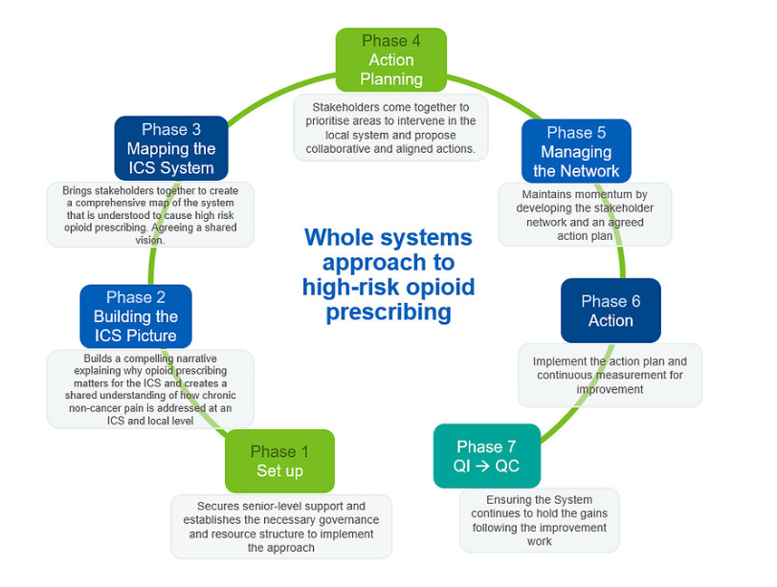
We are here

Slide 3
Phase two and three
Blended into one system mapping process that created a report to be sense checked and improved by the system and form the basis of action planning
Phase Two
Builds a compelling narrative explaining why opioid prescribing matters for the ICS and creates a shared understanding of how chronic non-cancer pain is addressed an ICS and local level
Phase Three
Brings stakeholders together to create a comprehensive map of the system that is understood to cause high risk opioid prescribing. Agreeing a shared vision
Deferred until phase 5

Slide 4
What was included in the system mapping
Data
Prescribing data (national, PCN, GP practice)
Inequality
Service provision
Skills need and service assessment
Primary care clinician survey
Focus group with PCN pharmacists
People and communities
Healthwatch
Voluntary groups
People with lived experience
Specialist pain service provision
Other commissioned non-pharmacological support
Physio
IAPT
Substance misuse services
Local authorities
Social prescribers and Health and Well-being coaches
Identify advocates/ examples of good practice

Slide 5
What was considered in the system mapping
Services offered
Capacity/waiting list
Inclusivity
Variation across the geography
Access to services and referral routes
Service and commissioning gaps
Location
Options for access (online/face-to-face/phone)
pharmacological
non-pharmacological

Slide 6
What went well (yellow boxes are key learning)
– phase two and three
People and communities event
Accept that the system map may not be perfect at first and be transparent
Choose between on-line and face-to-face events carefully
Think wider than pain services
Good data
variation
potential health inequalities
Understanding the upskilling need
Sharing lived experience
Videos
At action planning
Dividing the scoping between colleagues
Clinical
People and communities
One on one conversations
Share questions before
Book an appointment
Create a report that is
Accessible
Summarises key findings and gaps
Gives data
Visual system map
Report reviewed at ICS Integrated Pharmacy Medicines Optimisation board (IPMO) for comment before wider sharing

Slide 7
What did we learn for next time – phase two and three
Covid-19 has had an impact. Services and people have changed.
Involve the ICS communication team early
Try harder to involve local authorities earlier
Agree the action planning event date early
System mapping is likely to take 6-8 weeks
Collating and analysing the data, and writing the report takes significant time so start early

Slide 8
Key outcomes to achieve – phase two and three
Involvement of people with lived experience (and carers) with the programme
Identify advocates/good practice
Build relationships and enthusiasm
Listen to the system (service users and services)
Create a good first version of the system map that has been through local governance and IPMO review that can be shared widely
Identify key findings
Have a date and venue for the action planning event (face to face or on-line)

