Slide 1
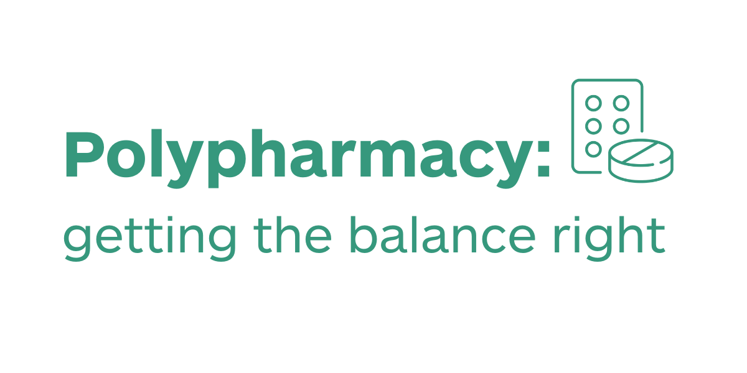

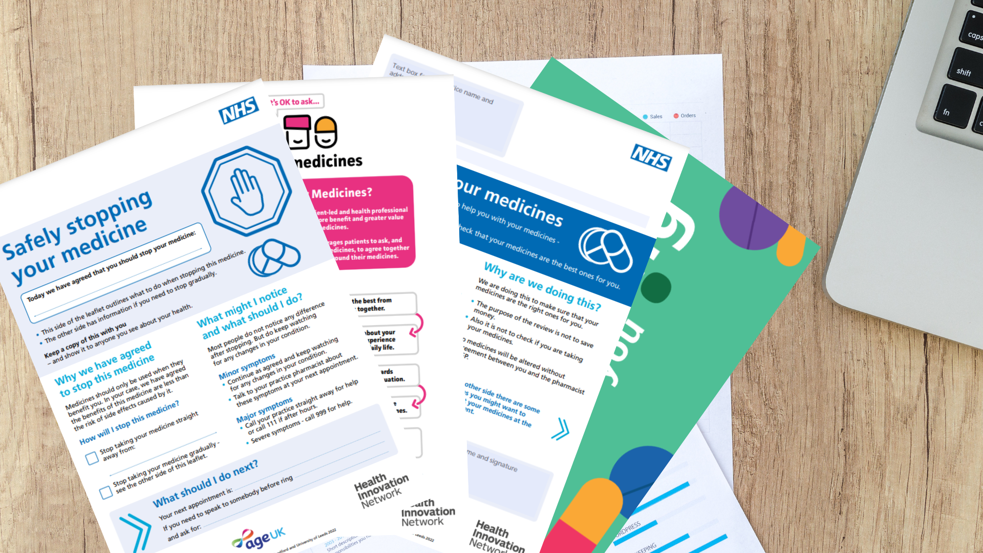
SMR project – Leicester City and University primary care network.
Polypharmacy project.
Insert any local logos here
Opportunity for change
Victoria Park Health Centre provides advice and care to over 20,000 patients. Although next to the University of Leicester, with many patients being students, it is based in Leicester City Centre and therefore has a highly diverse catchment, with English not always the first language.
For this project two defined groups were selected as the Seldom Heard Community and invited for structured medication review (SMR). Frail patients (defined as Clinical Frailty Scale >7 AND age over 75) with prescribed polypharmacy (10 medications) who are living alone or have difficulty accessing the surgery due to physical mobility issues or lack of transport, and patients from an Ethnic Minority Groups (EMGs) who do not have English as their primary language and have failed to attend a medication review in the past 12months.
Intervention
Patients booked in for SMR with senior clinical pharmacist with background in geriatrics.
Patients were identified using Systm1 reports.
Resources used: patient invitation letter, Me and My Medicines patient charter shared via Electronic SMS and paper letters in English and Gujarati.
20 SMRs done for purpose of this project and review of SMR process within surgery.
Comparative data:
Baseline number of SMRs: 82
SMRs comparative data : 239
For project purposes, 20 invited and 20 attended
Patient Quotes
“Very helpful chat about all of my medicines. We now have a plan to stop one or two of them after my blood tests” - Patient 1
“I had a chance to prepare questions beforehand” – Patient 2
Impact / outcomes
Patients advised they had the time to plan for discussion which helped with outcomes, led to productive shared decisions and deprescribing.
Out of 20 SMRs evaluated for this project, 10 medications were deprescribed/ trial reduction.
An outcome of the project that was not expected was patients advising relatives/ friends to book in for a SMR following their own experience.
An additional 157 SMRs were completed in the four months following the start of the project.
Future work
We will be identifying and prioritising high risk patient groups for SMRs – care home patients, 10 or more medications, elderly, high risk / addictive and opioid reviews.
More information
PCN contact Reshma.barot2@nhs.net
HIN contact lois.hooper-ainsworth@nhs.net
https://thehealthinnovationnetwork.co.uk/programmes/medicines/polypharmacy/patient-information/

