Slide 1

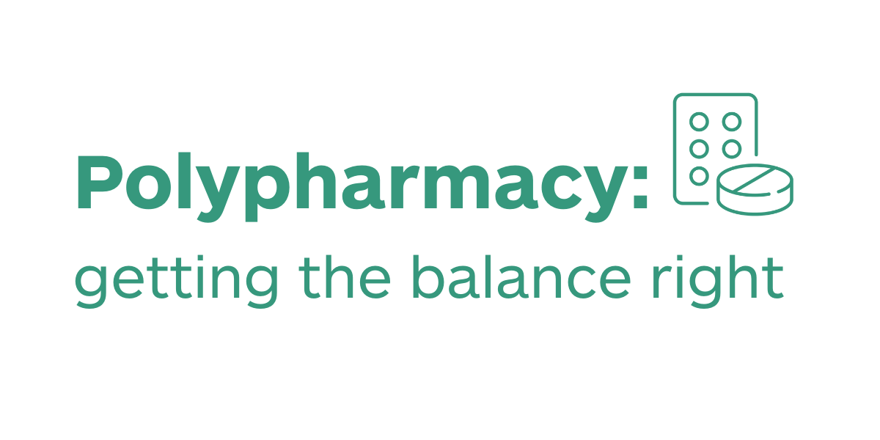
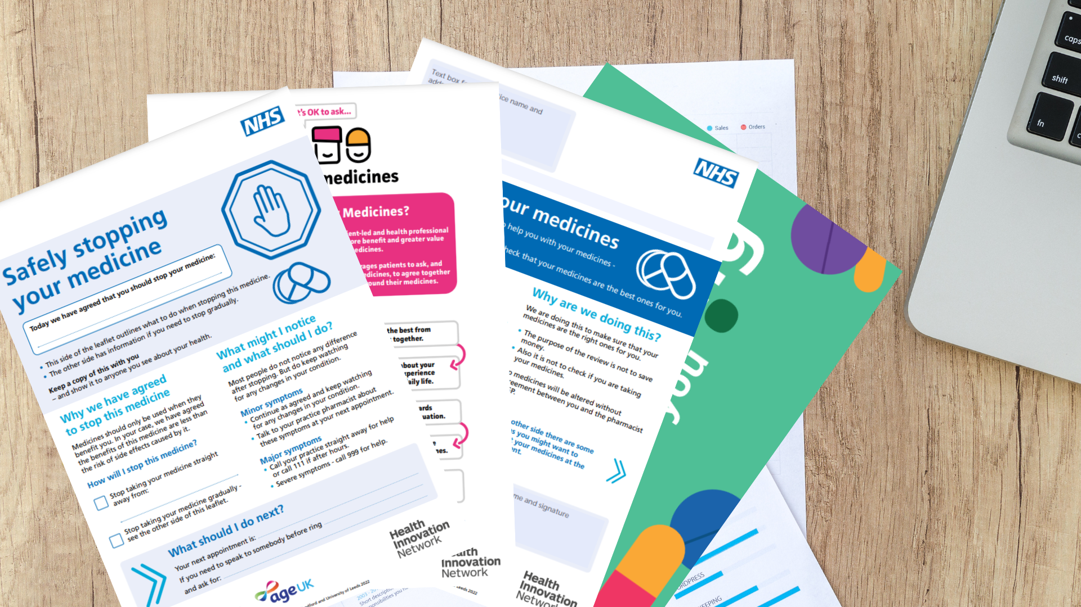
Larwood & Bawtry Primary Care Network
Seldom Heard Communities Polypharmacy project
Insert any local logos here
Opportunity for change
Westwood Surgery is a practice with 3,500 patients registered. Residents in the local community fall within the second most deprived decile in England, with NHS data showing a direct correlation between deprived communities and obesity, serious mental illness, diabetes or other long-term condition and learning disability. The King’s Fund also suggests that individuals living in more deprived areas are at great risk of illness and premature death. Due to this, these patients are more likely to be subject to complex polypharmacy and less likely to engage with health services.
Intervention
22 patients from the Westwood Surgery were invited for a SMR with a clinical pharmacist after meeting three or more criteria following searches using categories including: care home residents, complex polypharmacy (10 or more medicines), frailty, patients prescribed medicines known to cause harm, housebound, recent hospitalisation or fall in last three months or prescribed addictive medications
Resources used: patient invitation letter, Me and my medicines patient charter shared via Electronic SMS and paper letters in English.
Data
Baseline number of SMRs scheduled: 20
Baseline number of SMRs completed: 16 (80%)
Study number of SMRs scheduled: 22
Study number of SMRs completed: 20 (91%)
Impact / outcomes
At the practice, SMRs were previously completed by GPs, with an allocated time frame of 6-10 mins. For this study, SMRs were completed by a clinical pharmacist and 30 minutes allocated, allowing for a more comprehensive intervention.
Patients advised they had the time to plan for discussion which helped with outcomes, led to productive shared decisions and deprescribing.
SMR uptake increased by over 10% due to the targeted approach and materials provided.
Outcomes included:
The prescription and administration of inclisiran for familial hypercholesterolemia
The development of a deprescribing plan with the aim of reducing ACB score & opioid/gabapentinoids reduction
Opioid reduction for non-palliative pain, with a fully agreed opioid reduction plan
Addictive medicines review and mitigation of risk secondary to safeguarding concerns
Clinician quote
“I think this work highlights the value of a SMR. Patients felt heard; and every decision made was a shared one. It gave me a real sense of job gratification. I recall a patient telling me that they would never have considered reducing their opiates if we had not engaged with them.”
Future work
We will be identifying and prioritising high risk patient groups for SMRs – care home residents, housebound, complex polypharmacy, frail, and those prescribed addictive medicines or medicines known to cause harm.
More information
PCN contact yeling.wan@nhs.net
HIN contact Richard.mcbain@nottingham.ac.uk
Polypharmacy: Getting the balance right

