Slide 1



Midlands Shared Learning Event:
Planning for Sustainability in PSIRF
Victoria Harrop – Programme Lead – West Midlands Health Innovation
Sophie Mason – Improvement Lead – East Midlands Health Innovation
@PtSafetyWM @Healthinn_em

Slide 2

Housekeeping

Slide 3
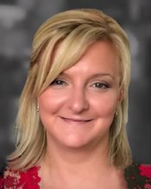
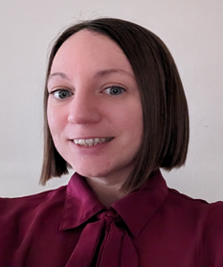
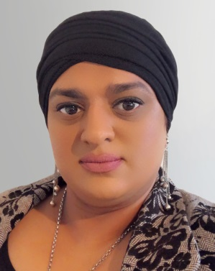
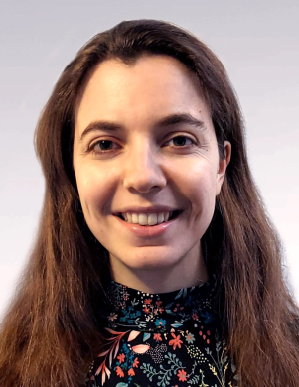
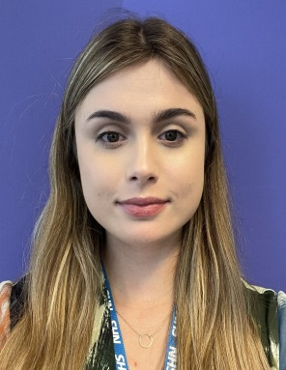
System Safety Improvement Programme
Victoria Harrop
Programme Lead & Associate National Co-lead– System Safety
victoria.harrop@healthinnovationwm.org
Sophie Mason
Programme Lead – System Safety
sophie.mason@nottingham.ac.uk
Nasrin Khan
Improvement Science Manager
Nasrin.khan@healthinnovationwm.org
Dale Lyons
Project Manager
Dale.Jenkins-lyons@healthinnovationwm.org
Ella West
Project Officer
ella.west@nottingham.ac.uk

Slide 4
Midlands Shared Learning Event
Time | Topic | Speakers
15.00 | Introduction | Victoria Harrop
15.10 | Planning for Sustainability | Lauren Morgan Director, Morgan Human Systems LTD
15.25 | The journey from investigation to improvement The Royal Orthopaedic Hospital NHS Foundation Trust | Adam Roberts Assistant Director of Governance and Risk
15.50 | Sustainability, its meaning to our system and planning for the year ahead Lincolnshire Integrated Care Board | Paul Jibson Head of Quality Serivces Team Tracy Petch Senior Patient Safety Manager
16:15 | Closing Remarks | Sophie Mason

Slide 5


What 3 words do you associate with ‘supportive oversight’?
Reflections - our last learning event
What 3 things will you take away from today’s learning event?

Slide 6




‘Wild Tea’ - Your thoughts
Be ready to share your thoughts on
What does sustainability mean to you?
STOP… do not hit return yet​
Share in Slido now …… GO!

Slide 7



Please download and install the Slido app on all computers you use
What does sustainability mean to you?
ⓘ Start presenting to display the poll results on this slide.

Slide 8
Planning for sustainability
Lauren Morgan, Chartered Human Factors Specialist
Director of Morgan Human Systems LTD
@PtSafetyWM @Healthinn_em

Slide 9
PSIRF Year 2 – The journey from investigation to improvement
Adam Roberts, Assistant Director of Governance & Risk
Royal Orthopaedic Hospital NHS Foundation Trust
@PtSafetyWM @Healthinn_em

Slide 10
PSIRF: From Investigation to Improvement
Adam Roberts
Assistant Director of Governance & Risk
Royal Orthopaedic Hospital NHS Foundation Trust

Slide 11
Content & Scope
1. Reflections on implementation of PSIRF
2. Challenges
3. Successes
4. The next steps
5. Sustainability of learning and improvement

Slide 12
Reflections on the implementation of PSIRF
My ‘eureka’ moment
A ‘safe’ PSIRF Response Plan
Evolution not revolution

Slide 13
Challenges
Exec Director & Board buy in
Proportionality of PSIRF responses
SEIPS based learning and actions
Assurance Reports
The Coroner

Slide 14
Successes
Proportionality
  VTE & Pressure Sore Triage Forms
Cultural maturity
  Divisional Governance, Exec Directors and Board
  Response to Coroner S28 Preventing Future Deaths Report
  Assurance Reports
Birmingham & Solihull (BSOL) ICB PSIRF Learning Network
  On the same journey
  Shared experiences and learning
  Action Learning Sets

Slide 15
The next steps
What has PSIRF taught us as a Trust?
PSIRF Annual Review & 2nd PSIRF Response Plan
Duty of Candour and passionate engagement
SMARTer learning and actions

Slide 16
Sustainability of learning and improvement
From investigation to improvement
  A PSIRF Response Plan that is reflective of the wider current issues, risks & priorities
  Aligning PSIRF to quality improvement workstreams/complaints/claims/business plans/trust strategies
  Best, most effective way to make improvements?
  Collaboration and shared learning with ICBs and system partners

Slide 17

PSIRF: Planning for Sustainability
Paul Jibson, Head of Quality Services Team
Tracy Petch, Senior Patient Safety Manager
Lincolnshire Integrated Care Board
@PtSafetyWM @Healthinn_em

Slide 18

Insert presenter slides here

Slide 19
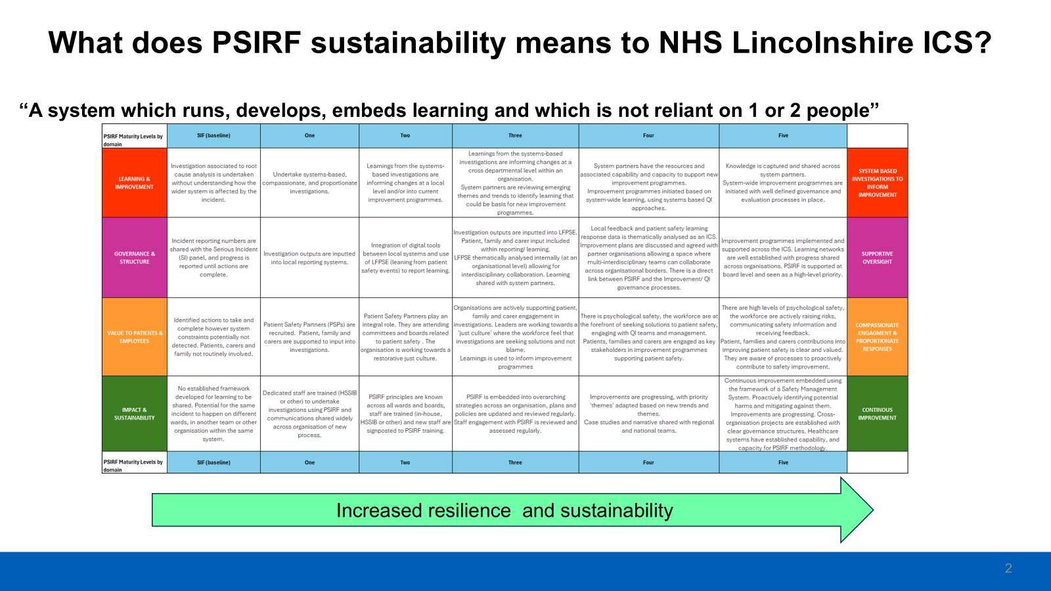
Insert presenter slides here

Slide 20
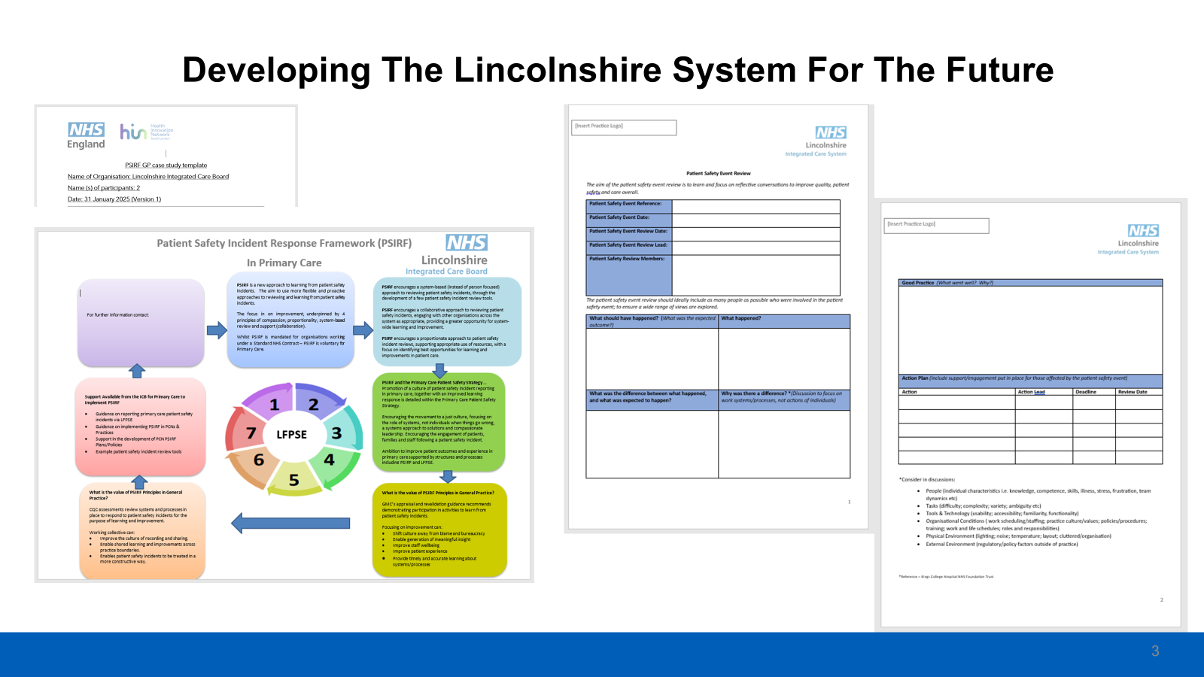
Insert presenter slides here

Slide 21
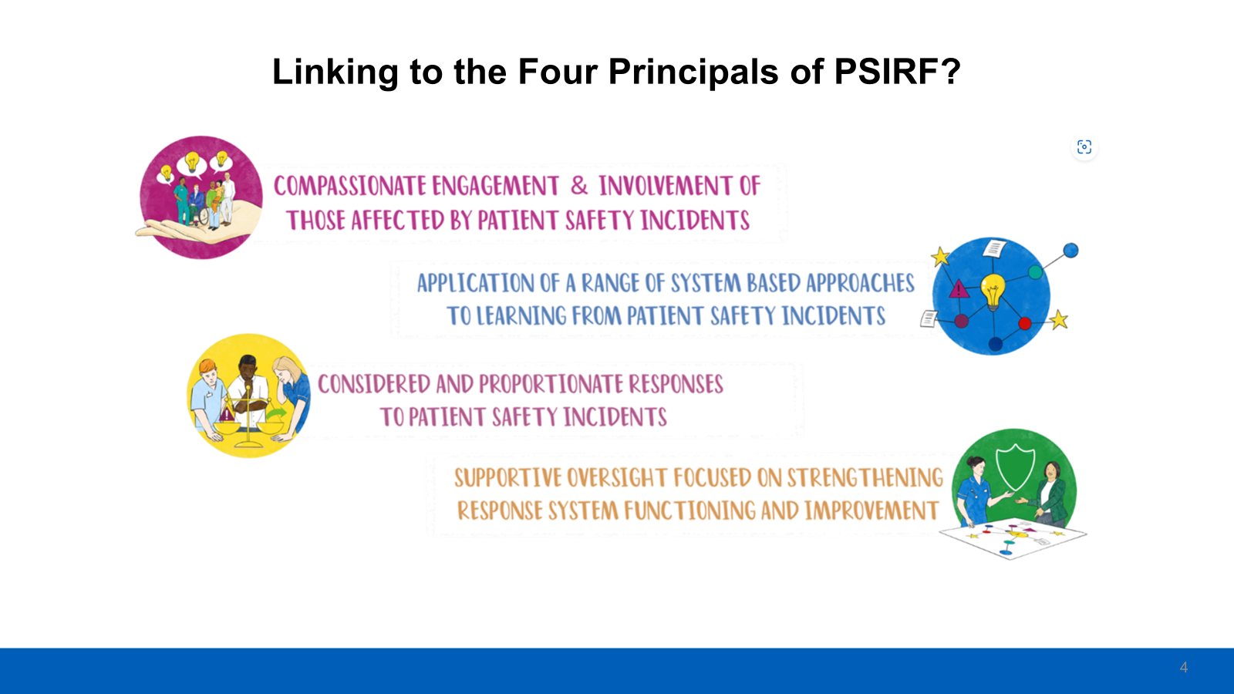
Insert presenter slides here

Slide 22
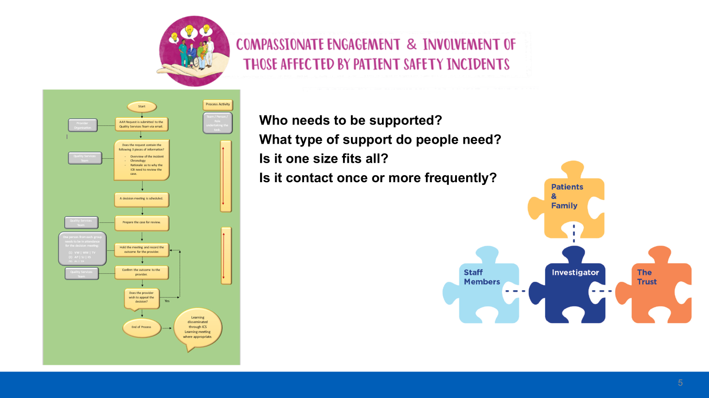
Insert presenter slides here

Slide 23


Slide 24
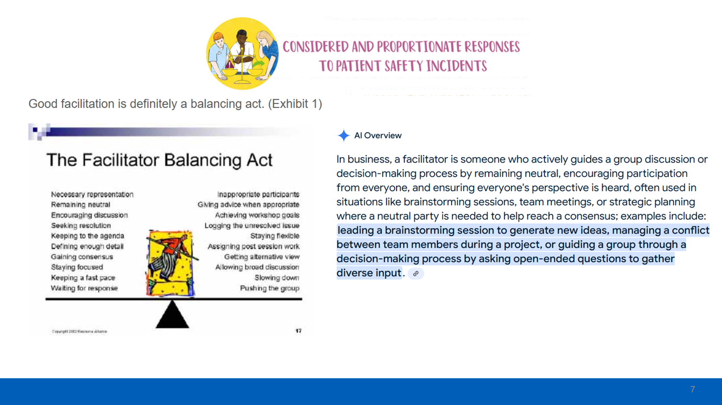

Slide 25


Slide 26
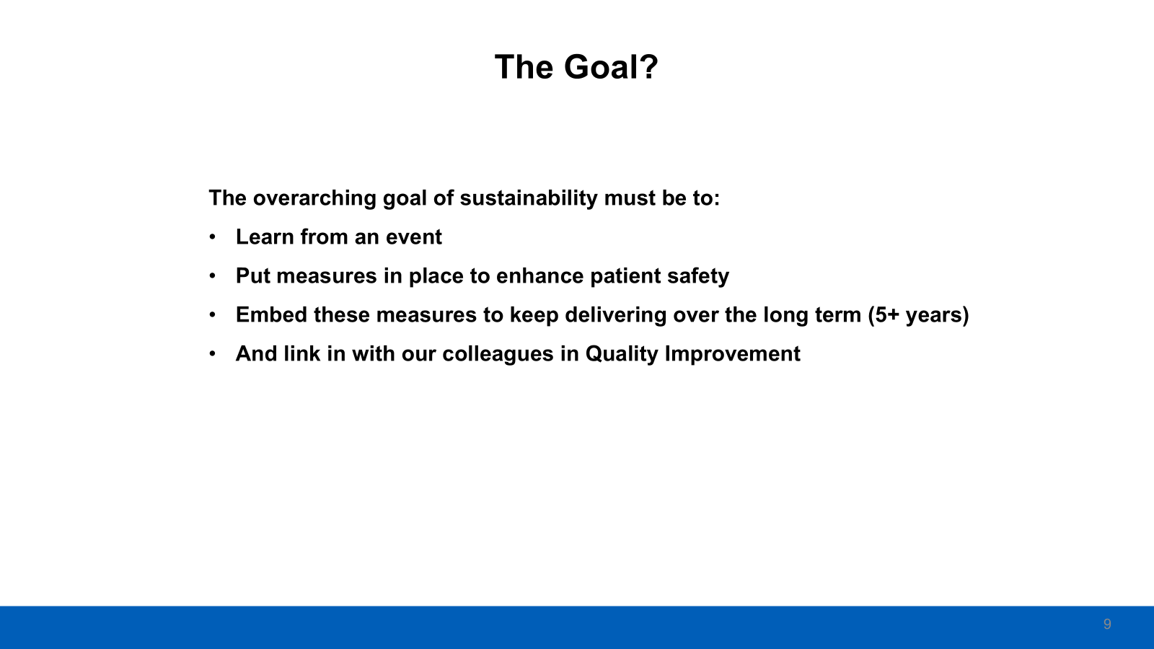

Slide 27
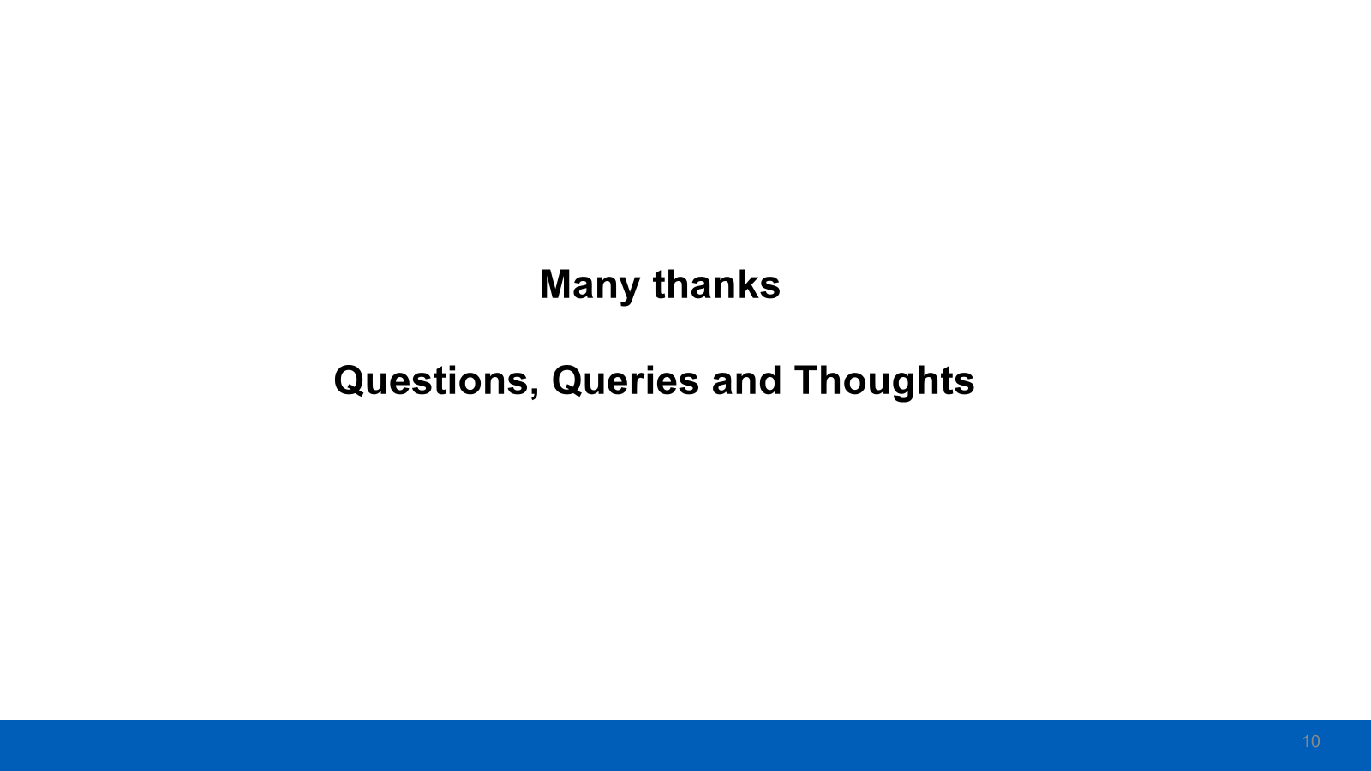

Slide 28

Word Cloud Slido -
What 3 things will you take away from today's learning event?

Slide 29
Please download and install the Slido app on all computers you use
slido
What 3 things will you take away from today's learning event?
ⓘ Start presenting to display the poll results on this slide.

Slide 30

Closing Remarks
Sophie Mason – System Safety Programme Lead – East Midlands Health Innovation
@PtSafetyWM @Healthinn_em

