Slide 1



Midlands Shared Learning Event:
PSIRF Measuring Impact of Improvement
26 November 2024
Victoria Harrop – Programme Lead – West Midlands Health Innovation
Sophie Mason – Improvement Lead – East Midlands Health Innovation
@PtSafetyWM @Healthinn_em

Slide 2
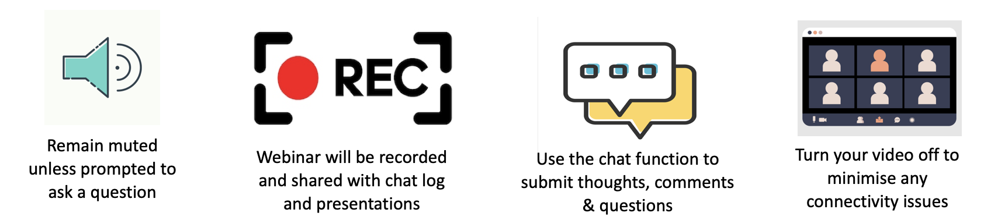
Housekeeping

Slide 3

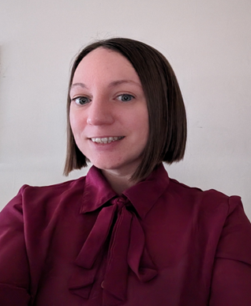
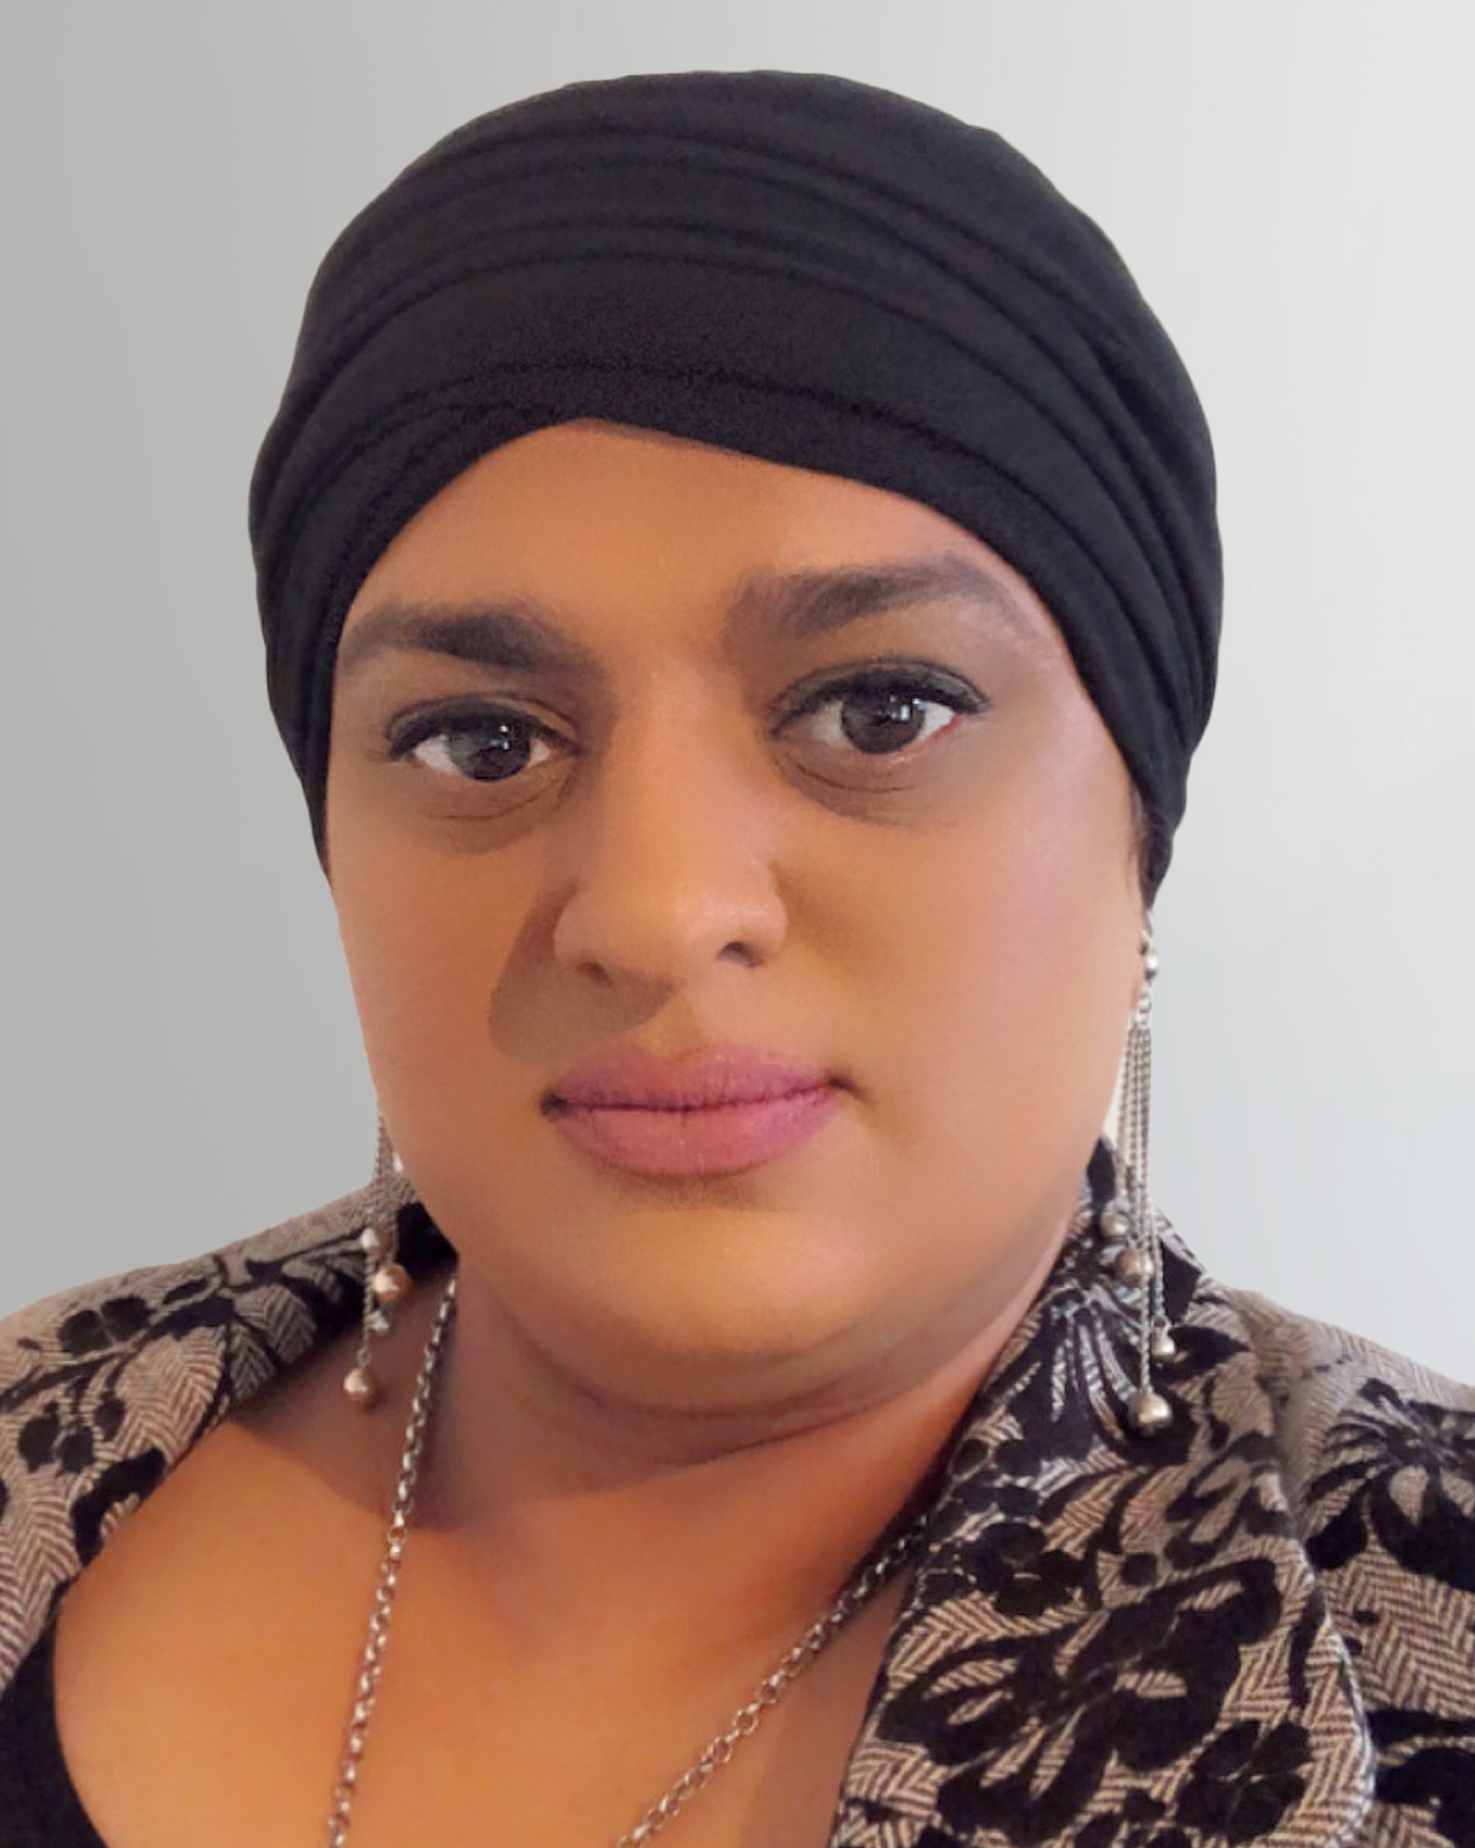
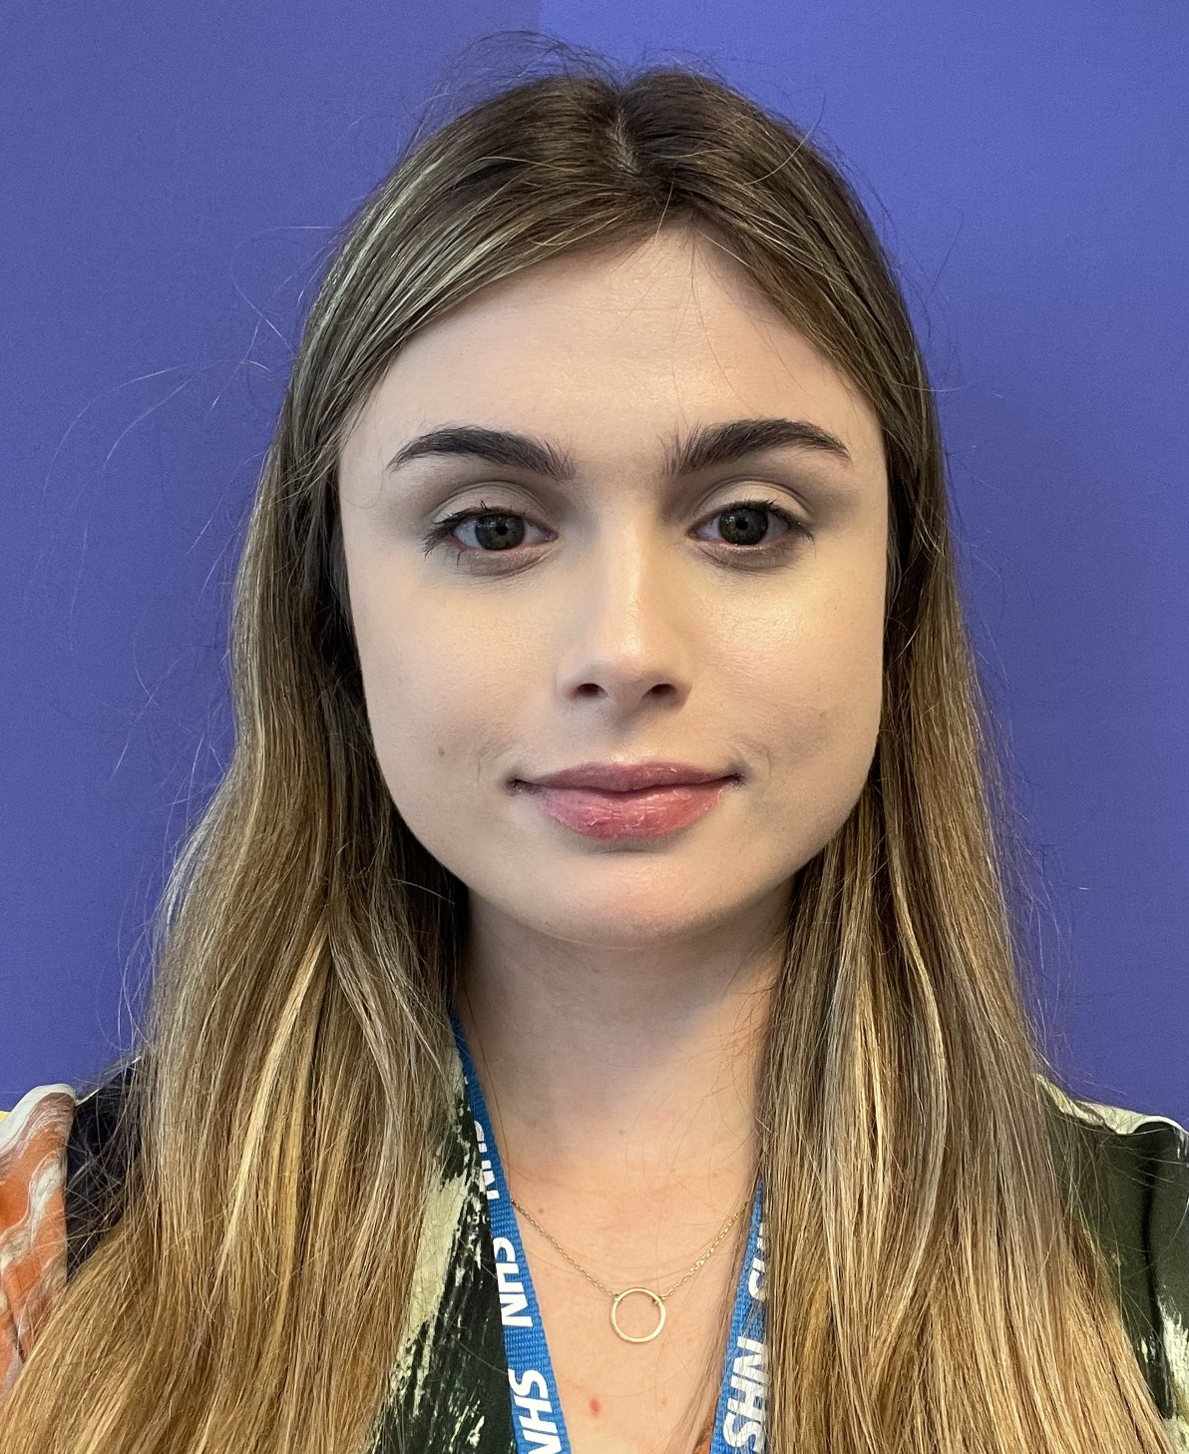
System Safety Improvement Programme
Victoria Harrop
Programme Lead & Associate National Co-lead– System Safety
Nasrin.khan@healthinnovationwm.org
Sophie Mason
Programme Lead – System Safety
sophie.mason@nottingham.ac.uk
Nasrin Khan
Improvement Science Manager
Nasrin.khan@healthinnovationwm.org
Ella West
Project Officer
ella.west@nottingham.ac.uk

Slide 4
Midlands Shared Learning Event
Time | Topic | Speakers
10.00 | Introduction | Victoria Harrop
10.10 | Oversight - supporting effective approaches for learning and improvement | Lauren Mosley, NHS England
10:30 | The use of thematic review to facilitate improvements in pressure ulcer prevention care in the community setting | Amanda Last and Clare Evans, The Dudley Group NHS Foundation Trust
10:55 | System Learning from Patient Safety Incidents | James Barker, Derby & Derbyshire Integrated Care Board
11:15 | Closing Remarks | Sophie Mason

Slide 5



Please download and install the Slido app on all computers you use
What 3 words do you associate with 'supportive oversight?'
ⓘ Start presenting to display the poll results on this slide.

Slide 6

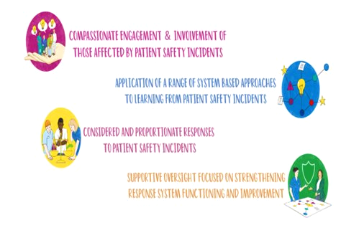

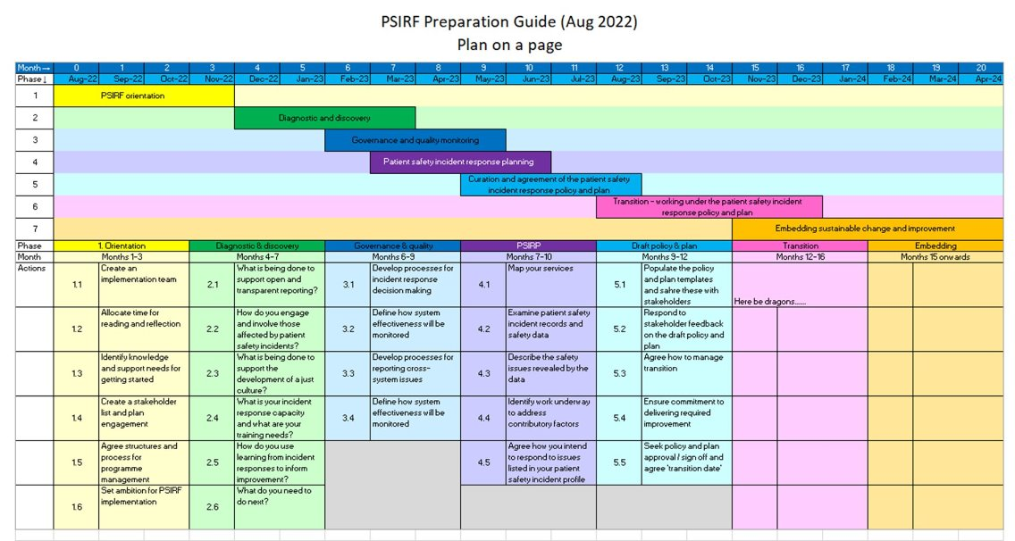
Oversight mindset principles
Improvement is the focus
Blame restricts insight
Learning from patient safety incidents is a proactive step towards improvement
Collaboration is key
Psychological safety allows learning to occur
Curiosity is powerful

Slide 7

Oversight - supporting effective approaches for learning and improvement
Lauren Mosley, Head of Patient Safety Implementation, NHS England
@PtSafetyWM @Healthinn_em

Slide 8

Oversight - supporting effective approaches for learning and improvement
Lauren Mosley, Head of Patient Safety Implementation

Slide 9


This Photo by Unknown Author is licensed under CC BY-NC-ND

Slide 10



Changing culture and behaviour
A study by Dixon-Woods et al (2013) which looked at culture and behaviour in the English NHS highlighted both ‘bright spots’ and ‘dark spots’; characterised by two key opposing types of behaviour: ‘problem sensing’ and ‘comfort seeking’
Targets
Demands for quick actions and fixes
Reaction and remarks to ‘things going wrong’
Judgement
In ‘problem sensing’ organisations focused on intelligence gathering, conscious inquiry and ‘organisational sense making’ to expose and explore both threats and opportunities so that meaningful action could be taken in response
In ‘comfort seeking’ there is focus on data generating, information on external targets collected and used for the purpose of false assurance and reputation management. Solutions proposed in response to incidents or concerns require a level of ‘magical thinking’ since underlying causes remained unknown.
Curiosity
Compassion and kindness
Fairness
Understanding
Collaboration

Slide 11



Supportive oversight
Oversight mindset Should underpin oversight approach from provider boards, ICBs and CQC | Oversight approach Principles to consider when designing an approach to oversight
Improvement is the focus Blame restricts insight Learning from patient safety incidents is a proactive step towards improvement Collaboration is key Psychological safety allows learning to occur Curiosity is powerful | Use a variety of data Reduce the information collection burden Oversight is not ‘one size fits all’ Capture meaningful insight from patients, families and staff Metrics require clarity and purpose Be aware of perverse incentives

Slide 12
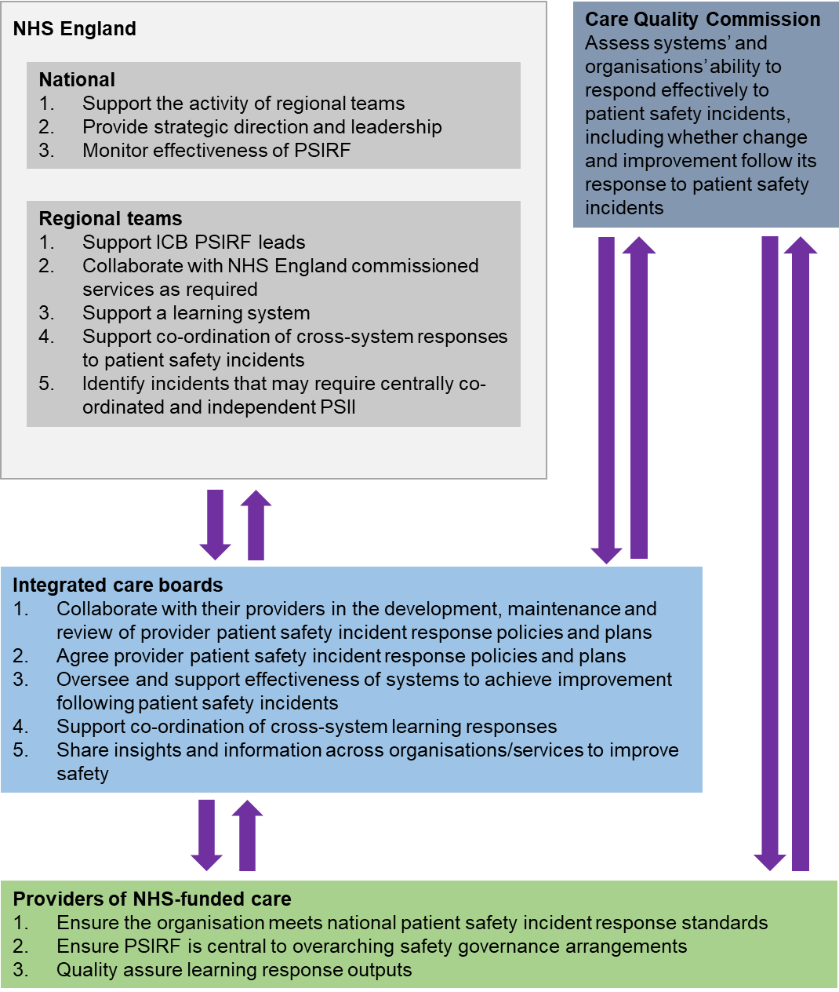
B1465-4.-Oversight-roles-and-responsibilities-specification-v1-FINAL.pdf (england.nhs.uk)

Slide 13
Setting the foundations
Relational vs transactional
Trust on both sides
Importance of being open and able to share information
Become partners in creating the best patient safety incident response pathways for your systems
How far are the standards being met?

Slide 14
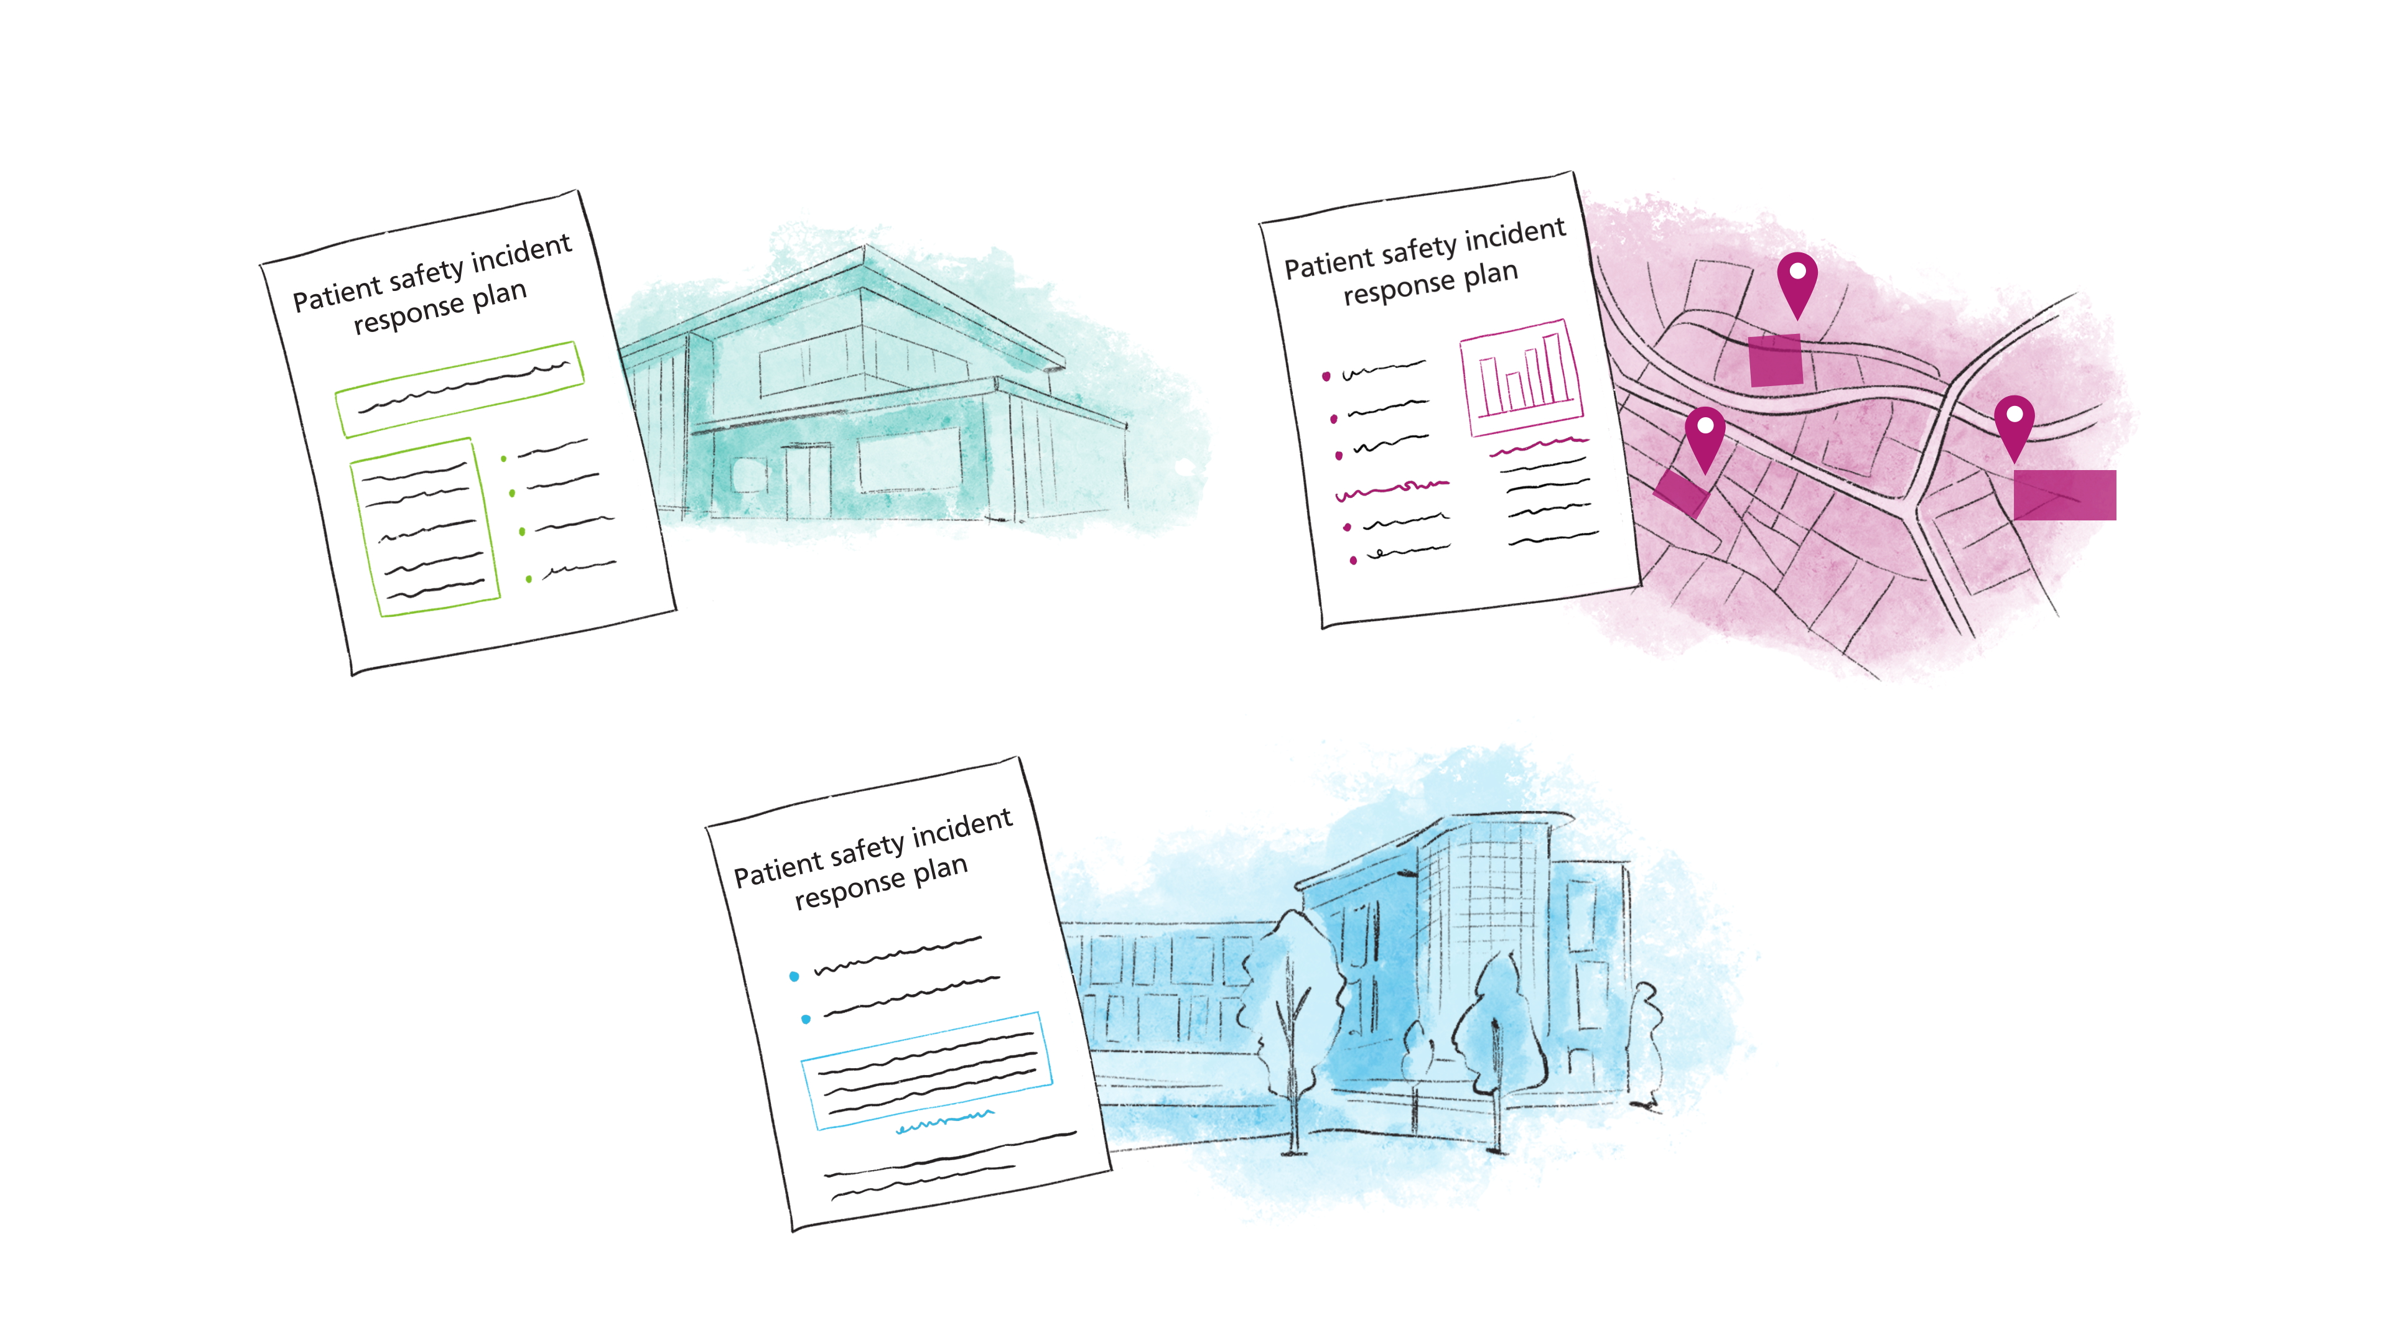

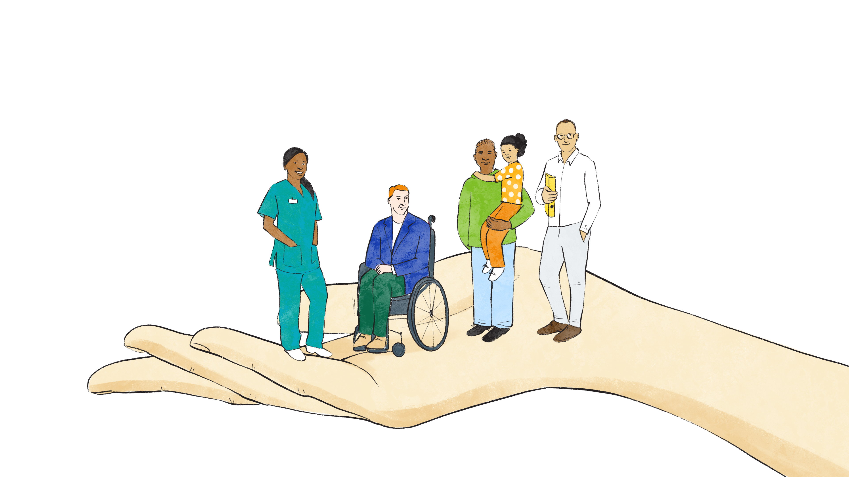

Developing new oversight processes
Is learning and improvement work adequately balanced?
How can the ICB support cross system responses?
How are we using insight for improvement?
Is the ICB active partner in review and development of plans.
Is work progressing to fulfil any gaps identified in meeting national patient safety incident response standards?
Policy, planning and oversight
Competence and capacity
Engagement and involvement of those affected
Proportionate response
Is compassionate engagement equitable for all?
How extensive is the evidence of a just culture (eg does ‘blame’, or focusing on individual actions or omissions occur)?
Can organisations describe their capacity to effectively deliver its patient safety incident response plan?
Is staff time protected or dedicated full-time roles in place for patient safety incident response?
Opportunity to support at system level?
B1465-5.-Patient-Safety-Incident-Response-standards-v1-FINAL.pdf (england.nhs.uk)

Slide 15

Notes:
Time for questions!

Slide 16
PSIRF Response Tool:
Thematic Review of Pressure Ulcer Preventative Care in the Community
Clare Evans & Amanda Last
The Dudley Group NHS Foundation Trust
@PtSafetyWM @Healthinn_em

Slide 17

PSIRF Response Tool:
Thematic Review of Pressure Ulcer Preventative Care in the Community
Clare Evans
Amanda Last

Slide 18
Overview
Planning and rationale of use for the use of thematic review
Response alignment to the PSIRF standards – proportionate response, engagement, system analysis, oversight
Adaptations to the process along the way
Outcomes of our review cycles so far
Developments underway
Reflections on process

Slide 19

Pre transition planning:
  In top 3 of the Trust’s most frequently investigated incident
  Review of sample 50 pressure ulcer investigations over 3-year period
  Good understanding of where issues in care were
  Avoid over investigation and refocus on improvement
  Designed a thematic review tool based on the themes identified
Issue | Position Statement at transition
Failure & lack of robust timely assessments Skin Bundle, MUST, WATERLOW | Issue still apparent
Equipment not in use delays in ordering | Issue still apparent
Lack of escalation of skin concerns to senior nurses to TVT | Issue still apparent
Safeguarding Lack of raising issues Insufficient documentation to evidence adequate review | Issue still apparent
Non-adherence to policy/procedure Leg Ulcer Policy, Pressure Ulcer & Prevention Management Lack of repositioning patients Failure to React to RED | Issue still apparent

Slide 20
Our Approach
Aims:
To assess the frequency of issue occurrence aligned to the key themes identified in the initial analysis
Provide a means of measurement of the effectiveness of the quality improvement activity between the cycles of thematic reviews
To inform our understanding of any system factors impacting pressure ulcer preventive care and management and inform new quality improvement work
Scope:
Minimum number of cases (30 +) (use incident investigations (SIT), patient notes
Desk top review completed
Mix of cases across all categories – don’t just focus on significant harm!
Review tool:
31- point data collection tool including the Trust’s baseline standards and expansion to include community specific processes
Standard reporting template – including theme and trend analysis, conclusions, improvement outcomes and recommendations

Slide 21


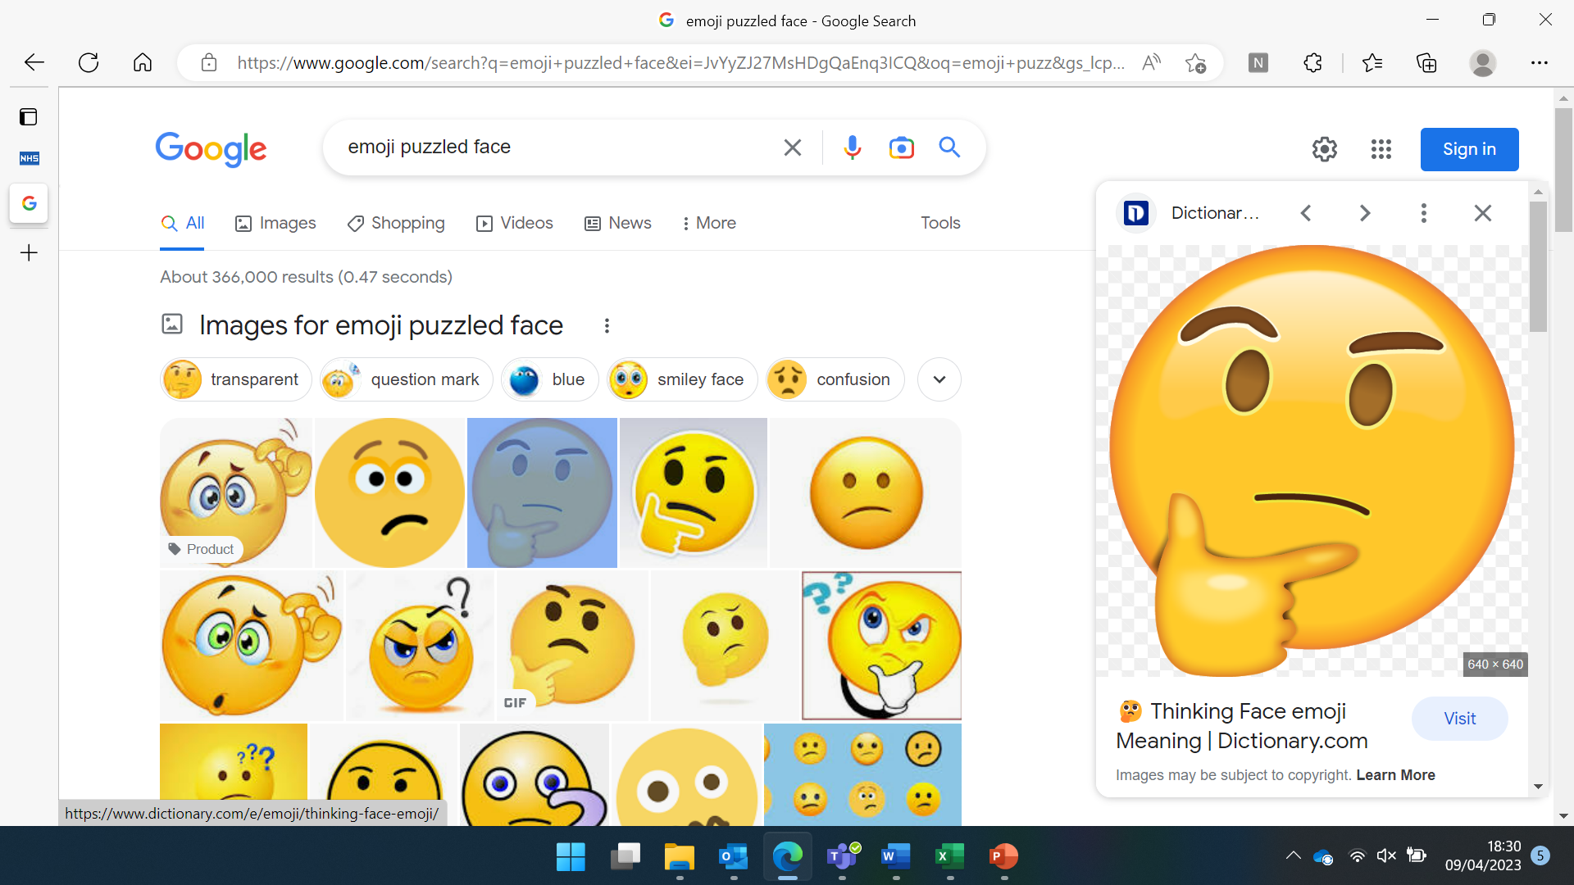



Staff Engagement:
First round of review….
Needed a way to share and explore the findings
Look at ‘work as done’
Challenge across Community District Nursing service
Engagement events VS Microsoft forms learning package
MS forms learning package includes- Thematic Learning slides- issue, impact and key message, what good looks like, assessment and staff engagement, Share process changes, Key messages, Reading list.

Slide 22
Anonymised Survey Monkey
Identified two of the key areas of practice which required improvement and posed questions to staff across District nursing to get their feedback on what works well what can be done differently.
Utilised to formulate the improvement action plan (SIP)

Slide 23

Single Improvement Plan:
Removed individual action plans regarding PUs
Formulated one overarching plan to support oversight/avoid replication
Datix (central oversight)
Reporting into governance structure within monthly Incident reports.
Reporting into SPUG
Next Steps………
Triangulation of learning: Triangulate learning from individual PU cases with that of the thematic reviews to develop the single improvement plan.

Slide 24
Findings
 | Thematic review Apr 2023 | Thematic review Nov 2023 | Thematic review June 24 | Trend
Assessment:
Lack of Waterlow reassessment in response to changes to the patient’s presentation | 12 out of 18 patients did not have their Waterlow updated in response to changes. (66.6%) | 2 out of 18 patients did not have a correct Waterlow assessment in response to changes. (11%) | 6 out of 52 patients did not have a correct Waterlow completed prior to the PU identification. (11%) | Improvement maintained
MUST assessments not complete and kept up to date. | 9 out of 18 patients did not have their MUST assessment completed accurately and up to date (50%) | 7 out of 18 patients did not have a MSUST/MUAC completed within 4 weeks prior to the PU development. (38%) | 6 out of 52 patients did not have accurate and up to date MUST assessment in place (11%) | Improvement
Lack of skin bundle completion. | 17 out of 18 patients did not have their skin bundle documentation completed accurately or up to date (94%) | 3 out of 18 patients did not have a skin bundle commenced. (16%) | 3 out of 52 patients did not have a skin bundle in place. (5.7%) | Improvement

Slide 25
Findings
 | Thematic review Apr 2023 | Thematic review Nov 2023 | Thematic review June 24 | Trend
Equipment:
Inadequate pressure relieving equipment for patient’s needs- | 14 out of 18 patients did not have the appropriate pressure ulcer prevention equipment appropriate for their needs (77%) | 5 out of 18 patients did not have the correct pressure relieving equipment in place (27%) | 1 out of 52 patients did not have the correct pressure relieving equipment in place (1.9%) | Improvement
Delay with pressure relieving equipment. | 9 out of 18 patients experienced delays in the receipt of equipment (50%) | Not assessed. | 4 out of 52 patients experienced delays in the receipt of equipment (7.9%) | Improvement
Mental Capacity Assessment:
Lack of consideration for MCA for patients that are non-compliant with pressure relieving equipment &skin checks. | 7 out of 18 patients did not have consideration for a Mental Capacity Assessment to be completed (38%) | 3 out of 18 patients did not have an MCA assessment when required (16%) | 3 out of 24 patients did not have an MCA assessment when required. (12.5%) (28 patients did not require an MCA) | Improvement

Slide 26
Findings
 | Thematic review Apr 2023 | Thematic review Nov 2023 | Thematic review June 24 | Trend
Review and escalation:
Lack of evidence of advice given to third party carers | 14 out of 18 case records did not evidence clarity on which was responsible to review the skin and advice not given (77%) | 2 out of 18 patients did not receive advice (11%) NB: This was advice in general not only to third parties. | 4 out of 41 eligible cases did not evidence third party carers being given the pressure prevention leaflet (9.75%) NB: 6 cases did not have third party involvement. | Improvement
Lack of TVT escalation and support | 16 out of 18 cases were not appropriately escalated to Tissue Viability Team for additional input/support (88%) | 16 out of 18 patients were not referred to TVT (88%) | 3 out of 16 cases of category 3 or above were not referred to TVT. (18.7%). 26 cases were locally managed/non-concerning ulcers (0%) | Improvement
Inaccurate descriptions of pressure ulcer categorisation. | 6 out of 18 patients did not get an accurate assessment of PU categorisation (88%) | Not assessed. | All 52 pressure ulcers were of the accurate assessment of category of pressure ulcer. | Improvement
No evidence of body maps completed in timelines /SITS | 0 out of 18 patient cases had no evidence of body mapping in any timeline or SIT that was completed (100%) | Not assessed. | 4 out of 48 cases did not have a body map completed (8.3%) | Improvement
Inaccurate SIT information | 14 out of 18 initial reviews (SIT) were not accurately completed (77%) | 8 out of 18 SITS were not accurate. (44%) | 6 out of 42 SITS were inaccurate. (14.2%) | Improvement

Slide 27
Outcome Measures: Improvement
↓ significant harm incidents
↑ Minimal/no harm caused
*Next Steps:
-To refine and develop our improvement measures

Slide 28
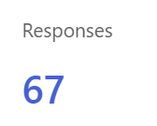
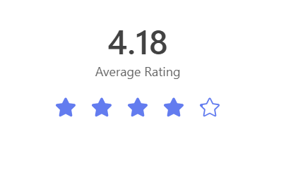
Outcome Measures: Process
Engagement – staff survey to collate staff feedback on process
66/67 respondents – have a robust understanding of the purpose of thematic review and PSIRF
*Next Steps:
To review the findings
Respond to the feedback
Tweak the questions
Implement routinely

Slide 29

Improvement focus groups incorporating SEIPS analysis
Incorporating “What you hear, what you see and what you perceive” triangulated with the hard data.
  Explore aspects of care following concern/themes on SIT presentation
  Exploration of ‘work as done’ identify relevant system factors that have contributed to deviations
  Work in collaboration with speciality teams such as TVT to review processes
  Work with staff to develop improvements and inform the Pressure ulcer SIP
  First session November 2024 - Focus on the pathway from Community to TVT referrals and miss classification of pressure ulcers

Slide 30

Reflections
Positive experience: good exec buy-in, staff embraced the change – SI exhaustion!
However, the shift in mindset from needing to complete full investigations was difficult for some and we work hard to avoid slipping back to the old ways of working
Proud: seeing good sustained improvements in the key standards we review
However, it did take us some time to get the process developed (working on this for 2+yrs) particularly the staff engagement elements
Collaboration: more recently the work undertaken in Community is being shared with inpatient PU thematic reviews, utilising the wider specialist support. Looking at the pathway rather than acute and community as separate reviews.

Slide 31

Reflections continued…..
Positive learning culture:
Ability to track improvements from previous reviews
Use of improvement metrics - visualises improvements
Provide assurance to staff and the Trust.
Share the good news story with the teams involved.
Positive staff engagement method:
MS forms provided an accessible, flexible approach developing wider awareness.
Focused shared learning vs lengthy RCAs to read and digest
Assurance of engagement and that learning has been embedded (last learning package 100% compliance and all scored above 95%)
Patient engagement:
Continue to ensure we comply with the statutory Duty of Candour regulations on individual cases, utilising local level investigation
We recognise there’s so much more to do!
Pilot studies underway to look at how we engage with patients to incorporate their experience and feedback into our improvement work
Utilising our Patient safety Partners to develop supportive materials to share our review approaches and findings

Slide 32
What made this work in Community?
Dedicated Community governance team with a passion for robust investigation and learning to support driving the thematic review process within Community.
Skill sets in relation to teaching, governance and investigation ( previous and current roles).
knowledge on the use of a variety of platforms such as MS forms, survey Monkey etc.
Driven and invested in the process working.
Passion to get beyond the obvious.
Positive approach with the learning package to build improvements and create a positive learning culture.
District Nursing teams' passion, dedication and commitment to delivering quality care driving engagement in the process.

Slide 33
Thank You
Questions?

Slide 34
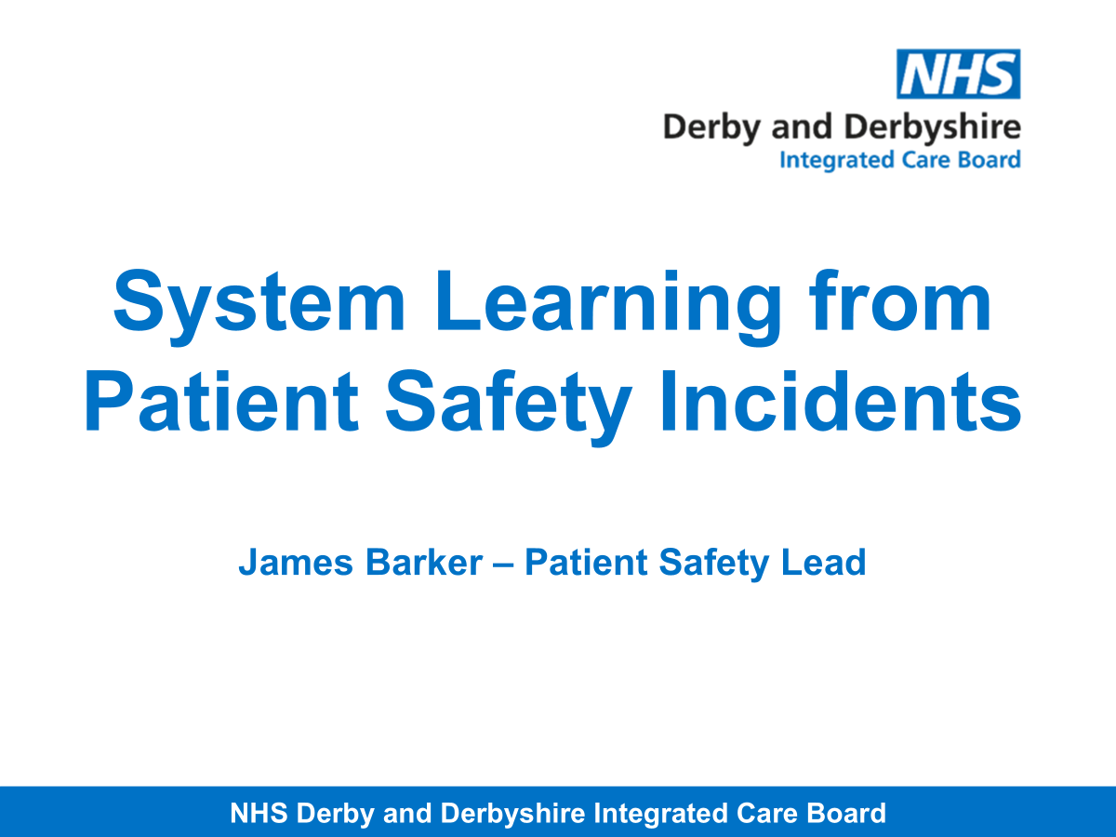
Insert Derby and Derbyshire ICB slides here

Slide 35
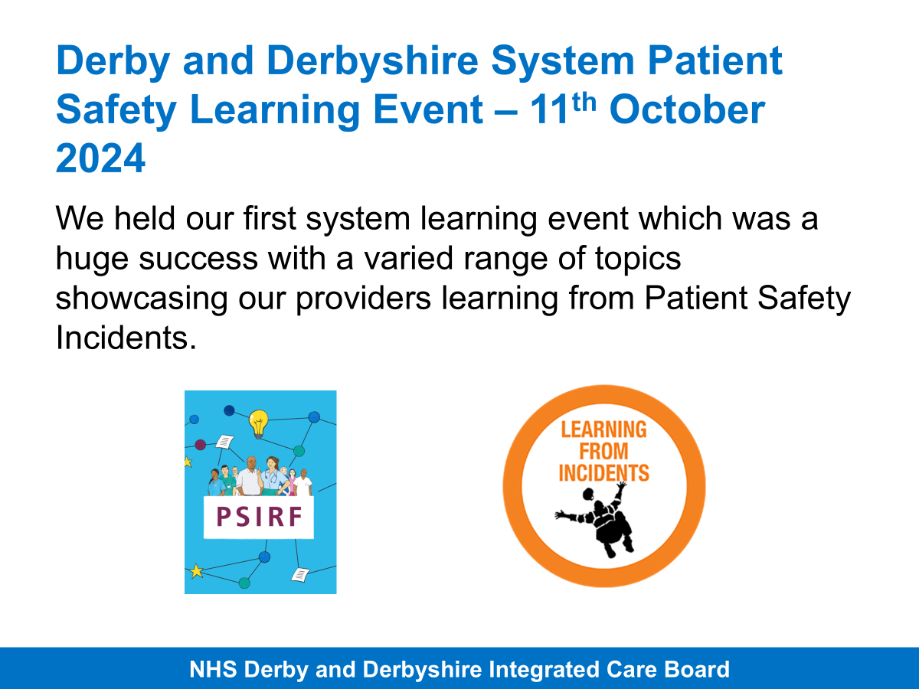
Insert Derby and Derbyshire ICB slides here

Slide 36
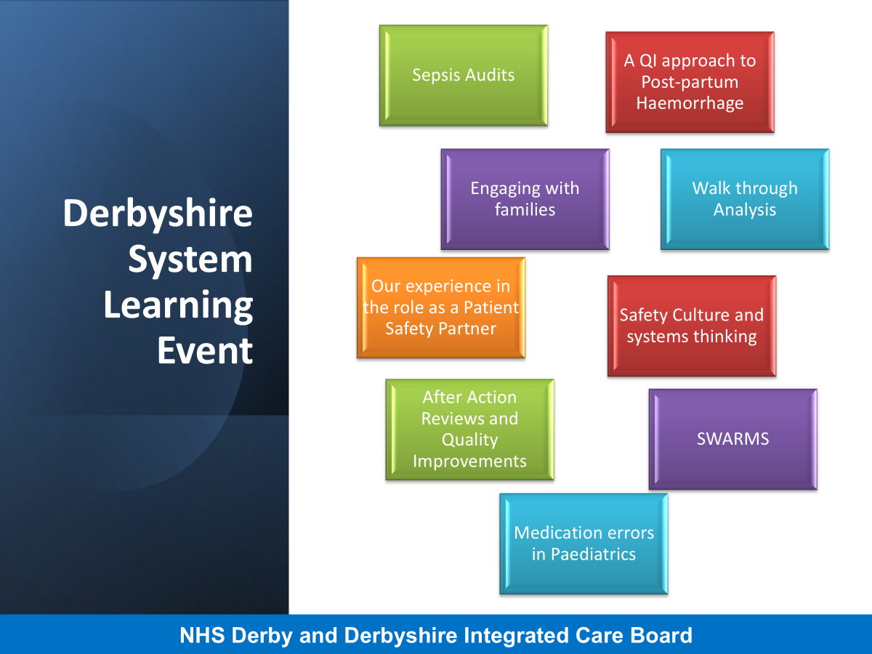

Slide 37
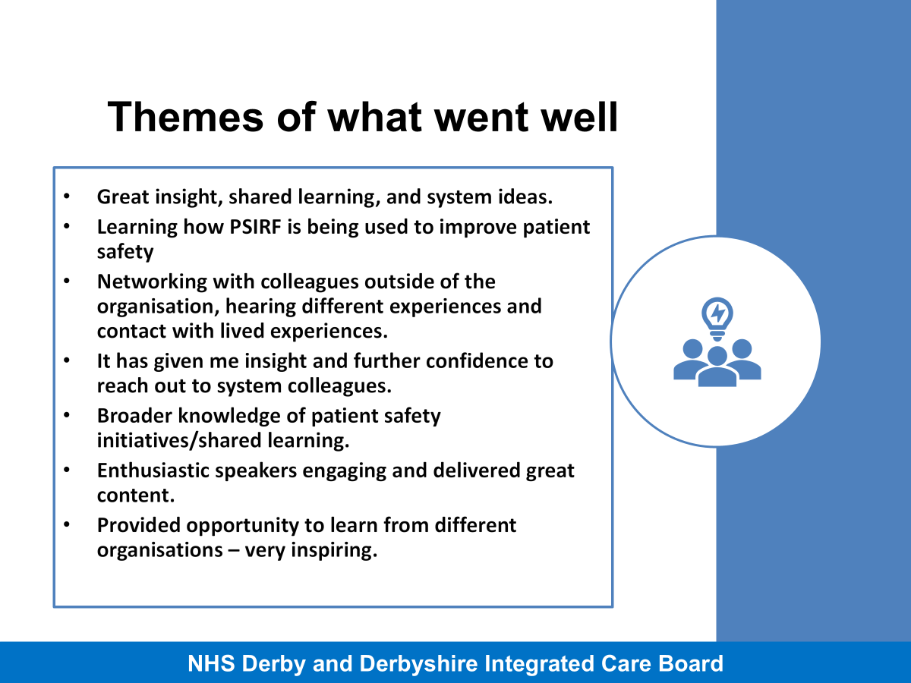

Slide 38
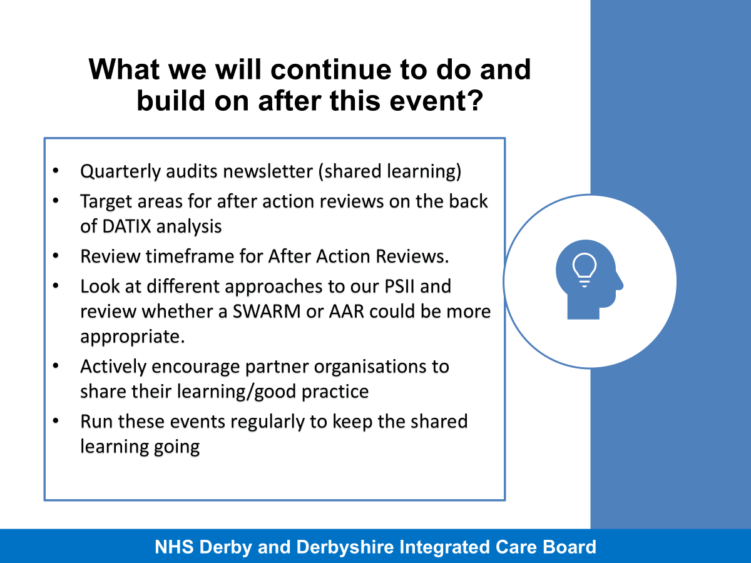

Slide 39
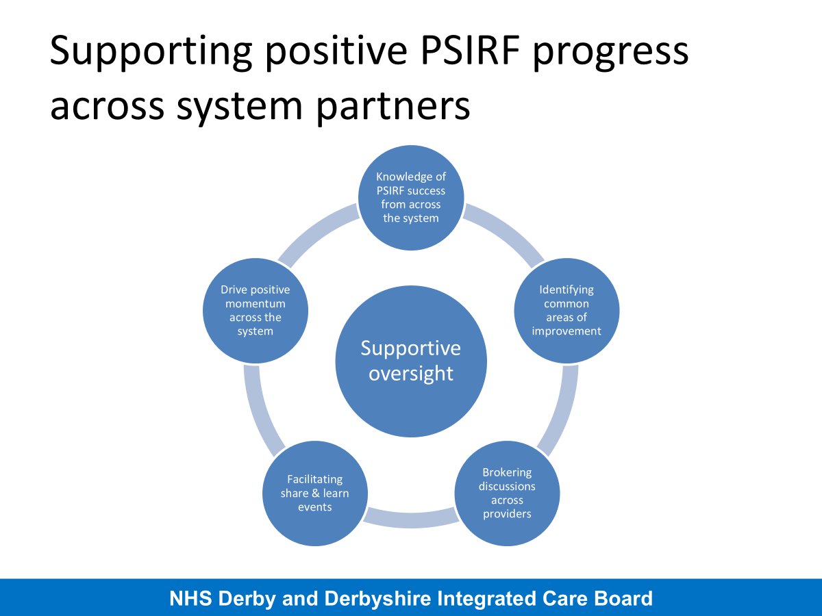

Slide 40
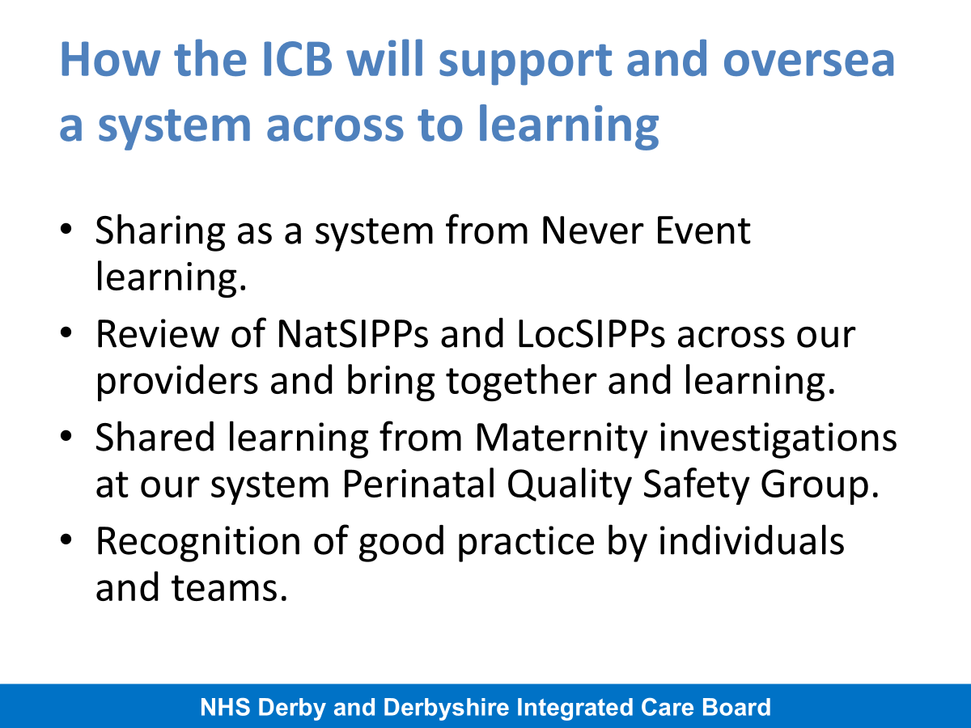

Slide 41
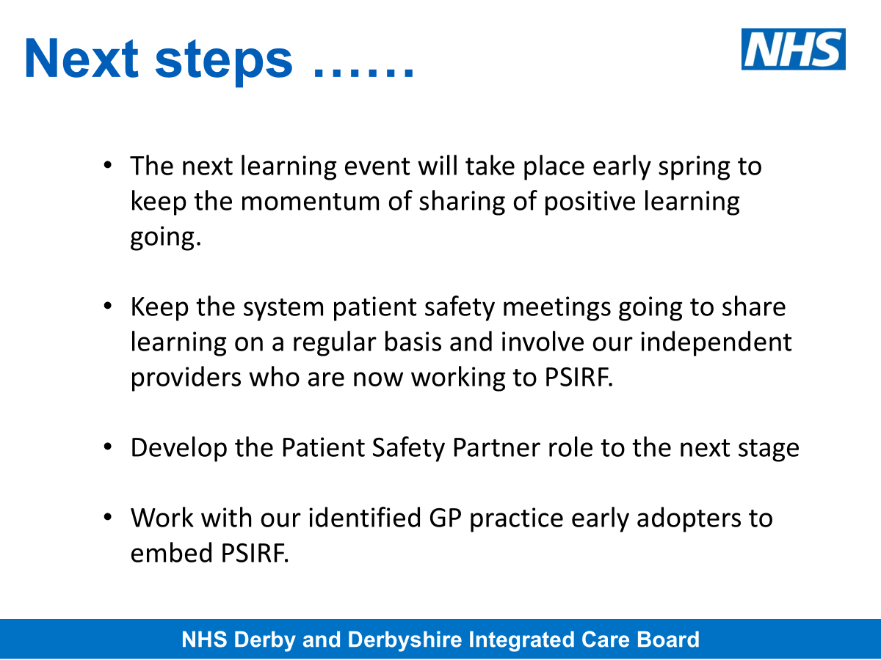

Slide 42


Slide 43
Please download and install the Slido app on all computers you use
What 3 things will you take away from today's learning event?
ⓘ Start presenting to display the poll results on this slide.

Slide 44
Closing Remarks
Sophie Mason – System Safety Programme Lead – East Midlands Health Innovation
@PtSafetyWM @Healthinn_em

Slide 45
Summary of the session
Support oversight
Relational governance
Learning & Sharing
Improvement planning
Working as a System
Thank you
Reflections
Access to today's resources
Any final questions

Slide 46

Feedback form
Thank you!
Please do complete our feedback form to help us shape future learning sessions (it only takes 3 minutes to complete).
The next 'Midlands Shared Learning' event will be:
10th February 2025 3-4:30pm: PSIRF Plan for Sustainability
This session is for ICBs and providers who want to learn (or share) examples
of PSIRF sustainability plans which could include:
The journey to sustained PSIRF practice into business as usual
Building the sustainability narrative
Differing governance structures supporting sustainability

Slide 47

Useful resources
NHS England - PSIRF
NHS Futures - PSIRF
Patient Safety Learning Hub - Patient Safety Management Network
Health Innovation East Midlands Website
Health Innovation West Midlands ​
PSIRF Shared Learning Webinar Series​
Webinar 1 - Safety Differently​
Webinar 2 - Human Factors & SEIPS​
Webinar3 - Quality Improvement & Model for Improvement​
Webinar 4 - Community of Discovery ​
West Midlands Health Innovation
Victoria Harrop – Victoria.harrop@healthinnovationwm.org
Nasrin Khan - nasrin.khan@healthinnovationwm.org
East Midlands Health Innovation
Sophie Mason – sophie.mason@nottingham.ac.uk
Ella West - ella.west@nottingham.ac.uk

