Slide 1





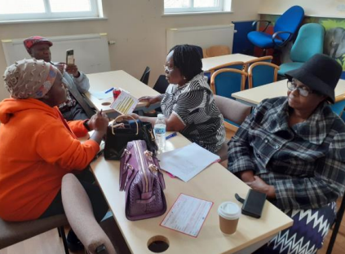
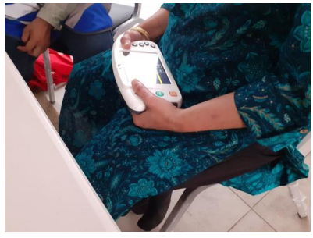
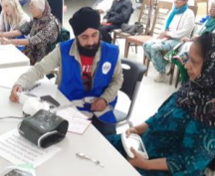
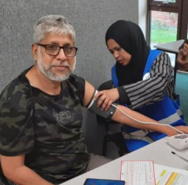
Using innovation to offer opportunistic Atrial Fibrillation and Hypertension testing for Black African, Black Caribbean and South Asian communities in Northamptonshire
Project overview - As part of the Innovation for Healthcare Inequalities Programme, this collaborative project is aimed at reducing health inequalities by identifying un-diagnosed Atrial Fibrillation (AF) and Hypertension (HTN) within black African, black Caribbean and South Asian communities, in Wellingborough and Northampton, where high levels of deprivation exist. The project supports a pathway to diagnosis and treatment, alongside some heart health education. The prevalence of AF and HTN are rising due to an ageing population. Under-diagnosis and lack of treatment may lead to serious complications, such as stroke, heart failure and heart attack (NHSE 2019), especially for people from within these identified communities. The project has been co-developed with the ICB Population Health team and Northamptonshire Black Communities Together, Health innovation East Midlands, public health and Social prescribing services, in collaboration with eight community partner organisations. Each organisation is hosting events where Community Champions facilitate the testing and the educational offer. The testing innovation is a handheld device, called Docobo, which captures AF readings which are fed back to a clinical team at the local trust for follow up, interpretation and possible onward referral to the GP. The InHIP project is delivered by the community from within the community.
Challenges
​Identifying community groups wishing to take part in the project, in an attempt to encourage people who might not usually engage with traditional health services to attend, get tested and learn about heart health.
We had to find an alternative device for the testing of Atrial Fibrillation after the proposed remote testing device and other similar products were withdrawn from use, just as we had completed the InHIP bid. We eventually found Docobo, a handheld virtual monitoring device, with a one lead ECG facility, which would enable us to record results and build in a questionnaire.
Ensuring the delivery and advice being given at testing by the Community Champions, across all eight communities, was consistent and that the pathways and blood pressure thresholds were adhered to support advice to participants.
Measuring success
We are using an outcomes questionnaire on Docobo and an attitudes survey, via a QR code, both of which capture lifestyle, vaccination, use of GP services and general health feedback.
Focus groups are also enabling participants from different communities to share their experiences of using health care, screening, GP and other support services.
To date 245 people have been tested, with the identification of potentially 17 with AF, 11 with other cardiac issues and 56 with Hypertension (end of October 2023)
Heart health education, advice and literature are initiating ongoing discussions within families and each community.
“Ensure the community are engaged throughout the process, from the design stage, implementation,
right through to the
delivery and evaluation.
Communication is key!!”
Tim Lloyd ICB InHIP project manager
Solutions
Northamptonshire Black Communities Together have established relationships with over 27 local community groups across Northamptonshire and have experience and knowledge of how best to engage with and nurture their involvement as champions and participants.
During our project startup phase the Docobo device was already being used in a trial at Northamptonshire Healthcare NHS Foundation Trust (NHFT), which was exploring virtual monitoring of patients within hospital discharge hubs, care homes and their own homes. This afforded us the opportunity to align our testing requirements with the existing NHFT clinical team and achieve the technical installation of our specific data needs.
Consistency was supported by clear scripts, written protocols, pathways, visual resources and videos to support beyond the training into test events.
Contact details:
ICB project lead email:-
tim.lloyd1@nhs.net

