Slide 1
Health Innovation East Midlands: System Based Investigations to Inform Improvement
Sophie Mason, Senior Innovation Lead
13th December 2024

Slide 2

Our support and expertise
One of 15 health innovation networks across England​, we are the East Midlands NHS innovation arm.
With 10 years expertise at adoption of transformative technologies and pathways, via our pipeline we help identify and import solutions to their challenges
We are funded by the NHS – our core support and services are free to local NHS partners

Slide 3
The Agenda
No/Ref | Times | Item
1 | 13.30 – 13.35 (5) | Welcome and Introductions
2 | 13.35 – 13.55 (20) | After Action Review for Pyridostigmine Incident, Deborah Dodge and Julie Croysdale, Leicester, Leicestershire and Rutland ICB
3 | 13.55 - 14.05 (10) | Your role within systems based learning – Interactive session
4 | 14.05 – 14.35 (30) | Patient Safety Incident Response Framework using Systems Engineering Initiative Patient Safety (SEIPS), Zoe Roosmale-Cocq and Gavin Simpson, Leicestershire Partnership Trust
6 | 14.35 – 14.40 (5) | Calls for help
7 | 14.40 – 14.45 (5) | Closing remarks and feedback

Slide 4
Housekeeping
Today’s session is built around appreciative inquiry: Please keep this in mind when asking your questions, as a reminder
Appreciative Inquiry is based on the concept that value increases when you put a focus upon it, it is a core concept in systems thinking as it brings into play the person (us) as part of the system by which we want to change/ influence/ improve.​
Identify the positive aspects of the story, try to draw that our further​
Be curious, ask questions to generate discussion​
Ask questions about what the speaker values, what they would change, what helped them to achieve this milestone.​
Listen and reflect

Slide 5

On a scale of elf, how are we feeling today?

Slide 6
What area of the East Midlands do you work in?

Slide 7
How confident do we feel that system based investigations are informing improvement?

Slide 8
After Action Review for Pyridostigmine Incident
Deborah Dodge and Julie Croysdale, Leicester, Leicestershire and Rutland ICB

Slide 9
After Action Review for Pyridostigmine Incident
December 2024

Slide 10
Incident details
A patient with myasthenia gravis living in a care home was without their pyridostigmine for 10 days – the resultant myasthenic crisis coupled with infection potentially led to her death.
Death was not referred to the coroner
Patient’s family raised concerns with Social Worker – didn’t come to light for several months – Section 42 Safeguarding enquiry raised
ICB SG alerted via SW and ICB PS team made aware
Medication identified as having been prescribed but not received from the community pharmacy so case referred to EMPCT to review/investigate
Notes:
The case was alerted very late into the system – we received it via the safeguarding team as the SW had contacted our SG team. The case was described by the SW as resulting from the pharmacy not providing the medication so we initially passed the case to EM PCT to discuss and review with the pharmacy. On speaking to the SW ourselves and getting some more details on the case we discussed the investigative approach with EMPCT to take into account all system partners.

Slide 11
Incident details continued
Details received from SW/Care home, GP and Community Pharmacy did not tally
Request from EMPCT to ICB to close the incident – disagreed due to lack of consistency and poor evidence of system learning
Took several months to get accounts from each agency of their input to the case
Determined a system learning response was indicated = After Action Review chosen
Notes:
The EM PCT were initially only viewing this through the community pharmacy lens and, having had a response from the community pharmacy, they were keen to close the incident – the team aren’t familiar with PSIRF and they don’t have a dedicated PSS supporting them.
This meant they were not looking at this case from a system perspective and we felt there was learning available that was not being captured.
There were lots of delays and inconsistencies in getting information and ultimately it was felt that we would benefit from using an AAR learning response to understand where actions could be taken to reduce future risk.

Slide 12
After Action Review – Cross-system LLR
Considered all stakeholders
FIRSTLY – gained support for a review of the case – all agreed necessary
Considered appropriate response – individual reviews of care hadn’t resulted in full understanding of the incident
Used iTS Leadership template and adjusted it to take into account learning from the ‘Mind the potholes’ article from Patient Safety learning charity.
Recognised most will have little experience of AARs
Notes:
iTS - Unable to access this now unless you join the organisation
Mind the potholes! Implementing After Action Reviews: A blog by the National AAR Reporting Template Team - Patient Safety Incident Response Framework (PSIRF) - Patient Safety Learning - the hub
After Action Reviews should be focussed on capturing learning to avoid failure and promote success for the future.
Our experience previously has been that bringing system partners together allows everyone to gain insight into the reasons behind the actions taken by all parties. Very often this is poorly understood, or assumptions are made and just by getting everyone together in a virtual room we achieve far greater understanding than by looking at statements or policies or by having individual conversations.
We have previously successfully used the ITS template although I’m not sure that one is easy to access these days. We have amended some of the wording to reflect the Patient Safety learning charity’s guidance paper. I am a big fan of their work and often use their resources.
We provided information before the meeting to everyone who was invited to describe how an AAR works and the questions we focus on – this recognises that most people won’t have been involved in such an activity before.

Slide 13
Why an After-Action Review?
Opportunity for reflection and learning
Allows deconstruction in a safe environment where all voices can be heard
Brings all stakeholders together to appreciate their differing understanding of the incident
Understanding will lead to appreciation of scope and limitations of practice to inform future interactions.
Gives space to consider alternative courses of action
We cannot solve our problems with the same thinking we used when we created them. (Einstein)
Notes:
I think I’ve already spoken about this but I think that ‘deconstruction’ piece was really important in this case – rather than reading very factual accounts we heard the thinking and reasoning behind the actions taken – the understanding of ‘work as done’.
It allowed all participants to understand the context in which other members of the system were working and the constraints that governed their actions.
We heard about changes already put into place involving tools and technology as well as organisational changes.
The conversation allowed members to consider alternative options and hypothetically apply with others who may be affected to prompt further conversation outside of the AAR.

Slide 14
Reflection
What went well?
What needs work?
All stakeholders agreed to join and turned up
We sent info out before the event to explain what an AAR was
Everyone contributed respectfully
Contacts were made for future work
Some actions were agreed
Greater understanding of each other’s ways of working
Stakeholders sometimes wandered into ‘blaming’ individuals
Hard to keep ‘on track’ with the 4 questions
Actions not necessarily clear to all parties
Took a long time to get organised so some learning had been superseded
Despite sending prep info some participants wanted to address the Section 42 query

Slide 15

Any Questions?

Slide 16
Your role within systems based learning – Interactive session

Slide 17



How to use the whiteboard
On the bottom right-hand side of the screen:
Zoom in and out
The button on the right 'fits to screen' which allows you to see everything on the whiteboard
At the bottom of the screen:
The Arrow: Allows you to click on items and move them around
The hand: Allows you to move the screen around
At the bottom of the screen:
Post It note: Add your thoughts to each box
Heart: Allows you to add emojis
Speech bubble: Add a comment on the page

Slide 18
Patient Safety Incident Response Framework using Systems Engineering Initiative Patient Safety (SEIPS)
Zoe Roosmale-Cocq and Gavin Simpson

Slide 19
Patient Safety Incident Response Framework using Systems Engineering Initiative Patient Safety (SEIPS)
SEIPS - A model that depicts the interactions between the work system processes that is used as a general problem solving tool to guide staff as to how we can learn and improve following a patient safety incident (NHS England 2024)
Zoe Roosmale-Cocq - LPT Patient Safety Incident Investigator
Gavin Simpson - LPT Patient Safety Incident Investigator

Slide 20
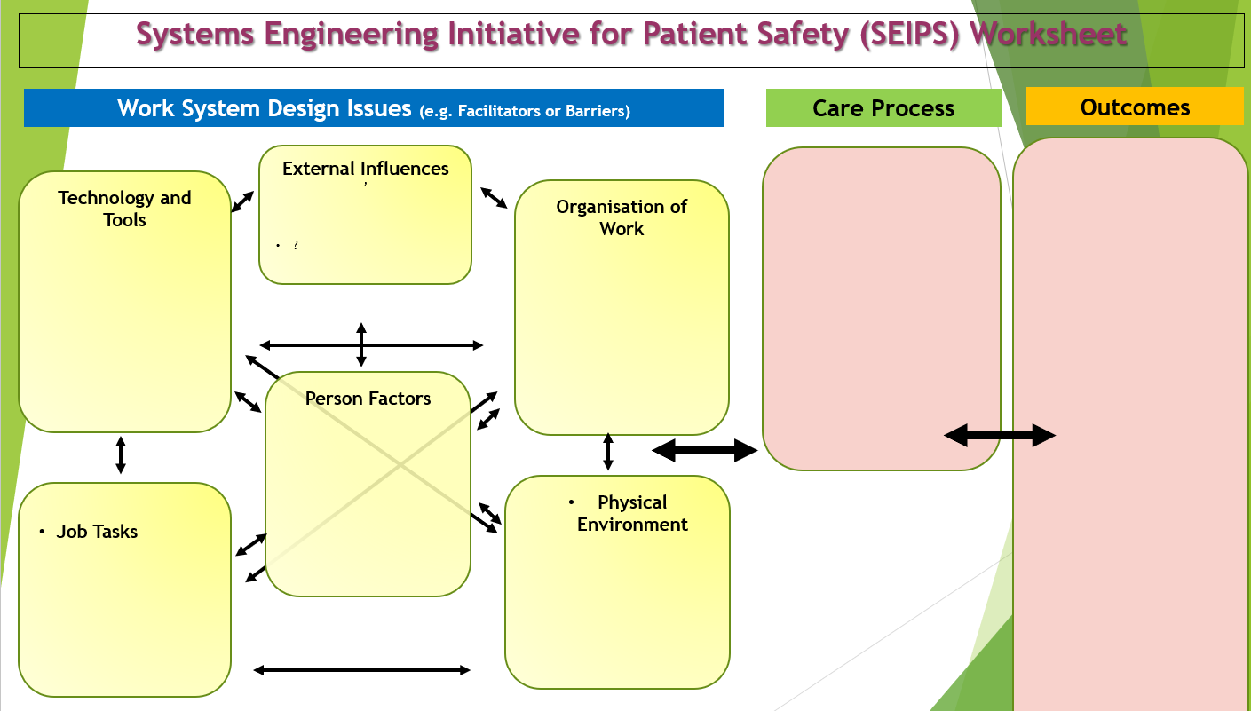
SEIPS is a model used to support the review of care following an incident
The model aims to review the provision of care from on system-based approach and staff are invited to a roundtable to discuss the incident and ensure that all staff have opportunity to provide their input.

Slide 21
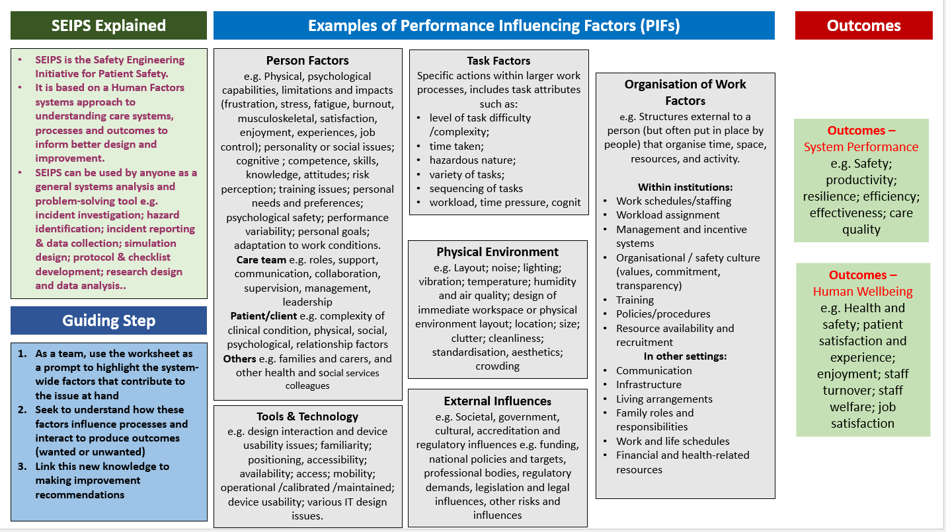

Slide 22
What makes a successful SEIPS review - Preparation is KEY:
Thorough review of Electronic Patient Records
Contact with the manager / leader – consider early staff views / conversations / issues to ensure staff “buy in”
Identifying which staff need to be present at the roundtable
Consideration of factors which may affect positive staff engagement and outcomes
Organise appropriate venue and time allocation
Consider support the staff may need during the roundtable and after the review as part of supportive supervision
Roundtable management – expectations of professional standards

Slide 23
Challenges experienced by Investigators:
General staff anxiety of staff about an incident review
Organising roundtable meeting – coordination of diaries (up to 12 members of staff)
Staff involvement in previous Serious Incident framework and approach – witness statements and interviews
Staff perception of ineffective learning and actions from previous Serious Incident reviews
Individual staff views and opinions and individual behaviours at the multi-disciplinary roundtable

Slide 24
SEIPS and Roundtable feedback:
“It felt supportive and safe”
“It was good for all of the team to discuss and share what we knew”
“When incidents have happened before I knew about them but I was never included”
“Being in the team and discussing everything together made me realise I was not alone in some of the things I was thinking”

Slide 25
Call for help
A 5 min section thrown open to those attending to ask a question on anything PSIRF related to their peers…
A request from Health Innovation East Midlands: We are seeking speakers for our next set of events in the new year: Falls (15th January 13:30 – 14:30) and the Midlands planning for sustainability (10th February 15:00 – 16:30)

Slide 26
After hearing todays speakers, how confident do you feel that system based investigations are informing improvement?

Slide 27
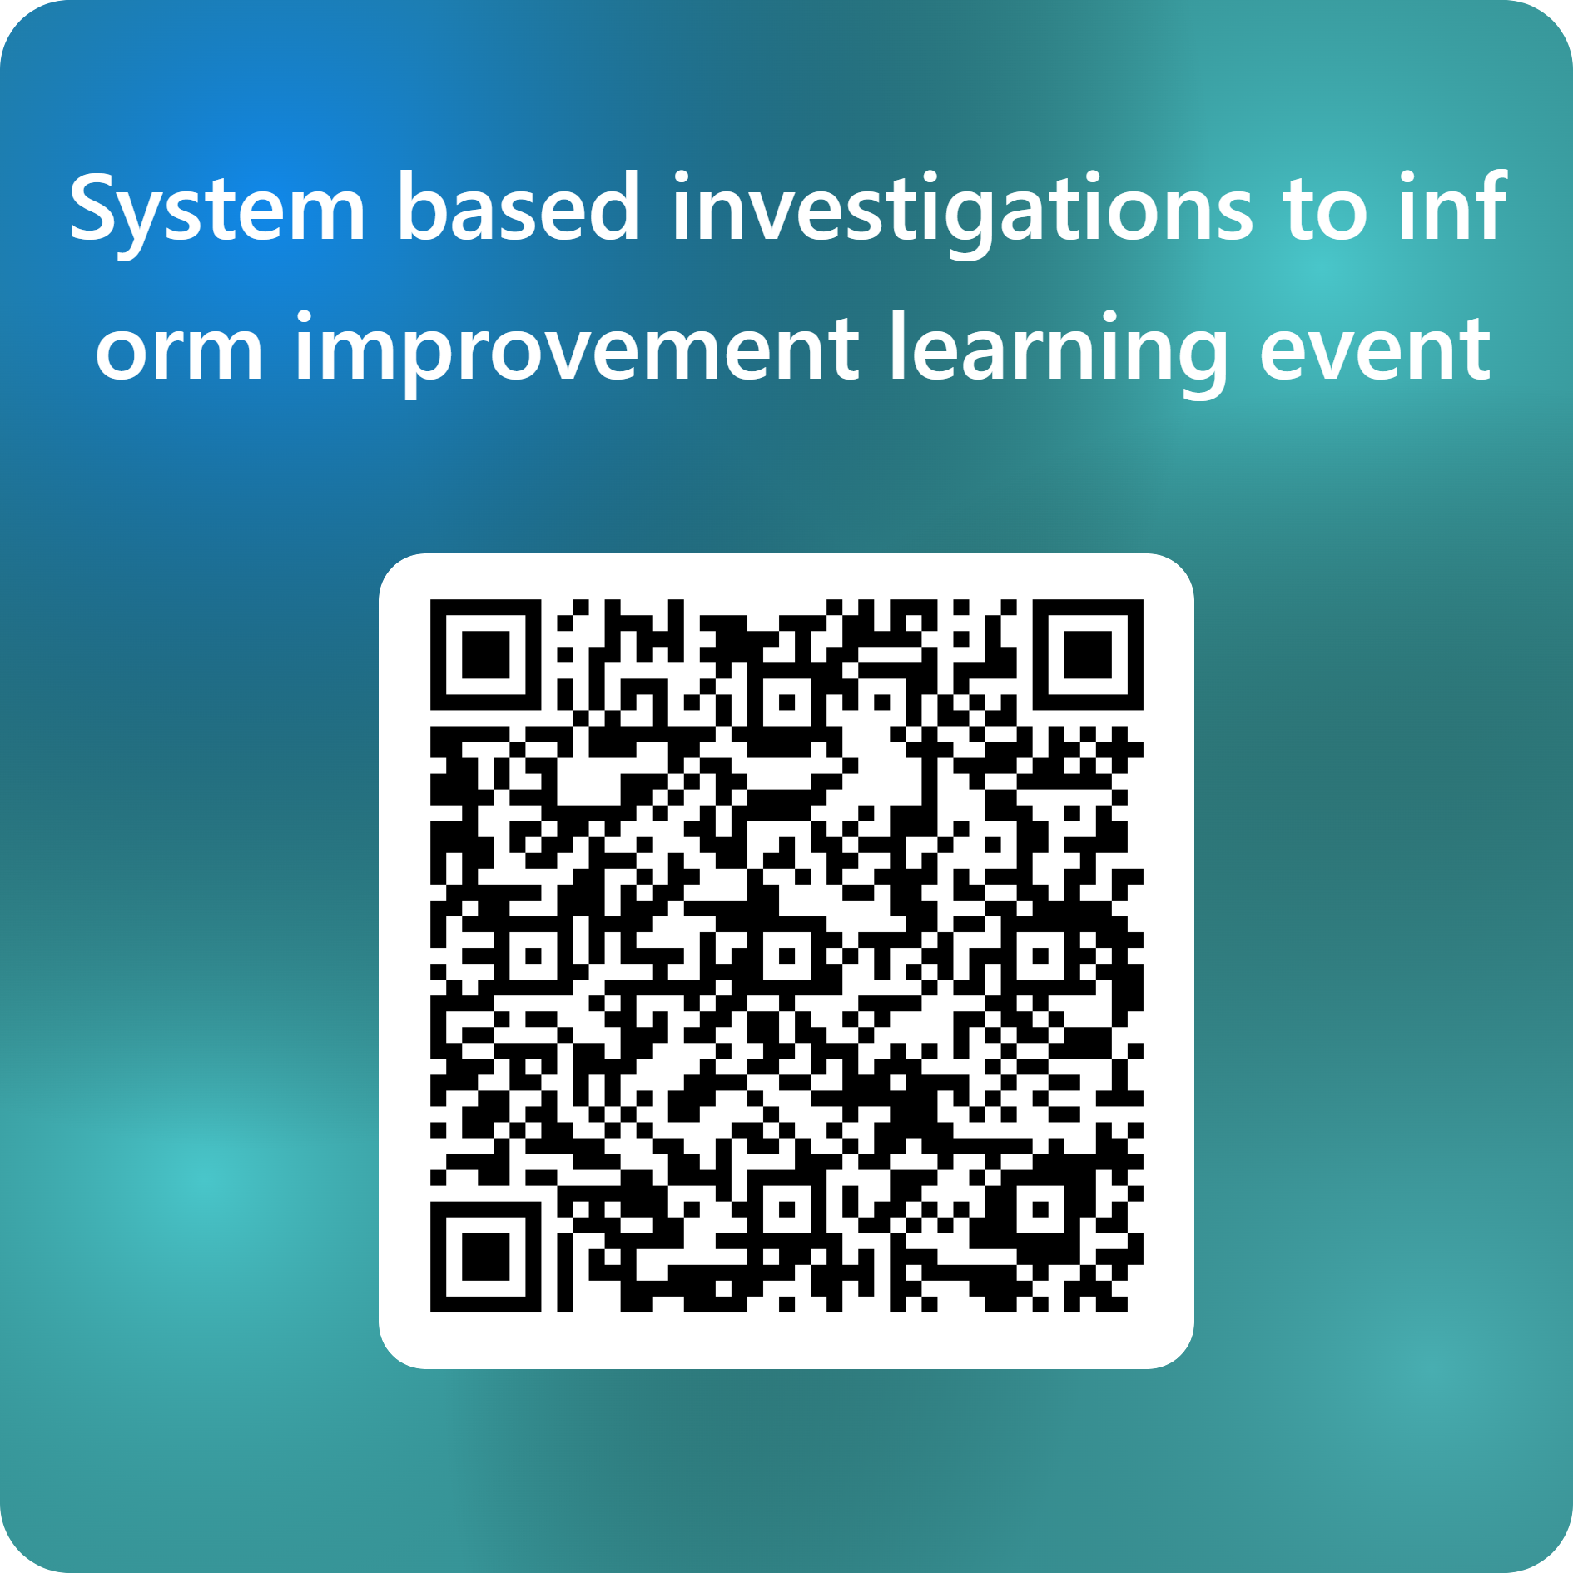
Thank you & Next session
Thank you! Please do complete our feedback form to help us shape future learning sessions.
The next set of sessions will focus on the key priority areas as included in your PSIRPs:
Falls - Wednesday 15th Jan 1:30-2:30pm
Planning for Sustainability (Midlands) – Monday 10th Feb 3-4:30pn
Medication – Wednesday 26th Feb 2:30-3:30pm
Pressure Ulcers Wednesday 5th March 11:30-12:30pm
Deteriorating patients Friday 14th March 10-11am
End of Year webinar: Safety Management Systems 1:30-3pm

