Slide 1

Welcome
Please introduce yourself in the chat!

Slide 2
Health Innovation East Midlands: PSIRF Safety Management Systems: learning from other industries
Sophie Mason, Senior Innovation Lead
26th March 2025

Slide 3

Our support and expertise
One of 15 health innovation networks across England​, we are the East Midlands NHS innovation arm.
With 10 years expertise at adoption of transformative technologies and pathways, via our pipeline we help identify and import solutions to their challenges
We are funded by the NHS – our core support and services are free to local NHS partners
The East Midlands Patient Safety Collaborative (EMPSC) support a range of patient safety initiatives including those associated to Medicine Safety, ManDet and MatNeo.

Slide 4
The Agenda
No/Ref | Times | Item
1 | 1:30-1:45pm (15 minutes) | Welcome and Introductions - Sophie Mason, Senior Innovation & Improvement Lead at Health Innovation East Midlands
2 | 1:45 – 2:50pm (65 minutes) | Presentation & Discussion: Safety Management Systems for Healthcare Brook Howells, patient safety researcher, undertaking a PhD with the Yorkshire and Humber Patient Safety Research Collaborative
5 | 2:50-3pm (10 minutes) | Closing remarks and request for feedback - Sophie Mason, Senior Innovation & Improvement Lead at Health Innovation East Midlands
Today's session will be recorded and will be sent out to all who attended todays session

Slide 5
What region of England do you work in?

Slide 6
How confident are you in your understanding of safety management systems?

Slide 7

PSIRF – Connection & Collaboration for Shared Learning & Practice
Providing an opportunity to learn from others
Nurturing new ideas for improvement & Innovation
Making connections across systems
Notes:
Todays event is the last in a series for my East Midlands PSIRF colleagues, however we decided that this speaker was too good not to share and we have opened up invitations to all those interested in understanding Safety Management Systems and their potential application in healthcare
In the last year colleagues have shared their learning of PSIRF in practice: we have a better understanding of how to implement and invest in Patient Safety Partners, Measuring impacts of Improvement, to working towards PSIRF sustainability and finally the importance of supportive oversight. This would not have been possible without those people from providers and ICBs eager to share both failures and successes and I want to take the opportunity to thank everyone involved.
We wanted to continue the theme of shared learning and end on something a little aspirational so today we will be hearing from the fabulous Brook Howells and maybe it will plant a few seeds of inspiration for our ongoing PSIRF practice!

Slide 8
Safety Management Systems for Healthcare
Brook Howells
26th March 2025

Slide 9




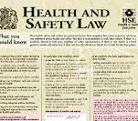


Session Overview
A brief history of safety management systems
Details of different safety management systems
Considerations for healthcare

Slide 10





Please be curious and join in the discussion using the chat / hands up
Notes:
NHS roles including quality improvement, personalised care and tackling safety challenges
Many different healthcare settings
Explain what NIHR is / the PSRC

Slide 11

The background: many high-risk industries require safety management systems (by law or regulation)
Aviation
Rail
Shipping
Nuclear
Chemical processing and storage
Oil and gas
Even food manufacturing!
Notes:
These SMSs are not foolproof, but the industries that do have them are considered very safe

Slide 12
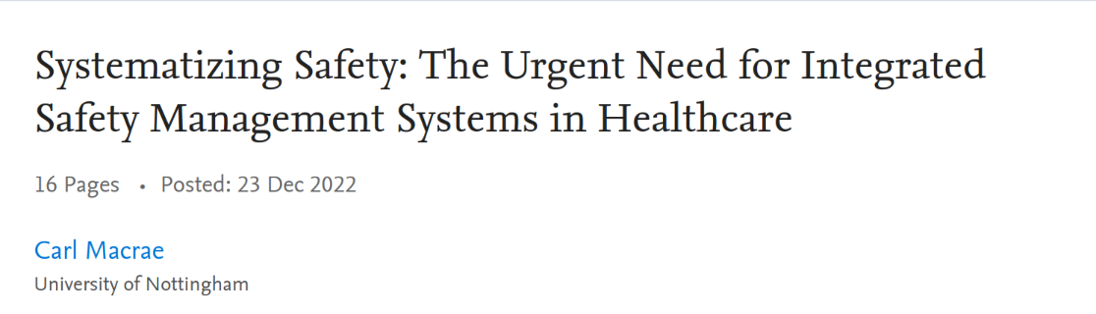
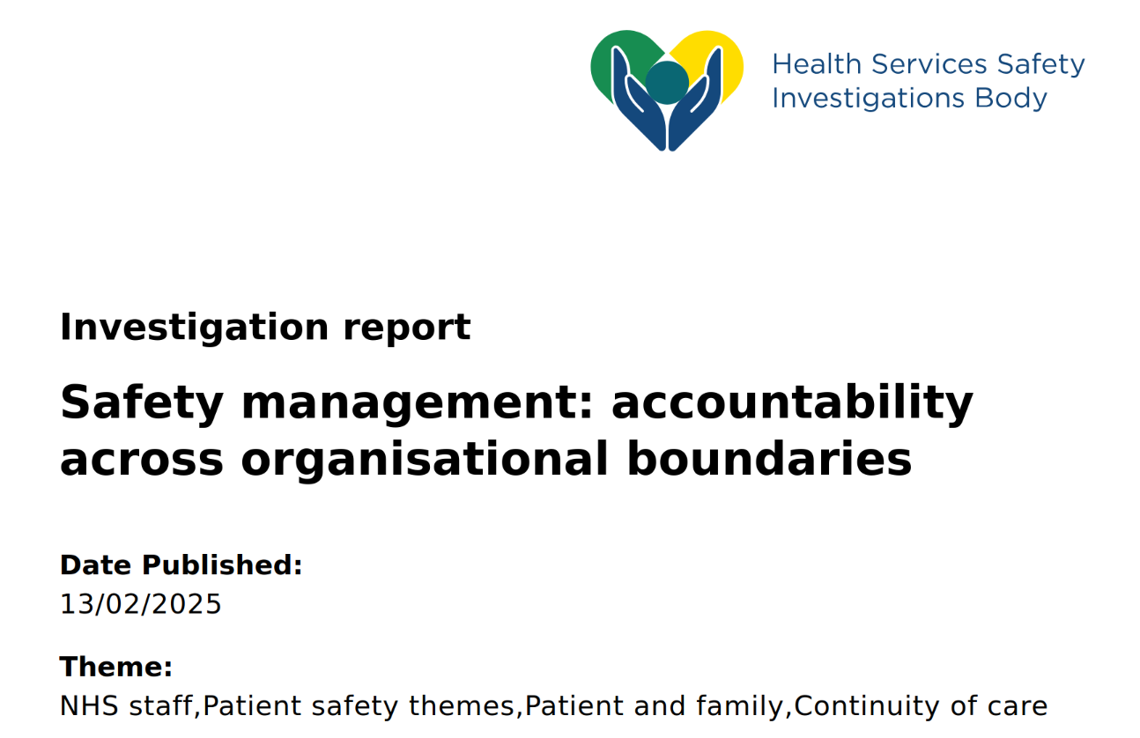
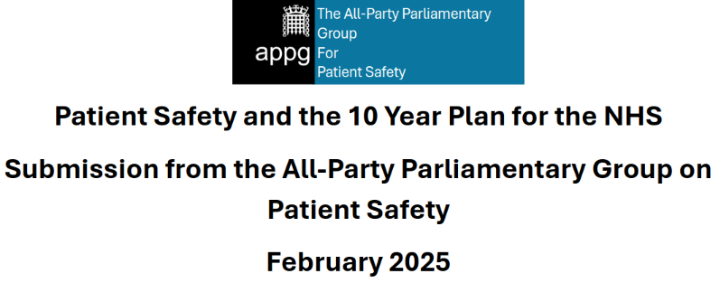
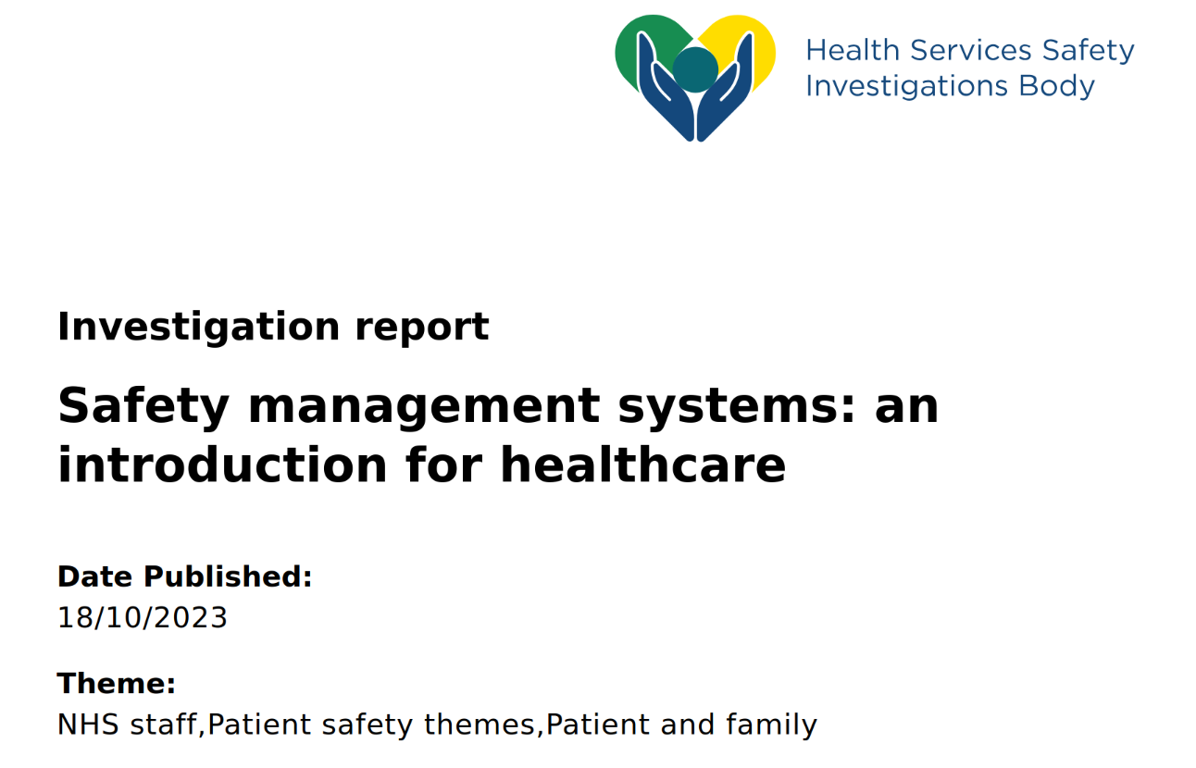
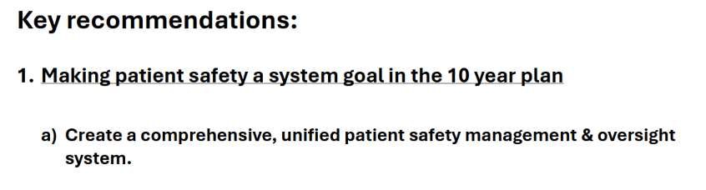
Notes:
Growing interest and calls for SMS in healthcare – ongoing research to understand their implications for healthcare

Slide 13
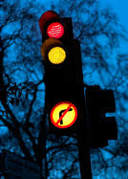
What is a Safety Management System?
Type your answer in the chat... don't press enter until I say go!
What do you think a Safety Management System is?

Slide 14
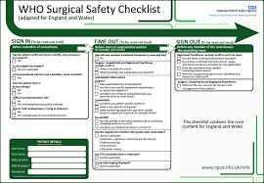

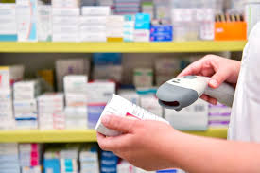
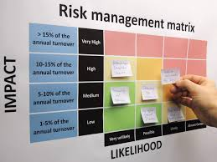
What an SMS is not...
(...at least, not for our purposes)

Slide 15
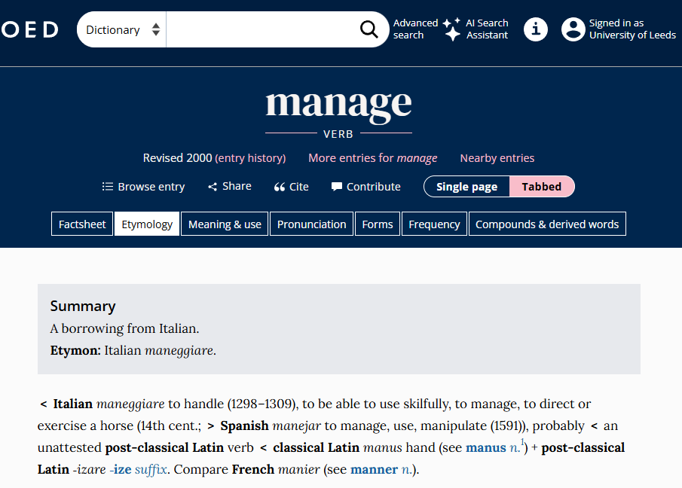
A safety management system is...
A system… (for) managing… safety
Formal
Proactive
Integrated
Systematic
Organisational
Absence of harm, prevention of accidents
An objective that is distinct from quality* or finance (for example)
*though in healthcare safety is sometimes regarded as a subset of quality...
Notes:
"A formal, organised and systematic approach to managing safety across an organisation” (Li and Guldenmund 2018)
An SMS is a proactive and integrated approach to managing safety. It sets out the necessary organisational structures and accountabilities and will continuously be improved. It requires safety management to be integrated into an organisation’s day-to-day activities (HSSIB 2023)
A systematic approach to managing safety, including the necessary organisational structures, accountability, responsibilities, policies and procedures (ICAO 2019)
A structured and documented system enabling company personnel to implement effectively the company safety and environmental protection policy (IMO 2013)
Formal and organised structures that aim to manage safety across an organisation in a systematic, proactive and explicit way (Hsu et al., 2010)

Slide 16
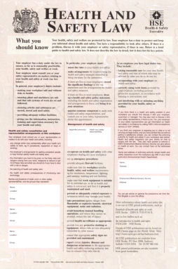
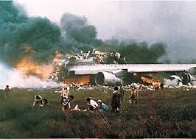
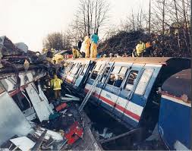
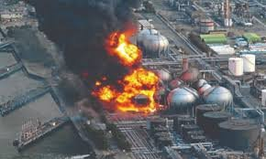
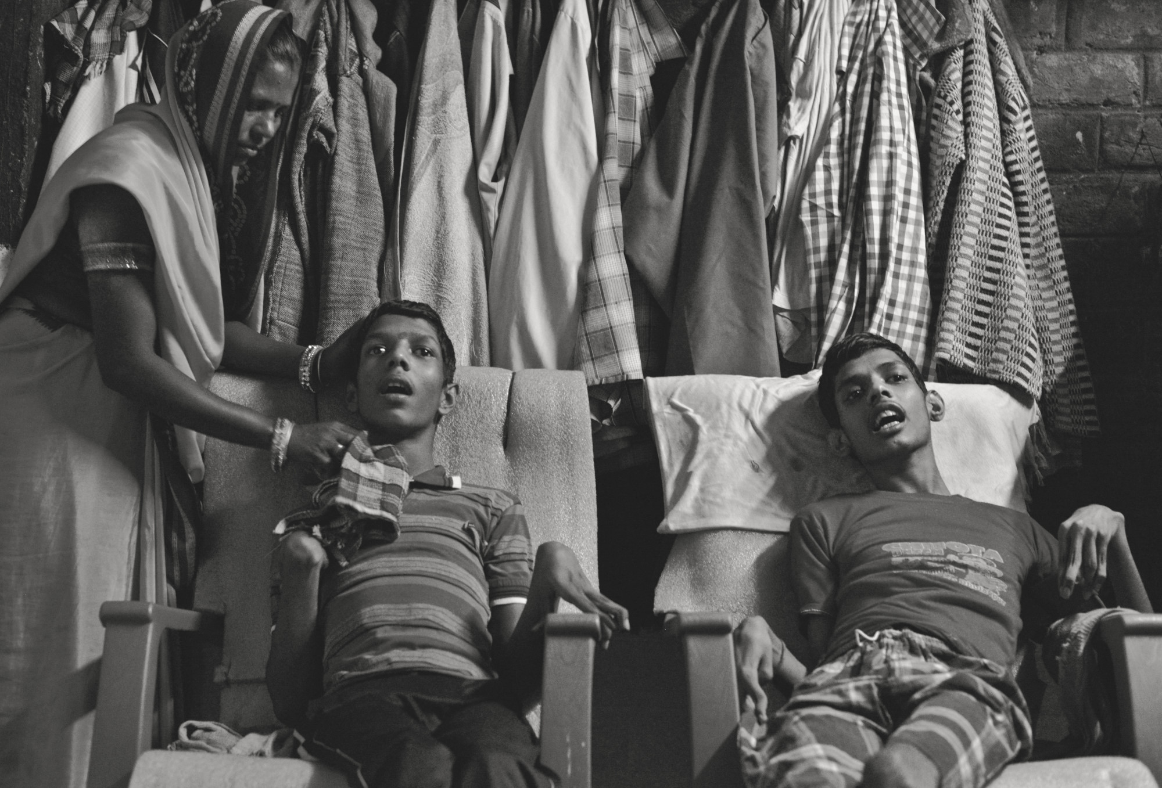
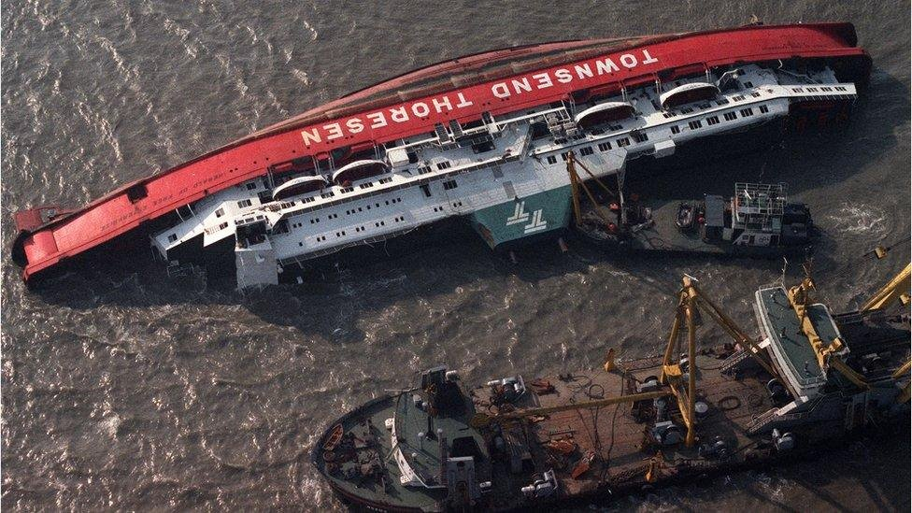
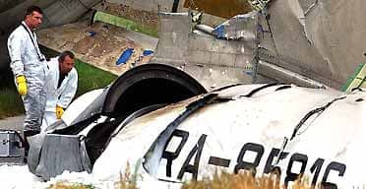
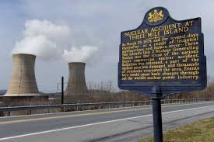
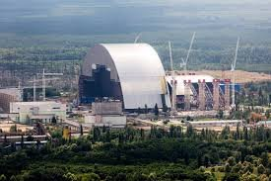

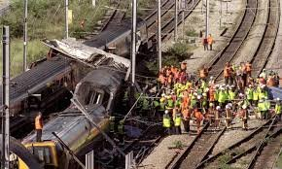
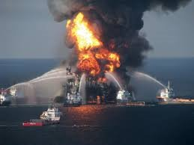
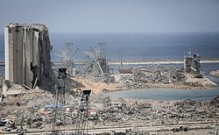
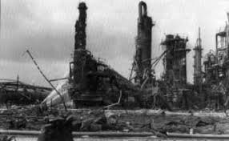
Why SMS: Significant events
1974
1987
1984
1986
1999
1988
2010
1979
2020
Seveso
Three mile island
Bhopal
Chernobyl
Zeebrugge
Piper Alpha
Ladbroke Grove
Beirut
Clapham Junction
Deepwater Horizon
2011
Fukushima
1988
2002
Uberlingen
1977
Tenerife
1976
Maritime, chemical processing, aviation, nuclear, oil and gas, rail
Notes:
Health and Safety at Work Act – following the Robens Report (roughly marked the start of public demand for safety)
Maritime
- Zeebrugge 1987 (193 lives lost)
Chemical processing
- Seveso – northern Italy 1976 – 80k animals culled, tens of thousands affected
- Bhopal 1984 – approx 2,259 deaths, 500k injured (and continuing disabilities)
- Beirut explosion 2020, at least 218 fatalities, 7,000 injuries, and approximately 300,000 displaced individuals
Nuclear
three mile island (US) 1979
chernobyl 1984
fukushima 2011
Rail
Clapham junction 1988 (high speed train collided with an empty train, pushing wagons on to an adjacent track where another train is passing. 600 injured, 35 lives lost
Ladbroke Grove, 1999 – 31 killed, 417 injured - criticisms of management, leadership, fragmented safety etc
,
Oil and gas
piper alpha 1988, 165 lives lost
deepwater horizon 2010 - 11 lives lost, huge environmental impact
Aviation – Tenerife airport collision 1977 – 583 fatalities
Uberlingen (midair collision between a passenger jet and a freight carrier in 2002, 71 fatalities

Slide 17
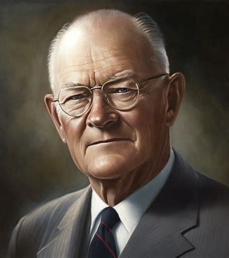
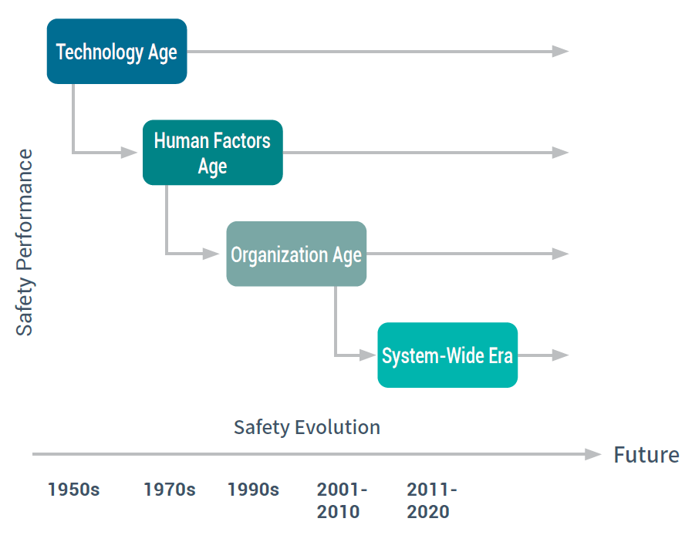
Why SMS: Advances in social and safety science
No industry has achieved perfect safety (and might never)
But understanding of how technological, human and organizational factors influence safety continues to develop
Insight from general management science (e.g Deming’s quality management philosophy) has also been influential
Resilience Engineering Era?
There is a growing recognition of the need or potential of adaptive capacity for safety​

Slide 18
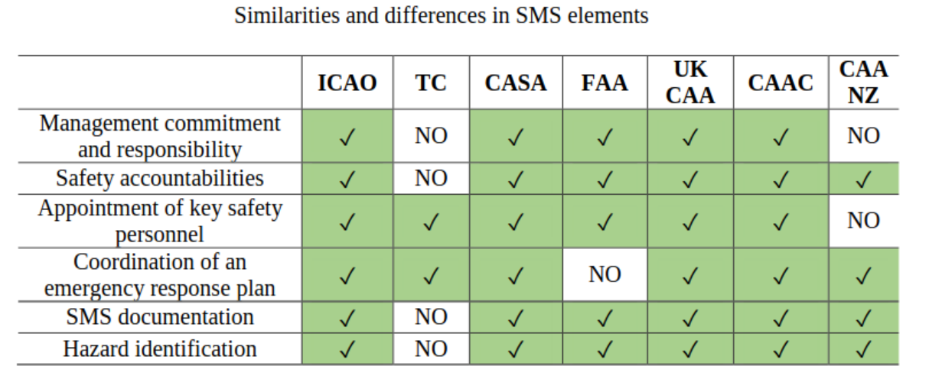

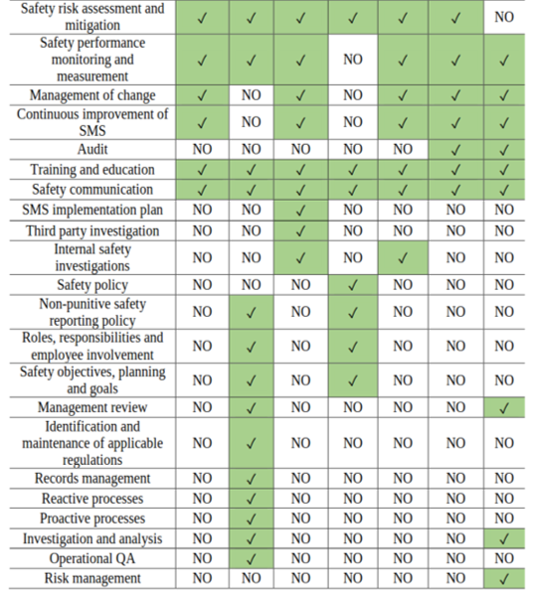
Variations of safety management systems
Not quite as unique as snowflakes, but there is no "one size fits all" design
(Blišťanová, et al 2021)
The aviation model has four pillars;
Safety Policy - a clear objective and written strategic plan
Safety Risk Management – identifying your hazards and planning mitigations
Safety Assurance – monitoring and continuously improving
Safety Promotion – communicating about safety measures and training staff
(ICAO 2019)

Slide 19
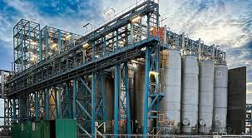
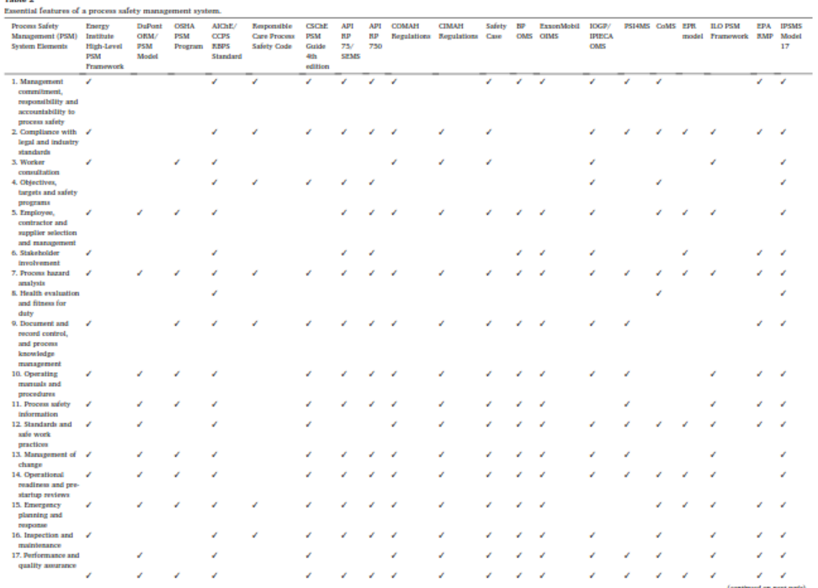
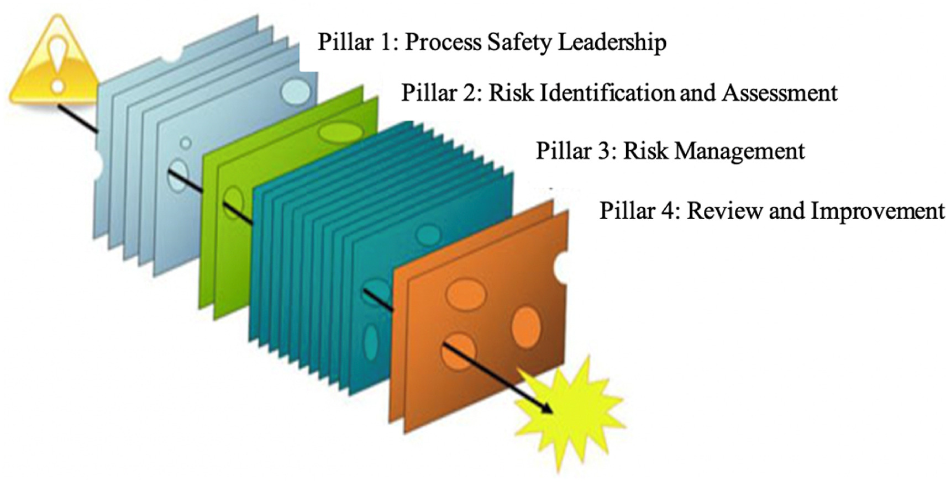
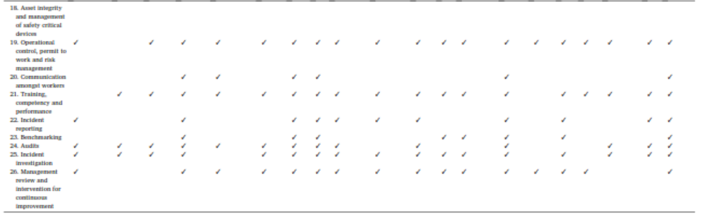
SMS in process safety
Different SMSs across the industry
Components of SMSs
(Energy Institute 2016)
(Nwankwo et al 2020)

Slide 20

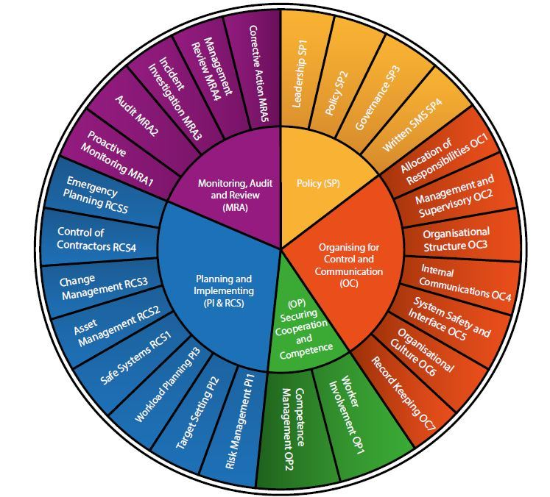

SMS in rail
In rail there are five areas in legislation;
Policy
Organising for control and communication
Securing cooperation and competence
Planning and implementing
Monitoring, audit and review
(Office of Road and Rail 2019)
The industry has now developed guidance for evaluating SMS maturity

Slide 21
So what might SMS look like for healthcare?
The common elements (many of which healthcare has in some form) include;
  Safety management policy​
  Clear accountabilities ​
  Hazard identification​
  Risk mitigation measures​
  Employee participation
  Management of change​​
  Communication of safety information​​
  Continuous improvement of the SMS​​
  Training of staff in safety​​
  Emergency preparedness
Which do you think healthcare needs? What might be missing?
Some potential elements that healthcare might add are
  Accounting for health inequalities and their impact on safety
  Ensuring patient and public involvement in safety

Slide 22
Further considerations for SMS in healthcare
Recursive (tailored) SMSs – at what level does the SMS apply?
  National, regional, provider, directorate...?
What sort of safety are we managing?
  Process or personal safety... is patient safety different again?
How do we define and manage uncertainty?
  Do we try and control to minimise risk, or enable adaptations?
What regulatory regime are we operating within?
  Prescriptive or flexible self-regulating?
Notes:
Recursive systems – at what level does the SMS apply? - National, regional, provider level … directorate level?
What sort of safety are we managing? - In healthcare staff health and safety is separate from patient or customer safety, in other industries they are one and the same (although there may be different incidents to worry about eg in rail there are major crashes vs slips, trips and falls on stations
How do we define and manage uncertainty? - do we want to minimise risk, in which case what is our "acceptable tolerable risk"? Or do we want to manage to cope with uncertainty and have resilience (in my view we need both but need to be considerate of which applies where)
What regulatory regime are we operating within?
Prescriptive regulation to demonstrate achieveing rules, or flexible regulation to demonstrate self-managed safety? Rely on others to tell us what the risks are and how we mitigate them, or find out for ourselves?

Slide 23
References
All Party Parliamentary Group for Patient Safety (2025). "Patient Safety and the 10 Year Plan for the NHS" https://static1.squarespace.com/static/5dc54ed5ade009281aa85792/t/67b71c234cadda3db8089ffd/1740053539524/APPG+10+Year+Plan+Submission+-+Feb+2025+final.pdf
Blišťanová, Monika, Michaela Kešeľová, and Ľubomíra Brůnová. "A systematic review of Safety Management System (SMS) in aviation with a focus on the safety level." Zeszyty Naukowe. Transport/Politechnika Śląska (2021).
Energy Institute (2016) High Level Framework for Process Safety Management https://publishing.energyinst.org/_users/ei2/registered/chizzyelfizzy@yahoo.com/High-level-framework-for-process-safety-management070416044249.pdf
Health Services Safety Investigations Body (2023). Investigation report: Safety management systems - an introduction for healthcare. url: https://www.hssib.org.uk/patient-safety-investigations/safety-management-systems/ (visited on 07/08/2024).​
Health Services Safety Investigations Body (2025). Investigation report: Safety management systems: accountability across organisational boundaries. url: https://www.hssib.org.uk/patient-safety-investigations/safety-management/investigation-report/ (visited on 15/02/2025).​
International Civil Aviation Authority (2019) Annex 19 – Safety Management
Macrae, Carl (2022). Systematizing Safety: The Urgent Need for Integrated Safety Management Systems in Healthcare. SSRN Scholarly Paper. Rochester, NY.
Nwankwo, Chizaram D., Stephen C. Theophilus, and Andrew O. Arewa. "A comparative analysis of process safety management (PSM) systems in the process industry." Journal of Loss Prevention in the Process Industries 66 (2020): 104171
Office for Road and Rail 2019; Risk Management Maturity Model RM3 https://www.orr.gov.uk/sites/default/files/2020-09/risk-management-maturity-model-rm3-2019.pdf

Slide 24

Thank You! rmgx2773@leeds.ac.uk

Slide 25
How confident do you now feel in your understanding of safety management systems?

Slide 26
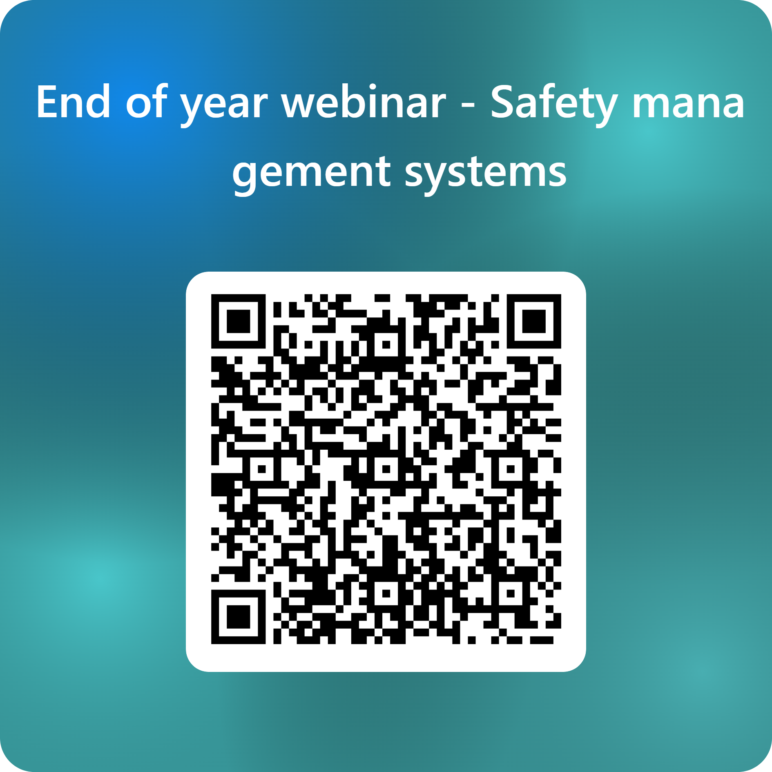
Thank you – request for feedback
For Further information and access to any resources shared at previous learning events please visit us at:
https://www.healthinnovation-em.org.uk/

