Slide 1
Health Innovation East Midlands: Patient Safety Partners learning session
Sophie Mason, Senior Innovation Lead
2nd October 2024

Slide 2

Our support and expertise
One of 15 health innovation networks across England​, we are the East Midlands NHS innovation arm.
With 10 years expertise at adoption of transformative technologies and pathways, via our pipeline we help identify and import solutions to their challenges
We are funded by the NHS – our core support and services are free to local NHS partners
Notes:
For those of you who are unfamiliar with HIEM, we are 1 of 15, together we are a network of connected ‘health innovation’ organisations commissioned to support the local delivery of national NHS programmes, I support (along with my colleague Ella) the PSIRF programme alongside another programme called MedTech Funding Mandate. That’s us now please can you introduce yourself in the chat t would lovely to see who we have here today!

Slide 3
The Agenda
No/Ref | Times | Item
1 | 10.30 – 10.45 (15) | Welcome and Introductions
2 | 10.45 – 11.00 (15) | Claire Rudkin, University Hospitals Leicester on recruiting Patient Safety Partners from diverse communities
3 | 11.00 - 11.15 (15) | Any Questions for Claire
4 | 11.15 – 11.30 (15) | Bridy Rendall and Colin Fiske, United Lincoln Hospitals on the implementation on Patient Safety Partners
5 | 11.30 - 11.45 (15) | Any Questions for Bridy and Colin
6 | 11.45 – 11.50 (5) | Calls for help
7 | 11.50 – 12.00 (15) | Closing remarks and feedback
Notes:
So onto the agenda, I will try to keep my introduction brief but we do have some slido slides to go through and then we can focus on what you came here for, the two presentations from Claire and Bridy & Colin, we have split the time between presentation time and question time and I hope you have considered your appreciative conversation questions, we really appreciate they have taken the time to speak today I hope you are all looking forward to it. We have a short section called ‘call for help’ and today this is a question that has come from our Notts ICB colleagues and it is a specific ask that they are looking for support with, this will be a standing agenda item for all our learning events, those little tidbits that could be answered fairly quickly. We would then at the end of the session ask you to complete our feedback form, mainly because this is the first learning event and we need to know if they are hitting the mark and because once you leave today there will be plenty more interesting things to do then give us feedback.

Slide 4
Housekeeping
Today’s session is built around appreciative inquiry: Please keep this in mind when asking your questions, as a reminder
Appreciative Inquiry is based on the concept that value increases when you put a focus upon it, it is a core concept in systems thinking as it brings into play the person (us) as part of the system by which we want to change/ influence/ improve.​
Identify the positive aspects of the story, try to draw that our further​
Be curious, ask questions to generate discussion​
Ask questions about what the speaker values, what they would change, what helped them to achieve this milestone.​
Listen and reflect

Slide 5
Appreciative Inquiry
Appreciative Inquiry is based on the concept that value increases when you put a focus upon it, it is a core concept in systems thinking as it brings into play the person (us) as part of the system by which we want to change/ influence/ improve.
How to prepare for appreciative conversations through carefully constructed questions :
Identify the positive aspects of the story, try to draw that our further
Be curious, ask questions to generate discussion
Ask questions about what the speaker values, what they would change, what helped them to achieve this milestone.
Listen and reflect

Slide 6
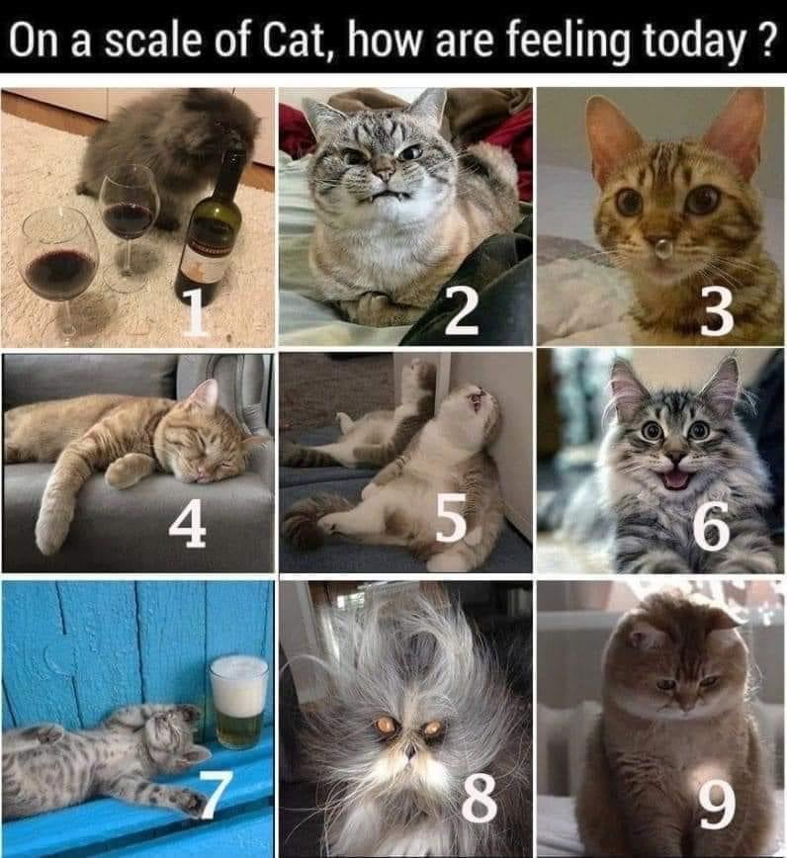
On a scale of cat, how are we feeling today?

Slide 7
What area of the East Midlands do you work in?

Slide 8
How confident are we feeling about the recruitment and potential impact of our patient safety partners right now?

Slide 9
Patient Safety Partners – Recruitment and Selection
Claire Rudkin, Head of Patient Safety
Health Innovation East Midlands Learning Event, 2 October 2024

Slide 10
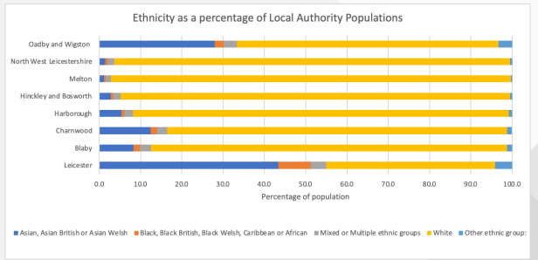
Background and context
Leicester, Leicestershire and Rutland has a diverse population

Slide 11
Recruitment
It was important to us that we recruited 3 Patient Safety Partners that were representative of our local population.
We added the shortlisted applicants to TRAC for ability to oversee DBS checks but the roles were not advertised on NHS jobs as we didn’t want them to see be seen as paid jobs.
We worked with People Services to develop an off payroll claim form for them to claim their payment of £75 half day/£150 full day

Slide 12
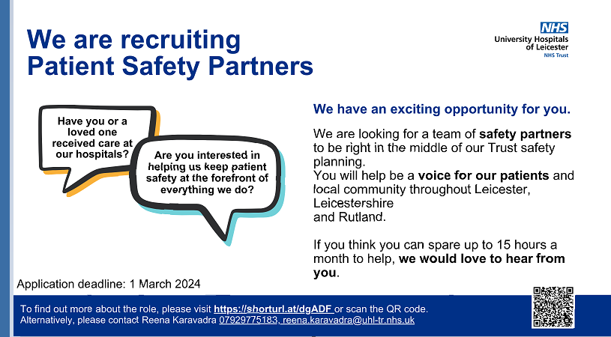
Our advert
Advert out from 17 January 2024- 1 March 2024

Slide 13
How we advertised
UHL public website
X (Previously Twitter)
Facebook
LinkedIn
Volunteering services – text messages
Patient Engagement and Involvement Lead
PSS in ICB – PPI groups
Sent to all GP Practices to put up poster and formulated slide so could be added to GP practice screen

Slide 14
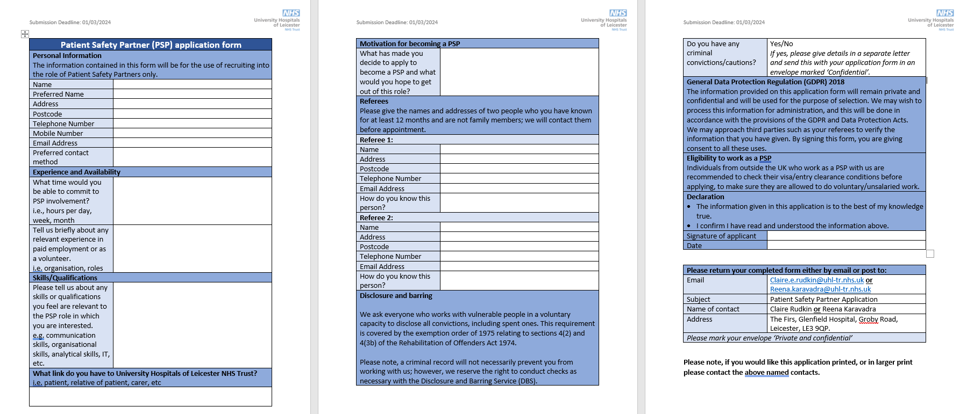
Our PSP application form

Slide 15
Selection process
Once applicants submitted an application form we sent them the equality and diversity monitoring form to complete.
We also looked at our applicants against their Index of Multiple Deprivation Decile (IMD) from their postcodes.
The equality and diversity information and the IMD gave us the assurance that we had applicants from diverse backgrounds.
All 4 Patient Safety Specialists and the NHS Patient Safety Strategy and PSIRF Programme Lead shortlisted the applicants; none of the E&D or IMD information was used in the shortlisting process.
We had 27 applications and shortlisted 7.

Slide 16
Selection process - assessment
Ward visit with one Patient Safety Specialist and two candidates – 30 mins (observation of them interacting with staff and patients)
Discussion with the two candidates together (with the all 4 Patient Safety Specialists and the NHS Patient Safety Strategy and PSIRF Programme Lead) – 30 mins

Slide 17
Our discussion points
When you first arrived in the ward setting, did it inspire confidence in the care that patients were receiving?
How can first impressions make patients feel that they will be safe and cared for?
What did you notice about safety issues?
Does this ward appear to think that safety is important?
What information tells you about the quality of care there?
What tells you that staff are concerned about safety and preventing harm (e.g. infections, falls)?

Slide 18
Our discussion points
What have you noticed that builds your confidence?
What makes you less confident?
What does good care look, feel, sound and smell like?

Slide 19
Our timeline and challenges….
July 2023 – Started work with People Services on how to recruit this bespoke role
December 2023- Budget confirmed for 3 PSPs to be able to make payment in line with the national guidance
December 2023 – PSP application form finalised
17th January 2024 – 1st March 2024 – role advertised
2nd-10th March 2024 – shortlisting took place and all shortlisted applications added to TRAC
18th and 29th April 2024 - informal interviews/assessments
17th May 2024 – PSP policy approved
10th July 2024 – PSP Agreement finalised
23rd August 2024 – Off Payroll claim form finalised by payroll services
13 September 2024 – PSPs commenced in role and now onboarding

Slide 20
Our timeline and challenges….
Challenges
Getting the funding agreed in a financially restricted climate
Shortlisting can very subjective – we wanted a fresh eyes/naïve view, either own experience of being a patient or that of a family member, not embedded in organisational culture, no agendas
Change in personnel in People Service roles
Never been a role of this type recruited to as different payment and role to previous Patient Partner role

Slide 21

Thank you for listening

Slide 22
Implementation of Patient Safety Partners
United Lincolnshire Hospitals
October 2024

Slide 23
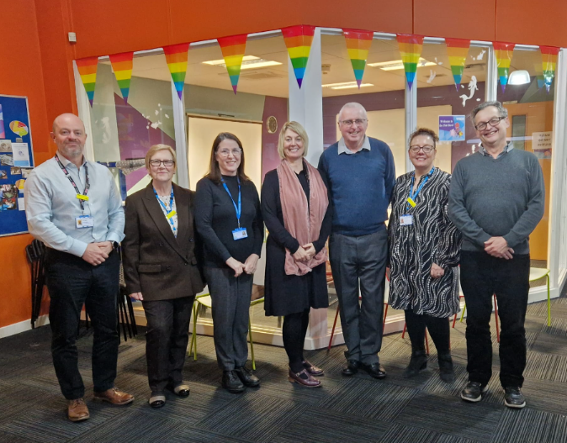
Our Team
Group Chief Clinical Governance Officer – Kathryn Helley
Head of Patient Safety – Bridy Rendall
Patient Safety Improvement Manager – Steve Martin
Patient Safety Partner – Elaine Freeman
Patient Safety Partner – Colin Fiske
Patient Safety Partner – Andy Izard
Patient Safety Partner – Dorothy Moore
Patient Safety Partner – Grace Heaton

Slide 24

Our Journey…
Sep 2022
3 PSPs successfully
recruited
April 2022
PSP Role Development
underway
Involvement:
20+ Meetings
PSIRF Support
Improvement Work
Now…
In all – improving Patient Safety!
Making a difference!
Role 4 and Onwards!
2023/2024
Growth – 2 more PSPs!
National Seminars/Workshops
Advocacy / Exemplar work
Recognition:
Annual Review
Positive Across the Trust
Valued
Mentors to other Trusts
Invitations to wider work:
CSJ co-author
Recruitment
Presentations
Ward Assurance Visits
Marketplace Events

Slide 25
Recent Quotes…
“When Patient Safety Partners (PSP) were introduced to the NHS, we were unsure who these people would be and where they would ‘fit’ in the organisation and the wider healthcare landscape. As chair of the Patient Safety Management Network (PSMN), I was keen to understand more.
Elaine was one of the very first PSP’s to join the network – and a very active member. Elaine has introduced us (at the network) her role, the challenges she has faced and overcome, the development of her role and the impact her role is having on her Trust.
The PSP’s at ULHT have been leading the way when it comes to ‘what good looks like’. They have been at the forefront of the development and evolution of the PSP role, not just with in their Trust, but beyond.”
Claire Cox
Chair Patient Safety Management National Network
Recognised for their work undertaken, one of our PSPs was requested to provide a quote on how the role has worked at ULHT. This will feature on the national PSP hub:
"Our Trust approached the PSP role from the start with a
strong implementation plan, a solid support structure in place
and a clear commitment to listen to the patient voice. This has
meant that as PSPs we have not only felt incredibly supported
but our voice has been listened to time and again.
We feel valued not only by the Trust but by the staff and clinicians
we continually engage with at all levels. In addition, the value of our
work has been recognised and two of our PSPs are now engaged at Level 4.“
Colin Fiske, PSP, ULHT

Slide 26
Colin's Story
Psychological Safety and its importance
Involvement with Patient Safety Incident Response Framework
Lived experience

Slide 27
Next Steps
Research project to review overall impact of implementation plan
Recruitment drive to increase team
Align PSP to portfolios and service line reporting
Increase Role 4 capacity amongst the team

Slide 28

Any Questions?

Slide 29
Call for help – PSP question
In terms of the recruitment process for a volunteer position has anyone here had any challenges associated to ensure the role does not equate to a ‘job role’, which has caused their organisation difficulties with recruiting PSPs?
If yes, how have you got through it?
If no, please say in the chat it is helpful to understand the full position.

Slide 30
How confident are we feeling about the recruitment and potential impact of our patient safety partners now?

Slide 31
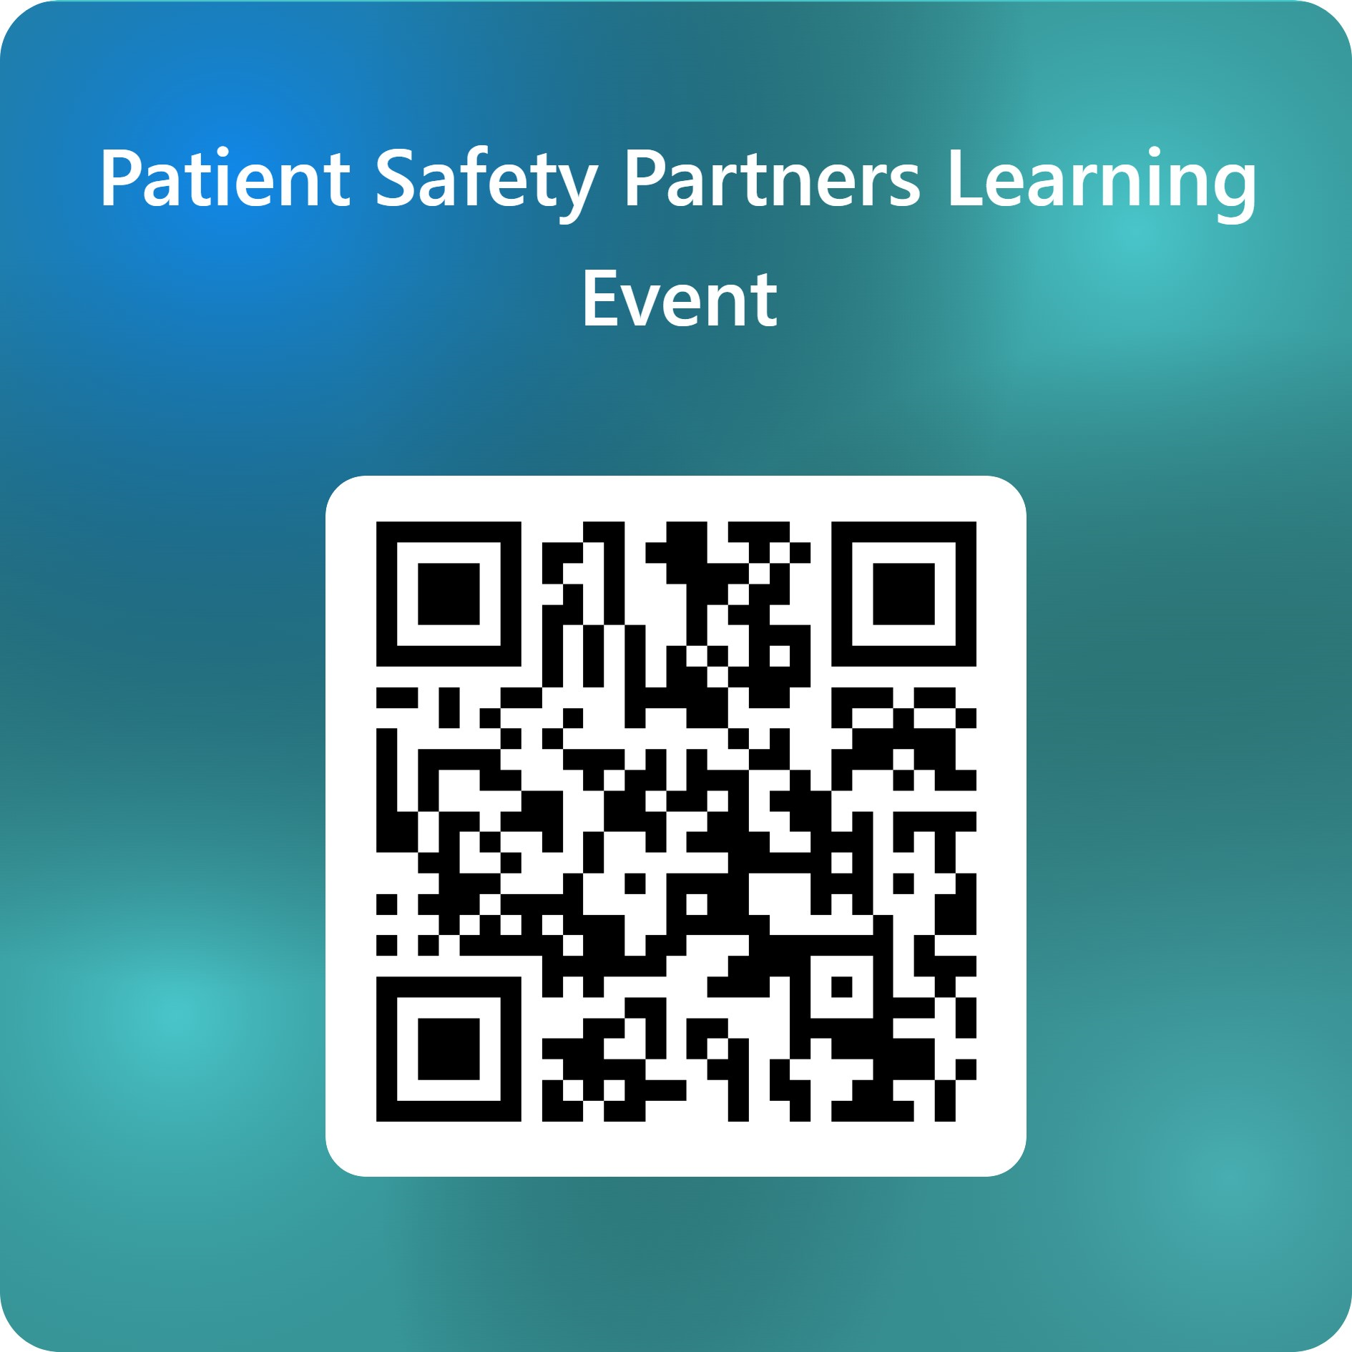
Thank you & Next session
Thank you! Please do complete our feedback form to help us shape future learning sessions.
The next session will be:
16th October: PSIRF measuring the impact of improvement
This session is for ICBs and providers who want a back to basics on measurements including:
Identifying when improvement is moving in the right direction
Selecting the right metrics and associating them to activity
How to measure and set realistic timeframes.

