Slide 1
Health Innovation East Midlands: PSIRP Theme - Medication
Sophie Mason, Senior Innovation Lead
26th February 2025

Slide 2

Our support and expertise
One of 15 health innovation networks across England​, we are the East Midlands NHS innovation arm.
With 10 years expertise at adoption of transformative technologies and pathways, via our pipeline we help identify and import solutions to their challenges
We are funded by the NHS – our core support and services are free to local NHS partners

Slide 3

The Agenda
No/Ref | Times | Item
1 | 14.30 – 14.40 (10) | Welcome and Introductions
2 | 14.40 – 15.00 (20) | Using a Human Factors approach to explore the facilitators or barriers to appropriate opioid prescribing processes in GP practice, Gill Gookey, Head of Medicines Safety Programme Delivery, Chartered Human Factors Specialist at Health Innovation East Midlands
3 | 15.00 - 15.20 (20) | Developing a Work System Interaction Map around the Patient Discharge Process, Stacey Sadler, Specialist Pharmacist in Quality Improvement at Nottingham University Hospitals Trust
4 | 15.20 – 15.25 (5) | Calls for help
5 | 15.25 – 15.30 (5) | Closing remarks and feedback

Slide 4
Housekeeping
Today’s session is built around appreciative inquiry: Please keep this in mind when asking your questions, as a reminder
Appreciative Inquiry is based on the concept that value increases when you put a focus upon it, it is a core concept in systems thinking as it brings into play the person (us) as part of the system by which we want to change/ influence/ improve.​
Identify the positive aspects of the story, try to draw that our further​
Be curious, ask questions to generate discussion​
Ask questions about what the speaker values, what they would change, what helped them to achieve this milestone.​
Listen and reflect

Slide 5

On a scale of sheep, how are we feeling today?

Slide 6
What area of the East Midlands do you work in?

Slide 7
How confident are you that system-based learning is improving patient safety incidents regarding medication?

Slide 8
Using a Human Factors approach to explore the facilitators or barriers to appropriate opioid prescribing processes in GP practice.
Gill Gookey – Head of Medicines Safety and Chartered Human Factors specialist
Gill.gookey@nottingham.ac.uk

Slide 9
Plan
Study in 6 GP practices and use of SEIPS
Supporting service innovation and improvement

Slide 10
Definition for Human Factors/Ergonomics
The scientific discipline concerned with the understanding of interactions among humans and other elements of a system, and the profession that applies theory, principles, data, and methods to design in order to optimize human well-being and overall system performance.
International Ergonomics Association
Notes:
Human factors and ergonomics used interchangeably
ergonomics — “the science of work” is derived from the Greek ergon (work) and nomos (laws).
the scientific discipline concerned with the understanding of interactions among humans and other elements of a system, and the profession that applies theory, principles, data, and methods to design in order to optimize human well-being and overall system performance. ”international ergonomics association”
“the study of all the factors that make it easier to do the work in the right way” World Health Organisation
Other safety critical industries have embedded Human Factors much better and for far longer than healthcare. Aviation use Human Factors methodology - All pilots have Human Factors training , Nuclear Industry it has also been embedded for quite a while – Chernobyl and three mile island. But transport are also quite far ahead. However It is increasing the Healthcare

Slide 11

Study detail

Slide 12
What was the issue that needed review?
Most long-term opioids are issued in GP practice via repeat (>18,000 people on long term opioid)
Opioids are high-risk drugs (22% of coroners preventable death reports relate to opioids)
Repeat requests are administration team led with minimal clinician interaction
Each GP practice runs differently and has different population needs

Slide 13
Methodology
Prescribing data
Recruited 6 practices
From 4 PCNs
17 interviews
6 pharmacists
6 admin team
5 GPs
Triangulated and analysed
1. Process map plus barriers and facilitators for each practice using template analysis
2. HF analysis of the system (SEIPS)
Overall aims plus facilitators and barriers
Notes:
Limitations – I only spoke to a maximum of 3 people per practice so a different 3 may have given a different story. Due to covid observations in the practice were more difficult and therefore there was a risk of not capturing work as done. Triangulation is hoped to have helped limit this.
The maps I have drawn should be the start of the discussions in the practice, helping to understand work as done and the links between different roles and possible assumptions. They are as good as could be achieved from 3 remote interviews.

Slide 14
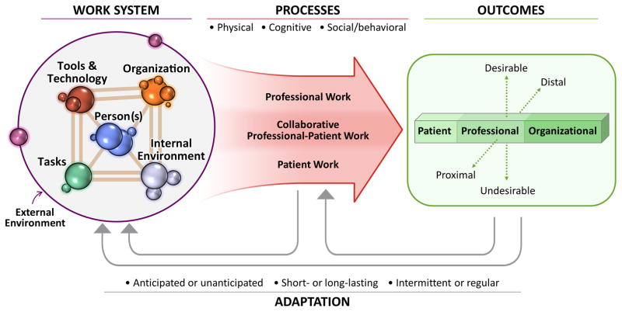
Systems Engineering Initiative For Patient Safety (SEIPS 2.0)
Holden, R. J., Carayon, P., Gurses, A. P., Hoonakker, P., Hundt, A. S., Ozok, A. A. & Rivera-Rodriguez, A. J. 2013. SEIPS 2.0: a human factors framework for studying and improving the work of healthcare professionals and patients. Ergonomics, 56, 1669-1686.

Slide 15
Expected opioids prescribing process – what is the work people are doing
Organisation
Notes:
Notes:
Many practices no longer routinely allow phone ordering or community pharmacy ordering due to the increased risk of error or waste.
Online ordering NHS app or clinical system is the safest and therefore preferred option.
Notes:
Early or late ordering is not defined in guidance. In practice >2 days early and more than two months late for regular medication should flag the review of an opioid.
Sch 2 & 3 opioids require strict control. Guidance is less clear sch 5 opioids is less aligned but experience would recommend that as a minimum liquid oral morphine should be managed closely.
A dedicated, quiet area, trained staff and allocated time is needed.
Notes:
Recommend carefully considering if opioids should be on repeat and limiting duration between review
Chronic pain is pain lasting three months, acute issues until this point and then clinical review and named clinician before continuing or placing on repeat.
Maximise the skills of clinical pharmacists and pharmacy technicians to reduce workload on GPs
Notes
1. Practice policy should be written down, shared and agreed with all new starters and temporary staff and include:
Whether opioids are allowed on repeat clearly stating the schedules of controlled drugs and where necessary the medication.
Clear roles and responsibilities
Only clinicians can issue acute requests, re-authorise repeat medication or update medication review dates
Who can issue a controlled drug even on repeat (some practices limit to clinicians only)
If repeat is acceptable practice, the maximum authorisation time period should be six months
A clinicians review is required after six months on repeat for all strong opioids. A practice may decide to extend this review period for weaker opioids e.g. codeine but this should be clear in the policy.
2. The clinical system should be used to provide maximum process control
Highlight controlled drugs
Flag early ordering
Flag if no-authorisations or passed medication review date
3. Where possible there should be a named clinician for patients on strong opioids.
4. A process should be in place to cover a clinicians prescription queries if they are not available

Slide 16

Example of process found – schedule 5 opioids were not identified by administration team and were not processed consistently
Notes:
Phone orders regularly used – for patient convenience, as well as community ordering
Pharmacist and GP assumed one process but admin were trying to use the procedure (which was written) and support the clinicians, but perhaps ending up with somewhere else.
Great proactive approach to identification of upcoming med reviews although acknowledged that med reviews and reauthorisations were out of sync due to the pandemic.
In this practice for non-opioids the process is very different to sch 2 and 3, administration team is given a certain amount of free-rein in re-authorising to match medication reviews. And they allow a certain amount of time before an overdue medication review is forwarded to a clinician (although are chasing the patient) They may also issue certain acutes but flag them by a query note that states acute for further review by the GP.
FOr sch 2 and 3 CDs they were never re-authorised although may override med review, however for sch 5 – no alert to them so variation increased hugely.

Slide 17
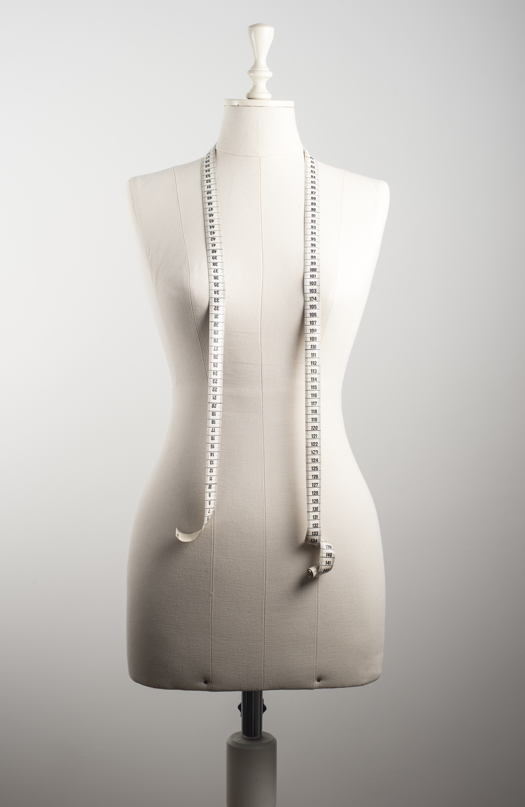
One process would not fit all general practices…But there are themes

Slide 18

Themes from interviews/mapping
Opioids are a priority area
Pharmacist /technician
Administration team
GP
Capacity
Clinical vs non-clinical
“Default”
Competence
High variation between and within practice
Complexity
Written procedure
Schedule 5s
Alignment to other high-risk drugs
Early-ordering
Who does the work and where
Notes:
Time between medication review is not agreed and often extended

Slide 19

SEIPS Framework Analysis

Slide 21
SEIPS for opioid prescribing process – People
SEIPS area | Aim | Facilitator | Barrier (* difficult to change)
People | 1. Manageable cognitive load | Dedicated time to focus solely on prescription management Straight-forward OPP | Multi-tasking Time or workload pressure
 | 2. Correct skill set | Competence and consistency with clinical system functionality Knowledge of opioids and the OPP Dedicated prescription processing roles | Tasks/role performed infrequently Non-clinical staff routinely issuing past review date without clinical input
 | 3. Consistent approach to OPP | Structured training including written information | Working across multiple general practices Locum involvement in OPP

Slide 22
SEIPS for opioid prescribing process –tasks
SEIPS area | Aim | Facilitator | Barrier (* difficult to change)
Tasks | 1. Prescription requests received safely and accurately | Patient ordering preferred on-line via clinical system/NHS app | Telephone orders Unnecessary community pharmacy ordering
 | 2. Effective screening and data input | High level of automation and control Collating all necessary information to allow efficient decision making | Failure to identify opioid medication, or over/under ordering Multiple manual data entries during prescribing
 | 3. Time-efficiency | Pro-active highlighting of medication reviews | Tasks that “bounce” around the practice

Slide 23
Summary so far…
Most of the results transfer to any medication – but is more important with opioids
Aim to remove pressure from the whole prescription process by better design which supports a focus on high-risk medicines
Top three things to improve:
  Improve the functionality and use of the clinical system
  Effective and embedded work procedure
  Manageable cognitive load/ workload

Slide 24
What happened next
Worked with Derby and Derbyshire ICS to develop minimum standards for opioid prescribing across all GP practices.
Brought people together from across the system to co-create
Used study outcomes to create the standards (11 in total)
Created an adaptable process flow chart to support implementation
Included as good practice case study into national repeat prescribing toolkit
Work currently being repeated in Lincolnshire ICS
Notes:
https://healthinnovation-em.org.uk/our-work/innovations/improving-the-management-of-non-cancer-pain-reducing-harm-from-opioids/704-improving-opioid-repeat-prescribing-processes-in-general-practice

Slide 25
Further information
Gill Gookey
Gill.gookey@nottingham.ac.uk
Web: healthinnovation-em.org.uk
LinkedIn: Health Innovation East Midlands
X: Healthinn_em
Bluesky: @healthinn-em.bsky.social

Slide 26
Developing a Work System Interaction Map around the Patient Discharge Process
Stacey Sadler – Specialist Pharmacist in Quality Improvement
&
Emma Smith – Human Factors Specialist

Slide 27

Overview of Presentation
Introduction
Aims of the work
Methodology
Developing a Work System Interaction Map
Findings
Recommendations & Reflections

Slide 28
Introduction – A Delayed Discharge
A deep dive into a patient compliant (associated with a delay of seven hours after they had expected to go home) found that effective communication in the 28 hours leading up to their discharge would have resulted in a more relaxed experience of the delay
The delay itself was not a result of a delayed medication dispensing process but compounded by several steps that preceded the prescription being written, such as lab capacity and multi-specialist reviews

Slide 29
Introduction – The Discharge Process
Patients’ perceptions of the NHS are shaped by their experiences of their journey through the system, including discharge from hospital
Managing patient’s expectations and effective communication between staff and patients prior to discharge may help to alleviate frustrations and improve the patient’s experience
The discharge process is complex – for an effective discharge to occur specialised services from numerous systems need to be coordinated and work together efficiently and communicate effectively

Slide 30
Aims
To further, understand the factors that may contribute and lead to an ineffective discharge process and communication between staff and patients during the NHS discharge process, using a Human Factors approach
To provide a visual representation of how SEIPS 2.0 Model work system factors interact with each other to shape processes and outcomes
To recommend changes to support improvements in patients’ perceptions, experience and communication between staff and patients during the discharge process

Slide 31
Methodology
Focus groups undertaken with 7 nurses and Discharge Co-ordinators (DISCOs)
Participants encouraged to discuss positives and challenges with the Trust’s discharge process. Broad questions were asked to aid these discussions
Field notes, along with the summarised key points were compared and thematic analysis undertaken to determine the common themes across the focus groups, categorising the identified themes into: Work System Factors, Processes and Outcomes

Slide 32
Methodology Continued
Themes were then mapped onto the Work System Interaction Map (WSIM) -focussed on work system factors that shaped undesirable outcomes to improve the discharge process
Finally, themes identified were further classified into issues that were having a direct impact on patients’ experience of the discharge process and those that were indirectly impacted on patient’s experience of the discharge process

Slide 33
The Work System Interaction Map (WSIM)
The Work System Interaction Map (WSIM) was designed to advance the use of SEIPS 2.0 Model to provide a visual representation of how work system factors interact with each other to shape processes and lead to an outcome (positive or negative)
Could be used because of an incident, or in a more proactive way to improve the system
The interaction map may increase the likelihood that recommendations can be targeted as system changes, increasing the probability of sustained safety & efficiency improvements

Slide 34

WSIM Diagram

Slide 35
Direct Solutions to Improve Patient Experience & Expectations
Improve communication and be honest with patients
Manage patient’s expectations better - doctors to start this process when tell patients they can go home
Improve patient’s knowledge around the discharge process
Notes:
”

Slide 36
Indirect Solutions
Doctors giving higher priority for TTOs
Changing distribution service for TTOs – split porter runs, look at providing, trust drop off service for TTOs (cross charge the ward), use taxis for TTOs if patients only waiting for medication
Higher recognition of roles/banding – utilise DISCO skills more, nurses/pharmacists write TTOs
More staff – doctors, pharmacists, and DISCOs on wards
Utilise the day case surgery system, would be able to have better flow of beds
Increase staff consistency, improve rapport between staff, designated ward pharmacists, pharmacists on the discharge lounge

Slide 37
Recommendations
Share the report with NUH’s Patient Partnership Group (PPG) so they can work with the Medics around appropriate language to use with patients on discharge
Feedback the initial results of the project at the ‘Excellence in Discharge’ Study Day
Work with Discharge Education Working Group to investigate the re-introduction of the ‘pharmacy video’ Your Medicines on Discharge - NUH Pharmacy - YouTube explaining the discharge process to patients
Share report with Improvement Leads, Serious Investigation Team and Integrated Discharge Lead

Slide 38
To Summarise
Using the SEIPs 2.0 model was a useful tool and highlights the complexity of the discharge process
Highlighted that a number of ‘direct solutions and indirect solutions’ needed to be acted on to improve the patient’s experience and expectation of the discharge process
Difficult to visually & quickly show the interacting factors and outcomes in this process and why a systems approach must be taken
The WSIM was a very useful tool and has been useful when presenting to people without a HF background

Slide 39
Acknowledgements
Discharge Co-ordinators and Nurses
Emma Smith
Giulia Miles and Eva – Maria Carman
Vivian De Vittoris

Slide 40
Call for help
A 5 min section thrown open to those attending to ask a question on anything PSIRF related to their peers…
If anyone is working or considering the spread the principles of PSIRF across the care home sector in their localities, please let myself or Leeanna Woodrow from Northants ICB know.
If anyone is either reviewing learning responses or has initiated activity associated to reducing ‘harm while waiting’ be that delays to transfer, ED or elective treatment please let myself or Julie Croysdale from LLR ICB know.

Slide 41
After hearing today's speakers, how confident are you that system-based learning is improving patient safety incidents regarding medication?

Slide 42
Thank you & next session
Thank you! Please do complete our feedback form to help us shape future learning sessions.
The next set of sessions will focus on the key priority areas as included in your PSIRPs:
  5th March 11:30 - 12:30 – Pressure ulcers – still waiting for confirmation of speakers
  14th March 10 - 11am – Managing deterioration – Due to be cancelled due no colleague willing to share work in this area
Last in the series is a webinar on safety management systems with a speaker already confirmed – Brook Howell

