Slide 1
Health Innovation East Midlands: Measuring Impact learning session
Sophie Mason, Senior Innovation Lead
16th October 2024

Slide 2

Our support and expertise
One of 15 health innovation networks across England​, we are the East Midlands NHS innovation arm.
With 10 years expertise at adoption of transformative technologies and pathways, via our pipeline we help identify and import solutions to their challenges
We are funded by the NHS – our core support and services are free to local NHS partners

Slide 3
The Agenda
No/Ref | Times | Item
1 | 13.30 – 13.45 (15) | Welcome and Introductions
2 | 13.45 – 14.00 (15) | Sophie Mason, Senior Improvement and Innovation Lead, Health Innovation East Midlands
3 | 14.00 - 14.15 (15) | Any Questions for Sophie
4 | 14.15 – 14.30 (15) | Hannah Jackson-Cox, Senior Improvement Lead, Mental Health Programme, Health Innovation East Midlands
5 | 14.30 - 14.45 (15) | Any Questions for Hannah
6 | 14.45 – 14.50 (5) | Calls for help
7 | 14.50 – 15.00 (15) | Closing remarks and feedback

Slide 4
Housekeeping
Today’s session is built around appreciative inquiry: Please keep this in mind when asking your questions, as a reminder
Appreciative Inquiry is based on the concept that value increases when you put a focus upon it, it is a core concept in systems thinking as it brings into play the person (us) as part of the system by which we want to change/ influence/ improve.​
Identify the positive aspects of the story, try to draw that our further​
Be curious, ask questions to generate discussion​
Ask questions about what the speaker values, what they would change, what helped them to achieve this milestone.​
Listen and reflect

Slide 5

On a scale of pumpkin, how are we feeling today?

Slide 6
What area of the East Midlands do you work in?

Slide 7
How confident are we feeling about measuring the impact PSIRF?

Slide 8

Measuring Improvement

Slide 9



MM
PSIRF
Goal: PSIRF has been implemented and the new investigation framework initiated, one which is compassionate, proportionate, engaging and systems-based, this will be garnering new insights into why & how patient safety incidents happen. PSIRF is changing organisational culture and for those responsible for its implementation being confident that this framework is causing the desired impact, of creating opportunities for new QI programmes to improve patient safety, which is key to maintain support and momentum from ward to board.
First step: Define & measure the change that using the new framework (in the form of systems-based, compassionate and proportionate investigations) has made. Next step: Take the learning from the investigations, review it across a system-wide platform and make changes in the form of improvement programmes which could span inter & multi-disciplinary teams, departments and organisations and make clear the connection between the measures associated when improvements are being realised and when PSIRF is taking effect. Disclaimer: these tools are intended to support the development of a measurement plan, if you have already established tools and techniques, please do not feel that you must duplicate work already done.
Measuring Impact

Slide 10
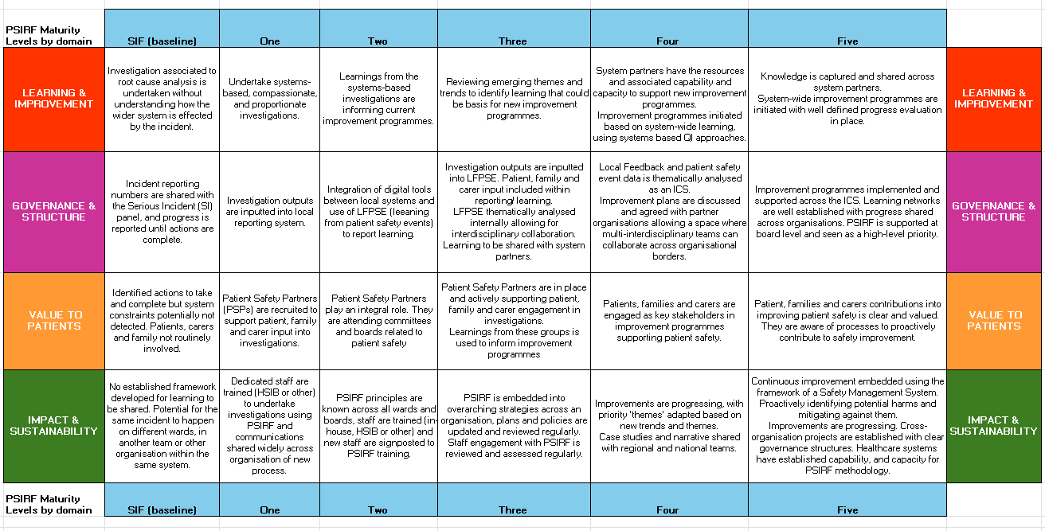
MM
Mapping current to future desired state
Maturity Matrix
This maturity matrix is intended as a tool to assess progress to date and to identify where you want to be, you can use this to evaluate your position and work through areas for future development. The next tool will help you work through the logical pathway from activity undertaken to the desired outcomes stated here.

Slide 11
MM
Linking activities to the future desired state
A: Huge cultural change programme in the way incidents are investigated
B: Opportunities for system-wide improvement programmes & working across organisations
C: PSIRF progress measured in line with intended outcomes as per the policy – improved patient safety
Ensuring what we are doing is putting us on the journey for where we want to be, will give us the confidence that change takes time but if our indicators are met, we are moving forward, if they are not met, we can change course to get us back on track again.
Once you have established where you are on the maturity matrix, you can then determine where you want to be within 6, 12, 18 months' time.
The next tool (logical framework) can be used to work through how your activities are linking back to your goal
Your indicators/ means of verification will become your success metrics.
You will then have the foundation for a measurement plan.

Slide 12
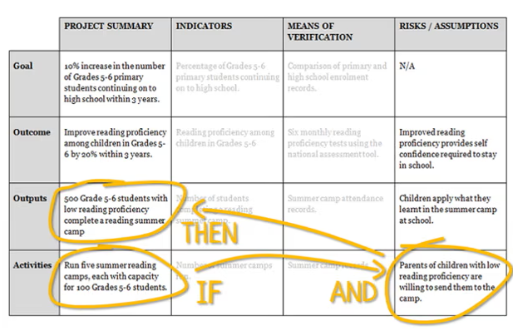
Logical framework Analysis
You start by adding you overall goal (aim) to the top left box.
Then you move down to your activities box in the lower left column. This is the ‘on the ground’ work that creates an output.
The risks and assumptions box is what you need to have happened to make the activity successful.
The logic comes through when you read it as ‘IF we undertake these activities AND these assumption hold true (or risks are mitigated) then this OUTPUT can be achieved. If it doesn’t read logically you need to have a re-think. Keep doing the same until you reach the goal.
Indicators – how you know this will be achieved and verification is the source of the data.
It can feel like you are writing the obvious at times, but this will help uncover where there are potential gaps and help you think through potential mitigations.
Activities is what we do, the action undertaken to create an output.
Output is the product; it is what is delivered and in causes the outcome.
Outcome is the result, or the difference made by the output and is a requirement to reach the overall goal or benefit.
Goal is the Improvement, where the value of undertaking the activity is achieved.

Slide 13
Example Logic Model: Technology Deployment Logic Model – ADHD/QbTest
Problem:
1. ADHD is a treatable disorder yet if left untreated, has a significant impact on personal development, academic outcomes and family interaction. There is no simple test to determine whether a child has ADHD. The process for diagnosing or ruling out ADHD is variable across England. Children in the UK wait 18 months on average to obtain an accurate diagnosis and multiple clinic visits over this period result in significant cost to the NHS.
ADHD pathways in the South West are variable and have many contact points. The commissioning environment in Devon, Cornwall and Somerset leads to confusing referral routes and large delays in diagnosing children with the condition. Only two out of our six pathways use the NICE recommended QbTest technology as one of the tools from which to diagnose children with ADHD. Of the other four pathways, Somerset and North Devon both require further transformational work to improve their ADHD pathways, in environments where local authority fund for patients with ADHD are every shrinking.
Aim: To improve ADHD pathways in the South West, through appropriate implementation of QbTest where appropriate and by engaging key system stakeholders, in order to improve patient and parent experience by 31 March 2022.
Assumptions
Stakeholders accept the evidence that QB test support more effective diagnosis of ADHD for children 6 to 18 years old in terms of health and economic benefit.
Rollout of nationally driven Qb test programme meets local needs and requirements
Stakeholders have the motivation, opportunity and time to engage.
Provider organisations want to collaborate in order to transform clinical pathways.
Resources
1x programme manager plus 0.2 EL support
Key skills required: Learning facilitation Spread, Data analysis, Communications, ADHD Pathway Transformation expertise
Activities –
a) Rapid learning with key local and national networks to understand barriers to adoption.
b) Tailored support to Community Paediatric Mental Health services and CAMHS, piloting and evaluating different approaches to using the technology
c) Surveys to collect feedback from clinicians, patients and families
d) Developing a robust business case to support rapid adoption and spread
e) Developing a coordinated approach to adoption and spread within the South West
Outputs (products)
a) Report of lessons learned generated. CCGs and Trusts engaged in ADHD programme of work.
b) ADHD assessment pathways redesigned placing QbTest at the beginning of the patient journey, or implementation into existing neurodevelopmental patient pathway, according to local need.
c) Evidence generated about whether QbTest supports diagnosis, and helps patients and families to understand symptoms.
d) Sustainability of funding for Qbtest secured
d) Well defined approach to spread methodology for such health innovations.
Outcomes (benefits)
Increase in the number of children and young people who have an objective assessment for ADHD.
Reduction in time for assessment and decision making.
Reduction in number of outpatient appointments between referral and diagnosis
Improved patient / family satisfaction / experience
Improved clinician satisfaction and confidence in diagnosing or excluding ADHD
Impact (higher level goals)
Patient benefit from improved access to Qbtest
Potential cost savings to system
Greater capacity and capability to spread and adopt innovation in the South West.

Slide 14


XprESS Logic Model
Problem
Context
Inputs
Outputs
Outcomes
Assumption
Impact
Patients with chronic sinusitis do not have equity of access to balloon dilation as a treatment offer in tertiary care.
Funding
Implementation funding for adopting new technologies like XprESS can be difficult to identify / secure. ENT is not a priority area.
MTFM financial mechanisms – mandating the use of local commissioner funding where there is clinical will
Providers utilise MTFM funding mechanisms and invest in NICE recommended MedTech
Providers are able to plan service improvements and agree funding
ICBs will reimburse for the cost of the technologies
Increased patient access to balloon dilation as a treatment for non-complex CRS
Increased clinical interest with roadmap to overcome common challenges
NICE Guidance & modelling
Systems struggle to identify MedTech likely to provide biggest clinical & financial benefits
MTFM policy teamwork with NICE to identify most promising medical technologies with guidance
Providers understand which technologies offer the best clinical outcomes and savings
Industry view NICE Medical Technologies Appraisal Process as a step for growth
Clinical leads trust NICE guidance and models
Patient numbers
XprESS is only a viable option for non-complex CRS patients 10-30% of those on the waiting list for surgery.
XprESS service reviews help to highlight wider system benefits. i.e. treatment earlier on in disease progression
Providers are supported to make well informed decisions on the inclusion of XprESS in ENT service provision.
XprESS as a viable offer across a locality or region.
Patient numbers are sufficient to elicit savings
Awake surgery
The current standard off FESS is performed in a theatre setting.
HINs to share good practice of where awake surgery works well
Clinicians are confident that awake surgery is a viable alternative for use of XprESS
Patient risks associated to GA are reduced. Patients will not require a follow up appointment.
Patients will want procedure in an awake surgery setting
Access to treatment rooms
Older estates may struggle to find suitable rooms to undertake awake surgery.
HINs to share examples from other adopting sites to help identify options
Implementing teams can identify space required to undertake procedure out of theatre.
More space in theatres for complex procedures
Space can be identified
ENT patient pathway
GIRFT ENT believe that the current ENT pathway does not support the use of XprESS
MTFM to share experience of clinicians across England's with GIRFT
Prominent ENT leads to broadly support use of XprESS in the right setting
Clinicians feel more confident of using XprESS in the right setting and context
Clinicians look to ENT GIRFT for recommendations

Slide 15
MM
Indicators and sources – Culture change
Feelings
Improving the way people feel about a situation, environment or process
Are investigations more compassionate, proportionate and engaging?
Knowledge
An internal change which supports external processes through skills, confidence, ability & capability
Data
The external system change that is measurable and viewable in a work environment, process or outcome
Shifts in severity – although counts are not always possible, what is the proxy data telling you – complaints etc
Do patients, family and carers feel listened to as at outcome of their involvement?
Can only be gauged by asking people but samples are a good way of not overburdening those around you!
Numbers who have attended patient safety or Quality Improvement training (formal or informal) or
Define the baseline, what is happening now that you hope to see this time next year.
New emerging trends in the learning causing a shift in what the system prioritises.
No shame in failure, people are supported to try and know when to try something else.
Increased proportion of people who know how to raise a change idea or share learning that could improve patient safety (whether it's called PSIRF or not).
Increases/ decreases in activity
New/refreshed SoPs
Improvement projects popping up here there and everywhere, no fear of trying

Slide 16
Logical framework analysis – Step 1 to 2 in the Value to Patients domain | Summary | Indicator | Means of verification | Assumptions (or risks)
Goal | Patient safety partners (PSPs) are an integral partner. They are attending & inputting into committees and boards related to patient safety. | PSP views/ opinion of impact Board/ committee views/ opinion of impact Patient, families & carers views. | Surveys/ interviews | 1) That individuals will have the capacity to complete surveys & interviews. 2) That PSPs will be able to incorporate patient voice effectively to inform programme planning decisions.
Outcome | Learning from patients, family & carers to inform the planning and preparation of new improvement programmes. Patient Safety Partners inputting into strategic decisions that will take into account patient voice & perspectives. | Improvement projects that include aims/ objectives associated to patient, family & carers input Meeting minutes Strategic documents | Improvement plans / action plan documents. Stakeholder maps (PSP as key stakeholder) Decision logs Patient perspectives included | 1) Priorities of the organisation, align to what matters most for patients, families or carers. 2)New improvement programmes incorporate learning from PSPs. 3) Meeting minutes provide the level of detail needed to identify PSP input.
Output | Patients, family & carers informing investigations that improve understanding of incidents to inform learning. Patient safety partners bring ‘patient voice’ to strategic board/ committee meetings. | Patients input into Systems based investigations recorded Meeting minutes | Investigation report either within local records or on LFPSE. Meeting notes stating where ‘patient voice’ is considered | 1) Information recorded in a manner that it can be thematically reviewed. 2) Learning that informs the generation of outputs from improvement projects. 3) Patient voice as an integral to patient safety decisions at board level
Activities | Patient Safety Partners in place and have started in their role, part of which is ensuring patient voice is captured in investigations. Patient safety partners are invited to strategic board/ committee meetings. | PSP recruited PSP input into investigations undertaken PSPs at meetings | Count of people recruited/ retain over x time #s of investigations that they are included on/ reviewed. Meeting minutes/ notes stating where ‘patient voice’ is considered, | 1) Sufficient training available for PSPs. 2) An environment which prioritises psychological safety. 3) PSPs have the ability to attend meetings. 4) Patients, family, carers are willing to input into investigations to support future learning.

Slide 17
Logical framework analysis – template | Summary | Indicator | Means of verification | Assumptions (or risks)
Goal
Outcome
Output
Activities

Slide 18
Any questions?

Slide 19
Mental Health Programme-
Counting what counts
Hannah Jackson-Cox RN
Senior Improvement Lead at Health Innovation East Midlands

Slide 20
Mental Health Programme
Improving
Improving Sexual Safety
Preventing
Preventing Suicide and Self-Harm
Reducing
Reducing Restrictive Practice

Slide 21

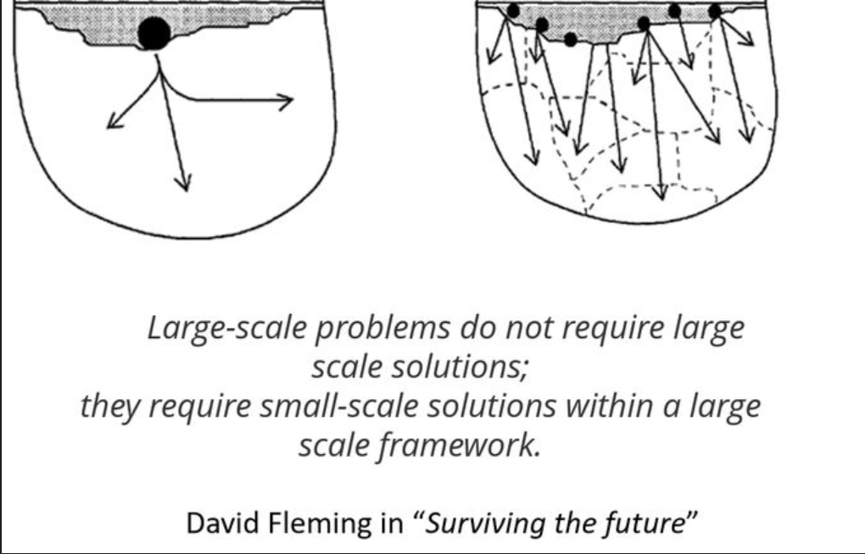
Patient safety and improvement
“It doesn’t matter how small the improvement, we’re going to do it, we’re going to energise each other and create this culture which is about this idea of continuous learning and continuous improvement” –Sir Dave Brailsford

Slide 22
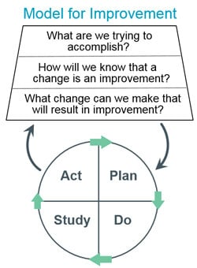
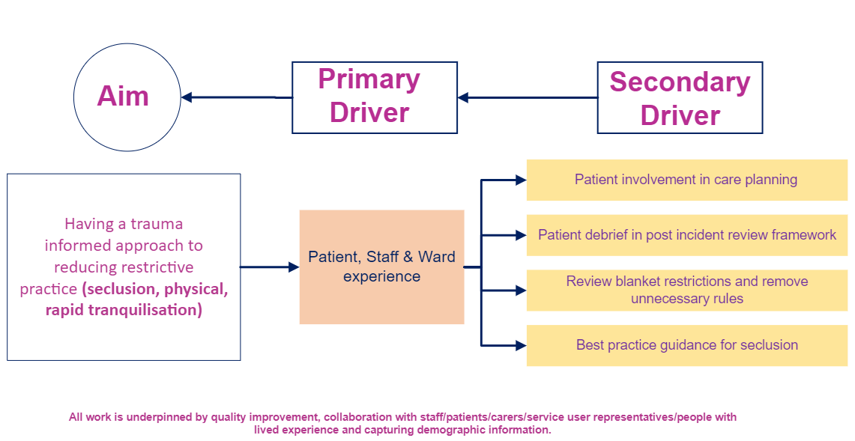
Spotlight on: Reducing Restrictive Practice
Notes:
Model for improvement: https://aqua.nhs.uk/wp-content/uploads/2023/07/qsir-pdsa-cycles-model-for-improvement.pdf

Slide 23
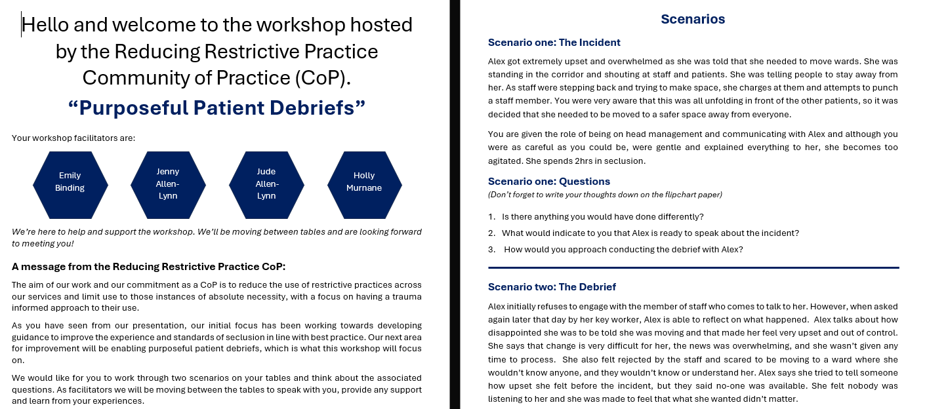
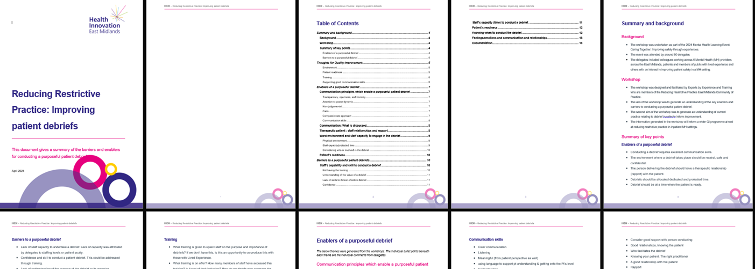
A
B

Slide 24
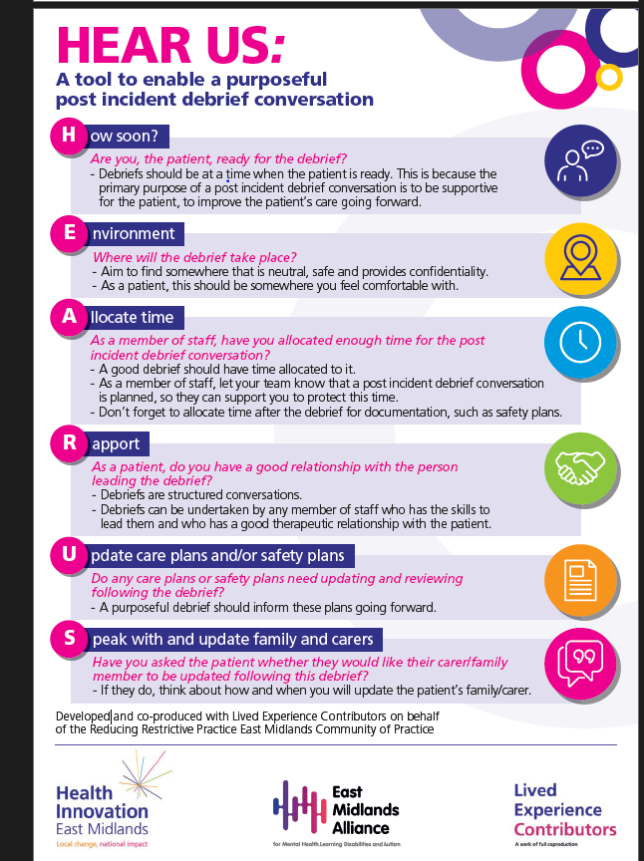
HEAR US- A framework to enable a purposeful debrief

Slide 25
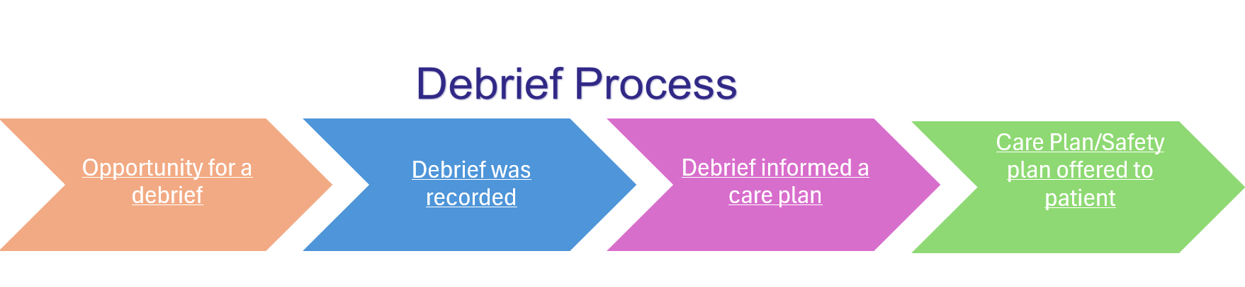




Phases and layers- Post incident debrief
Understanding current debrief practice- is this being recorded? Is it informing care plans?
Measure as we move through the process

Slide 26
Spotlight on: Reducing Self-Harm
We were data driven and asked questions of the data and chose to take an appreciative approach
We asked: Where are incidents happening most often? Certain time of day?
But also: Where are incidents happening least often?
And it was by doing this that we could formulate change ideas and take a different approach
Notes:
https://www.england.nhs.uk/long-read/improving-patient-safety-culture-a-practical-guide/

Slide 27
Aim
To reduce the number of incidents of self-harm between 6pm – 9pm by December 2024
And then we will take the learning and layer this up with a new aim statement…
Notes:
In improvement, we find ourselves learning as we’re moving through the changes

Slide 28
Measuring the impact

Slide 29
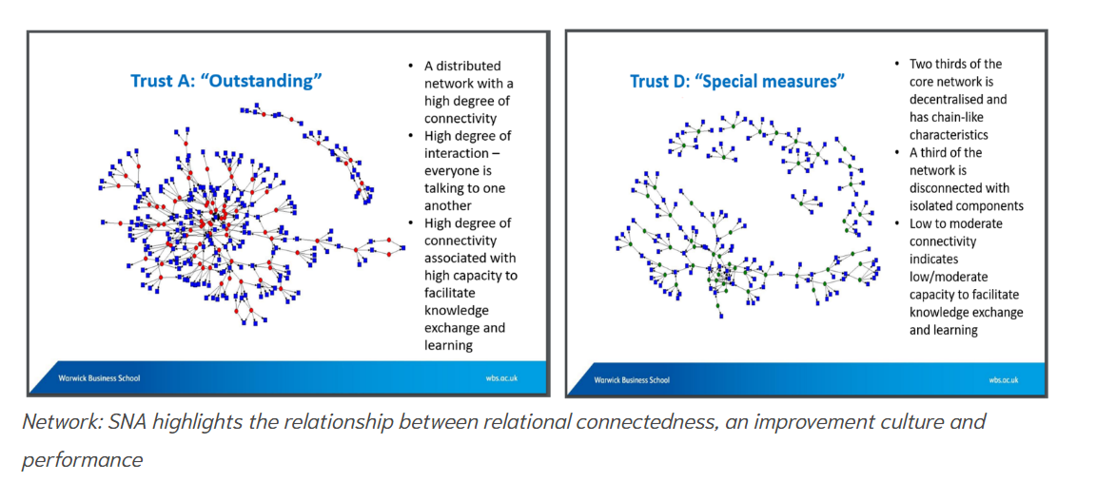
Social connectedness & Quality Improvement
“Relationships aren’t a priority, they’re a prerequisite”
Warwick Business School, in collaboration with Virginia Mason Institute
Notes:
Reference: https://warwick.ac.uk/fac/soc/wbs/research/vmi-nhs/reports/report_-_leading_change_across_a_healthcare_system_22.09.2022.pdf

Slide 30
Communities of Practice
Potential value- What has all this activity produced?
How has your participation changed you/the way you think about X topic?
Applied value – What difference has it made to my context/practice/life?
Can you give an example of where you have used a product/tool from this community/network?
Realised value- What difference has it made to my ability to achieve what matters to me or other stakeholders?
What has your organisation been able to achieve because of your participation in this community/network?
Transformative value - Has it changed my or other stakeholders understanding or definition of what matters?
Has this new understanding translated into institutional/organisational changes?
Has this process of social learning influenced conversations you’re having on what matters?
Notes:
Network focussed on communities of practice: https://q.health.org.uk/community/groups/communities-of-practice/

Slide 31
Thank you
Hannah.jackson7@nottingham.ac.uk
Senior Improvement Lead
Health Innovation East Midlands

Slide 32
Call for help
A 5 min section thrown open to those attending to ask a question on anything PSIRF related to their peers…

Slide 33
How confident are we feeling about measuring the impact of PSIRF now?

Slide 34
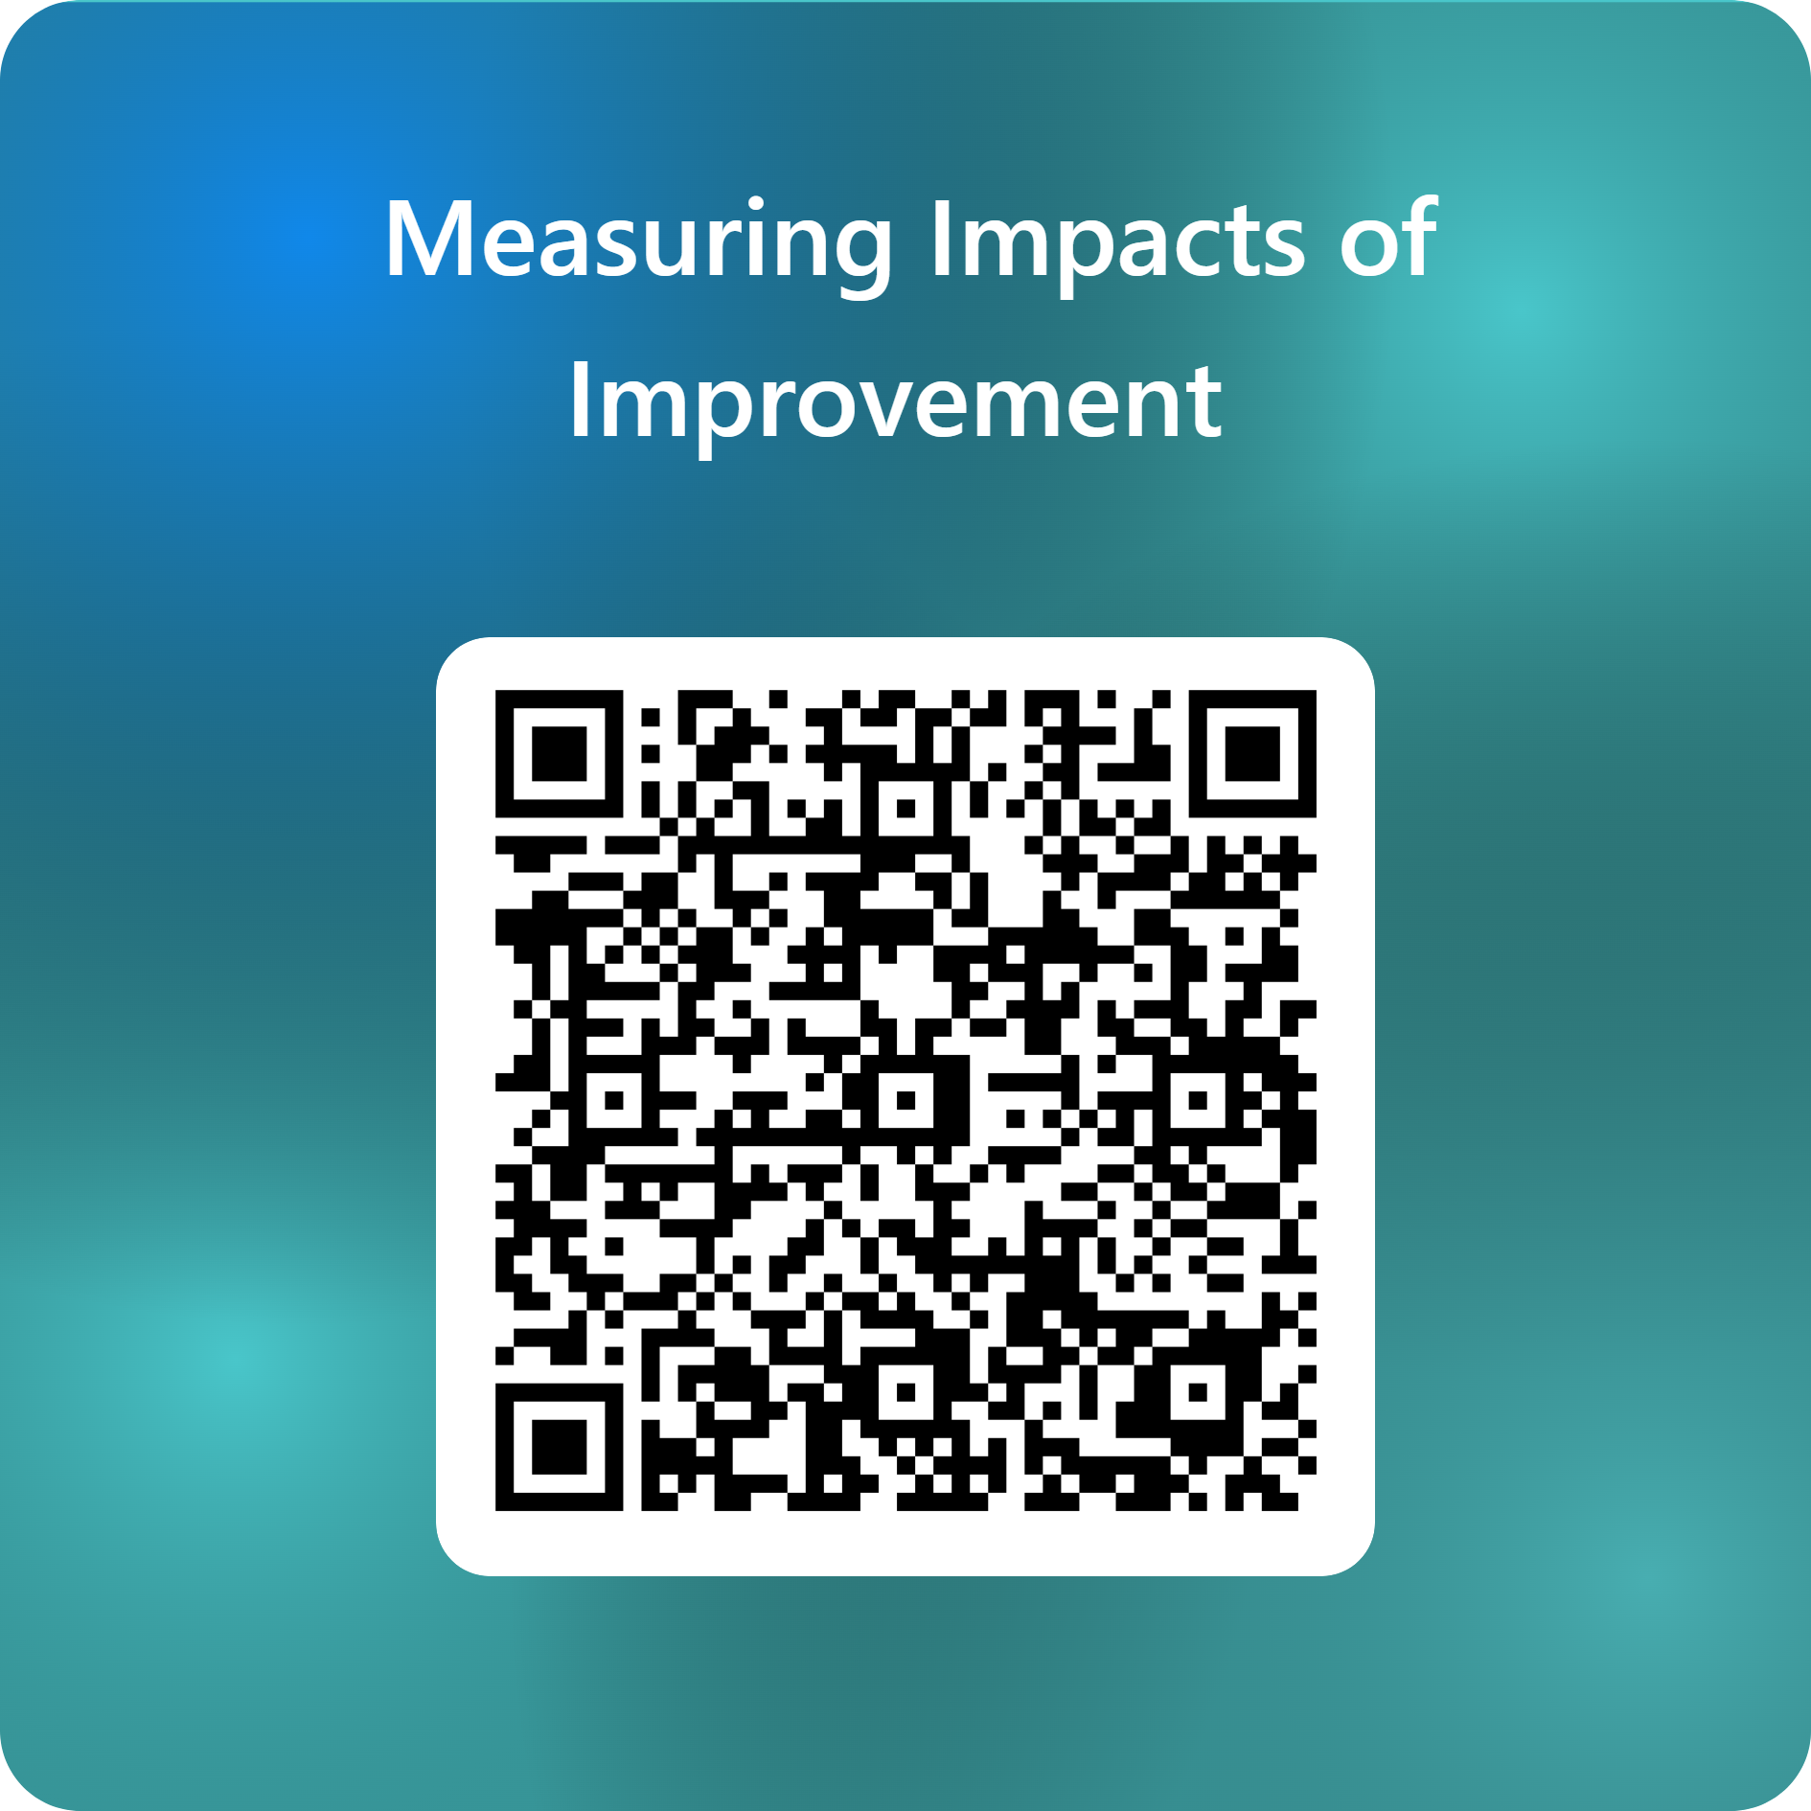
Thank you & Next session
Thank you! Please do complete our feedback form to help us shape future learning sessions.
The next session will be:
26th November: PSIRF Midlands measuring the impact of improvement part 2
This session is for ICBs and providers from across the East and West Midlands who want:
To hear & learn from those undertaking improvement programmes
To hear from Lauren Mosely from NHSE talk about oversight & governance
Details to follow!

