Slide 1
Health Innovation East Midlands: Falls
Sophie Mason, Senior Innovation Lead
15th January 2025

Slide 2

Our support and expertise
One of 15 health innovation networks across England​, we are the East Midlands NHS innovation arm.
With 10 years expertise at adoption of transformative technologies and pathways, via our pipeline we help identify and import solutions to their challenges
We are funded by the NHS – our core support and services are free to local NHS partners

Slide 3
The Agenda
No/Ref | Times | Item
1 | 13.30 – 13.40 (10) | Welcome and Introductions
2 | 13.40 – 14.00 (20) | Targeted medicines review for patients who have fallen and sustained an injury while in an acute hospital trust, Emma Grace, Nottingham University Hospitals Trust
3 | 14.00 - 14.20 (20) | Strategies for delivering falls improvement, Stephanie O'Connell, Leicestershire Partnership Trust
6 | 14.20 – 14.25 (5) | Calls for help
7 | 14.25 – 14.30 (5) | Closing remarks and feedback

Slide 4
Housekeeping
Today’s session is built around appreciative inquiry: Please keep this in mind when asking your questions, as a reminder
Appreciative Inquiry is based on the concept that value increases when you put a focus upon it, it is a core concept in systems thinking as it brings into play the person (us) as part of the system by which we want to change/ influence/ improve.​
Identify the positive aspects of the story, try to draw that our further​
Be curious, ask questions to generate discussion​
Ask questions about what the speaker values, what they would change, what helped them to achieve this milestone.​
Listen and reflect

Slide 5
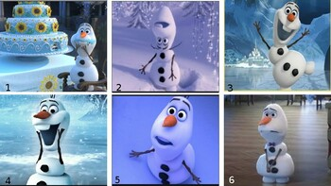
On a scale of Olaf, how are we feeling today?

Slide 6
What area of the East Midlands do you work in?

Slide 7
How confident are you that system-based learning is improving patient safety incidents regarding falls?

Slide 8
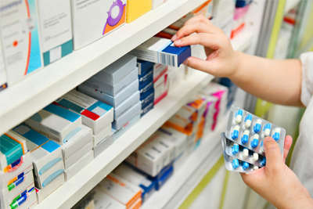
Medicines and falls at NUH
Emma Grace, Lead Pharmacist: Stroke and HCOP
Nottingham University Hospitals NHS Trust

Slide 9
Medicines and falls at NUH - how did it start?
Long been recognised that NICE guidance is challenging to meet consistently – applied ‘ad hoc’.
Opportunity during COVID to trial a programme of actively prompting for targeted medicines reviews after a fall
Supported by EPMA which has allowed some remote reviews
Currently targeting inpatients who have fallen and come to moderate, severe or catastrophic harm
ability to feed into investigations and have a platform for active learning
ensuring patients are safe in the acute setting – adjustments made while inpatient

Slide 10
What were the goals?
To standardise how medicines are reviewed within pharmacy / medical teams following an inpatient fall.
To raise awareness of medicines as a contributing factor to falls.
To gather themes and areas for learning relating to medicines and falls.
To develop teaching and encourage medicines to be considered as part of holistic care in falls prevention and management.

Slide 11
Why target falls?
NICE
British Geriatric Society
NOGG
World Falls Taskforce
Financial, Medico-legal, and moral need

Slide 12
Why target falls?
‘Ensure that any multifactorial assessment identifies the patient's individual risk factors for falling in hospital that can be treated, improved or managed during their expected stay’¹
BMJ Best Practice (Frailty):
  Diagnose and treat any sustained trauma.
  Establish and manage the cause of predisposing factors to fall.
  Conduct a structured medication review.
  Prevent complications of fall.
  Prevent future falls.
  Arrange for multi-disciplinary team assessment prior to hospital discharge²
¹NICE [CG161]: Falls in older people: assessing risk and prevention 12 June 2013
²BMJ Best Practice: Frailty. Last reviewed Dec 24

Slide 13
And for your patient…
Distress and anxiety / reduced confidence
  depression
  impaired rehabilitation
  increased lengths of hospital stay / higher rates of discharge to long-term institutional care
Physical trauma
  Bruising, bleeding (including intracranial)
  Bone fracture (eg wrist, hip, rib, facial, skull)
  Pain
Secondary effects
  Long lie at home
    Hypothermia
    Burns
    Muscle damage → raised CK → AKI
  Infection
For those sustaining a hip fracture: 20% will enter long-term care in the first year after fracture, and there is an increased one-year mortality of between 18% and 33%
Fear of falling is a positive risk factor for future falls.

Slide 14
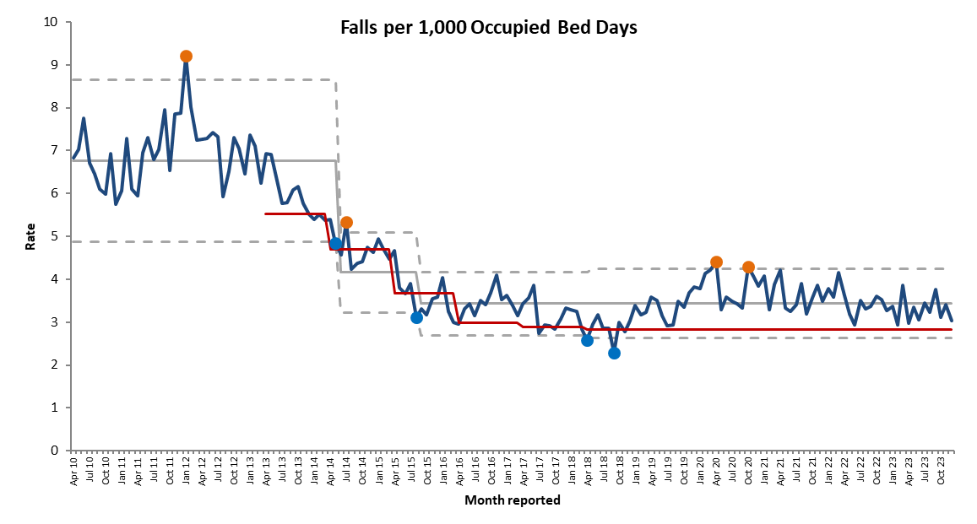

NICE guidance was published 2013.
Falls are not ‘just one of those things’ – with targeted intervention we can proactively reduce.

Slide 15
How does it work?
1. Lead pharmacist receives Datix reports of all falls reported within NUH.
2. With help from colleague, triages falls to filter any patients who have come to moderate, severe or catastrophic harm while in our care.
3. Where possible, ward or specialist pharmacist in that area tasked to review medicines in the light of the fall and injury.
  Encourage ownership and patient / physician involvement in any review
  Where not possible lead pharmacist will support (but may be remotely)
  Developed a proforma to guide what should be included in a structured meds review – ‘learning by doing’.
4. Changes to medicines are actioned or requested via GP if more appropriate.
5. Any learning / themes recorded.
Outcome and learning embedded in formal case reviews (including duty of candour, SI or coroners’ investigations).

Slide 16
Challenges
Currently the service is not funded / commissioned but absorbed into usual clinical work. Struggling with capacity, increased awareness of what we do!
Inefficient method of filtering out patients for review, including checking imaging requests after any fall.
    Currently setting up dashboard to assist, but this may involve delays as some incidents get upgraded following investigations.
Reactive – does not pick up patients who have not sustained injury but remain at risk of future falls and harm.
  capacity does not allow every patient fall to have a centralised review, but continue to encourage local review for those coming to low or no harm or who are at risk of falling

Slide 17
Specific interventions and outcomes
Contributed to coroner’s cases and SI investigations (with both learning and commending positive care)
Fed into directorate governance where use of new hypnotics in hospital was linked to several falls
    Along with primary care colleagues developed APC guidance on use of hypnotics
    Developed ‘sleep hygiene in hospital’ guide to support
Delivered teaching on medicines and falls to pharmacy, nursing, therapy and primary care teams
Contributed to MDT learning for holistic care eg making nursing / physio staff aware of key medicines that may highlight a patient needing additional supervision
Developed relationships with directorate level safety teams which has opened opportunities to support more globally with medicines safety and harm-free care.

Slide 18
Positive outcomes / learning
We can’t prevent every fall, but….
Ability to make patients safe as soon as possible during their hospital stay
Embeds learning / standardise review of medicines post fall
  Promoting application to all clinical areas (not just within HCOP)
  Proactive support for colleagues in Haematology / Oncology
Allows structured and specific feedback to hospital and primary care teams
Opportunity to recognise and share positive interventions and pre-emptive care

Slide 19
The future…?
Starting work to refine findings from the last 4 years
    eg most common medicines contributing to falls , proportion of falls reviewed that resulted in change to medicines.
Supported by established Frailty pharmacy team who offer more proactive review for patients admitted via frailty pathway.
  Considering how to in-reach to ‘at risk’ patients in other directorates and upskill others
Linking into bone health teams and promoting fracture prevention
Consider if the programme is sustainable in its current form with current lack of funding / capacity, and what the most efficient way to deliver may look like in future.

Slide 20


Slide 21
Strategies for delivering Falls improvement
Steph O’Connell
AHP Lead and Clinical Director,
Community Health Services, Leicestershire Partnership Trust

Slide 22
Background to LPT
Community Trust with 3 directorates – each with different Falls issues
Community Health
Mental Health
FYPC LDA
12 wards over 7 hospital sites
Frail elderly
Rehab + medical step down
D2A
Adult Mental Health 15 inpatient areas over 2 sites
MH services for older people 4x wards
Huntingdon’s Disease Unit
CAMHS
Eating Disorder Units
Learning Disability Units
Notes:
My Background – chair Organisational Falls Steering Group – looks at data, themes, best practice, learning from incidents
22

Slide 23
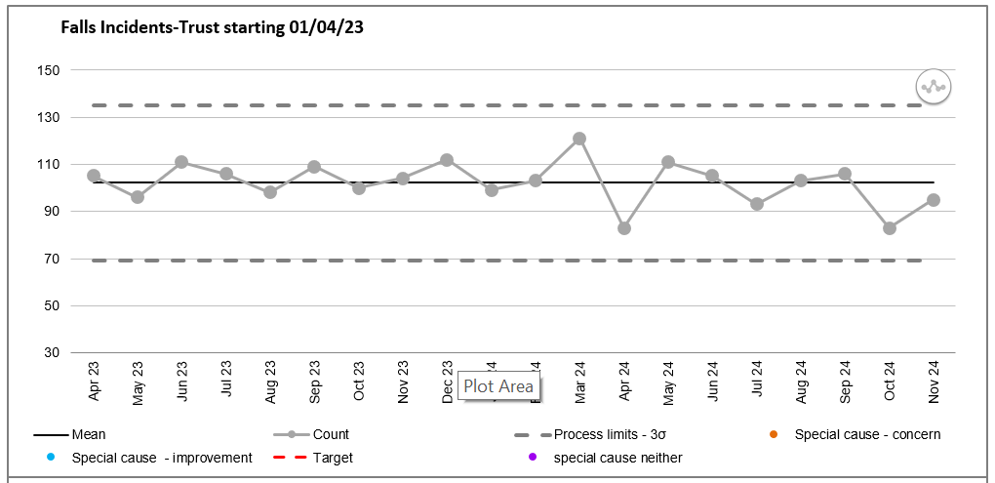

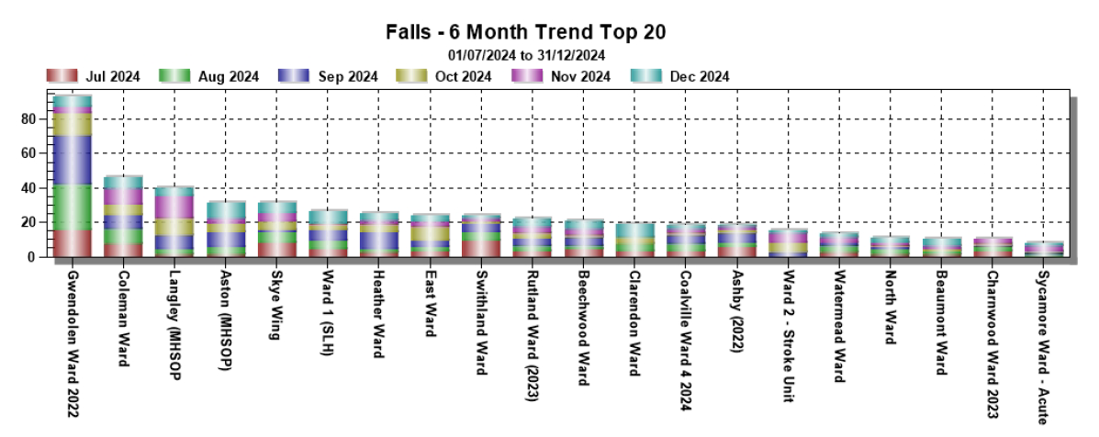
Falls Performance
Policies
SOPs
Benchmarking
Investigations
Audits
Training
Notes:
Focus on inpatients
Organisation SPC
Direstorate
Ward
Huddles, location, time, themes
23

Slide 24
LPT Approach
Make it easy as possible for the staff to do the right thing
Directorates and local teams needed to own the local falls agenda
Encourage professional curiosity and critical thinking
Approach needed to be meaningful and bespoke to the specific patient cohort
Tailored approach in each directorate based around common principles
Clear expectations of local teams in terms of local scrutiny and governance
Monthly feedback into LPT Falls Steering Group and quarterly reflective Deep Dives
Notes:
So what
24

Slide 25
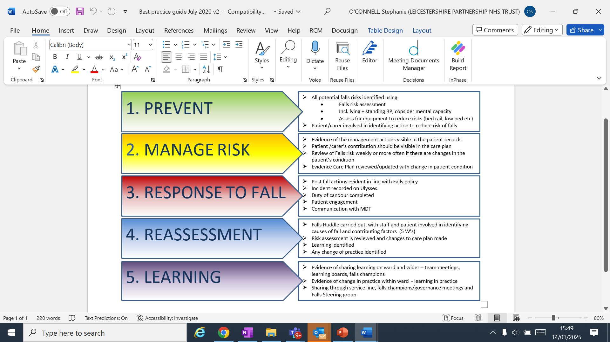
Principles of Falls Management

Slide 26
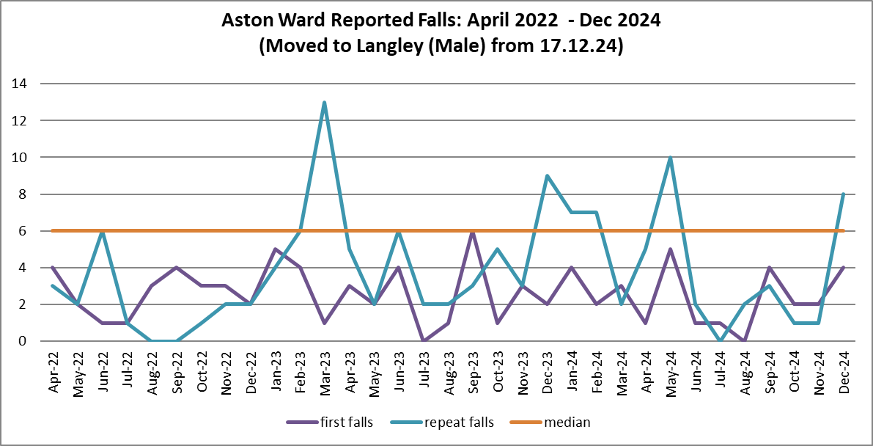
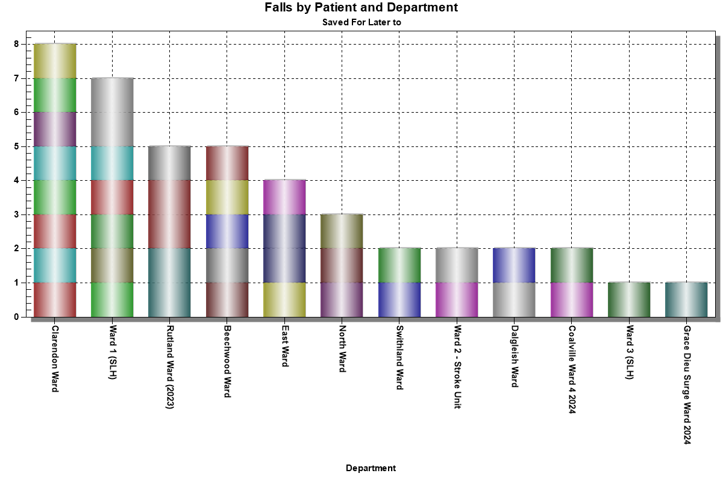
Local Ownership
Ensure robust local data e.g.
    Incidents first and repeat falls
    Time / location / compliance etc
Compliance with policy / Falls Huddles / post falls
Incident outcomes + learning
Identify THEMES
Improvement activity
Deep Dives
Notes:
Focus on repeat falls
26

Slide 27
Directorate responses
Examples of applying principles in a bespoke way
Community Health
Mental Health
FYPC LDA
Ward Validation meetings
Falls Champions
Screening tools – safe bed management tool
Directorate meetings
Virtual Huddles
Management of physical health issues
Quarterly reviews
Adapting falls principles and pathways to teenagers/young adults
Cross Directorate work examples: Embedding Flat Lifting across all sites / benchmarking learning from NAIF / Anticholinergic Burden and link to increase risk of falls
Notes:
27

Slide 28

Thank you for listening!
Any questions
or thoughts?
stephanie.oconnell@nhs.net
This Photo by Unknown Author is licensed under CC BY-NC

Slide 29
Call for help
A 5 min section thrown open to those attending to ask a question on anything PSIRF related to their peers…
HIEM are looking for speakers (including PSPs) for the next themed events if you or someone you know has learning to share, please do let me know!
  10th Feb 3 - 4:30pm – Plan for sustainability (midlands wide + guest speaker)
  26th Feb 2:30 - 3:30 – Medication
  5th March 11:30 - 12:30 – Pressure ulcers
  14th March 10 - 11am – Managing deterioration
Last in the series is a webinar on safety management systems with a speaker already confirmed – Brook Howell

Slide 30
After hearing today's speakers, how confident are you that system-based learning is improving patient safety incidents regarding falls?

Slide 31
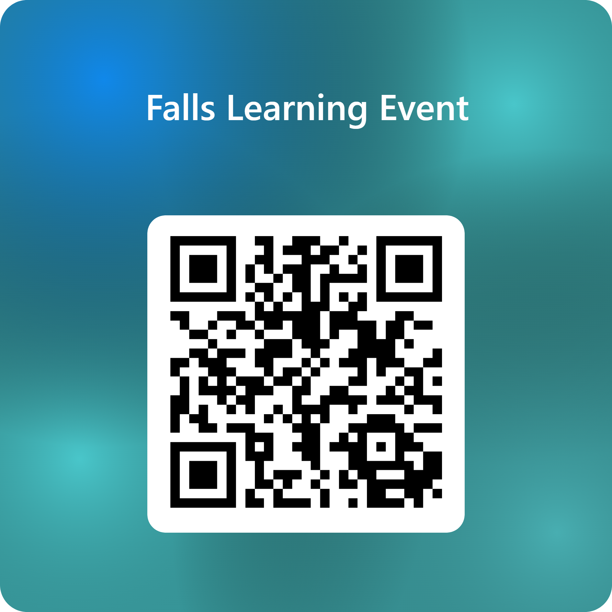
Thank you & next session
Thank you! Please do complete our feedback form to help us shape future learning sessions.
The next set of sessions will focus on the key priority areas as included in your PSIRPs:
Planning for Sustainability (Midlands) – Monday 10th Feb 3-4:30pn
Medication – Wednesday 26th Feb 2:30-3:30pm
Pressure Ulcers Wednesday 5th March 11:30-12:30pm
Deteriorating patients Friday 14th March 10-11am
End of Year webinar: Safety Management Systems 1:30-3pm

