Slide 1


AirEmail Digital Tool
Protecting NHS patients and staff from email overload
©2024 Proprietary and Confidential. All Rights Reserved.

Slide 2








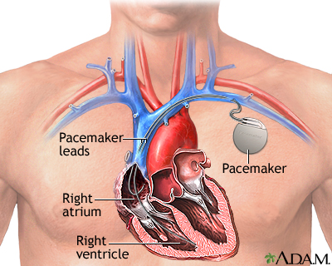

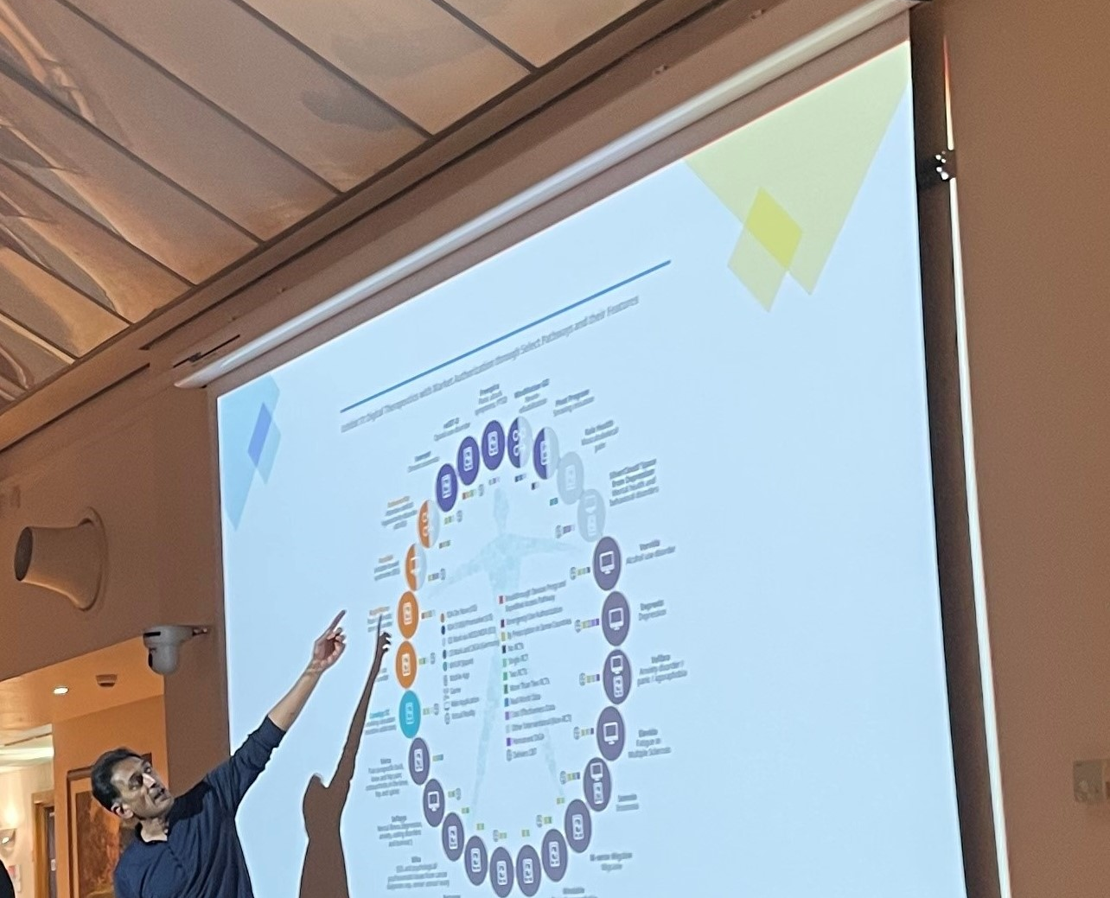
ABOUT ME
Ameet Bakhai MBBS, MD, FRCP
Co-Founder AirEmail
Consultant Cardiologist
R&D Clinical Director
Chief Research Informatics Officer
Clinical Safety Officer

Slide 3


THE PROBLEM
Not able to Cope with Email Traffic
>1 million emails daily will be never read in the NHS
Annually:
Estimated 19 million patient emails will be “missed”
~1 million patients care will be delayed with potential harm
>20 patients per organization per day will have care delayed and potential harm due to unread emails
Senior Coroner 2024 – Prevention of Future Deaths Report – Death of Mr AH, Age 51 Teacher, due to Email triage delay
©2024 Proprietary and Confidential. All Rights Reserved.

Slide 4

SHINING A LIGHT SURVEY:
EMAIL OVERLOAD > STAFF BURNOUT
N = 3,047 NHS Staff, May 2020, UK Wide Survey Study
31%
47%
1 in 3 Find email unmanageable at work
1 in 2 Use home time to process emails
57%
64%
1 in 2 Cannot switch off when they want to
“Just Checking”
2 of 3 Core work disrupted by email
https://www.ncbi.nlm.nih.gov/pmc/articles/PMC9676904/
©2024 Proprietary and Confidential. All Rights Reserved.

Slide 5

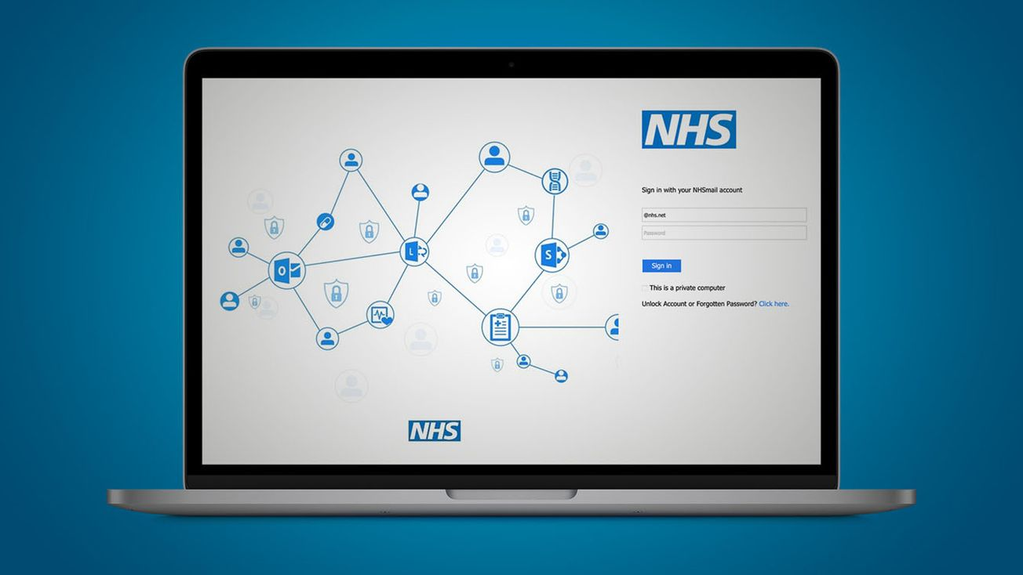
AIREMAIL SOLUTION
An Outlook Addin tool designed for healthcare email
The only email application approved for NHSmail integration
The only digital communications tool validated in a clinical trial*
Scalable, adaptable, affordable, user friendly
NHS DigiWell Study 2024
©2024 Proprietary and Confidential. All Rights Reserved.

Slide 6

BENEFITS – NHS DigiWell Trial
66 Unselected NHS Staff, ~380,000 Emails, 14 weeks each, over 8 months 2024
AirEmail Improve Clinical Safety
Reduced unread emails by 36% in 2 weeks (P<0.001)
AirEmail Improve Productivity
Faster patient email response by 12 hours (17% faster) (P<0.001)
Releases 30,000 working days annually in a typical hospital – reduced email triage time
AirEmail Improve Wellbeing
Decreased staff anxiety HADS Score by 13% (P=0.01)
AirEmail – NHS IT Support to Deploy – NHS-D approved
< 1 day to whitelist and create a security group
©2024 Proprietary and Confidential. All Rights Reserved.

Slide 7
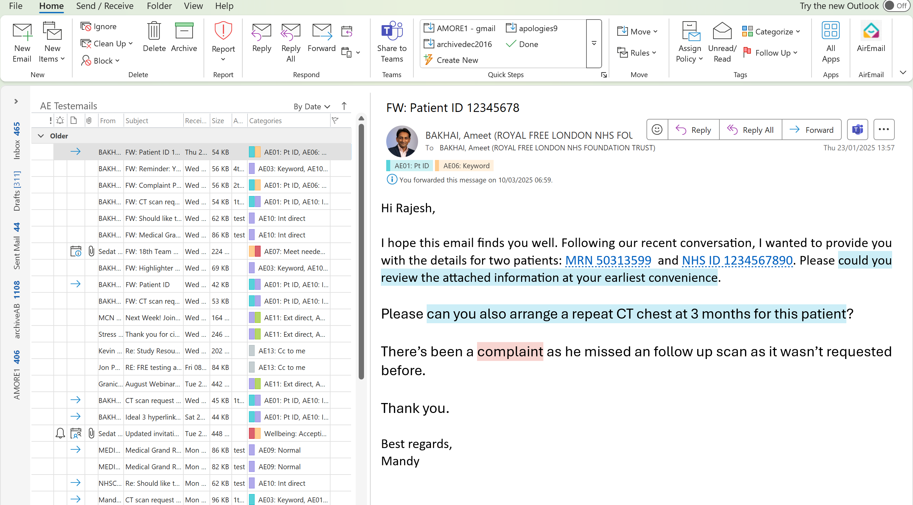
My Outlook – See AirEmail Add in
Improves
Patient & Clinical Safety
My Email
Improves
Productivity
AirEmail Email Triage has processed your email and
Found and blue highlighted a task in the text for you
Found 2 patient number identifiers
Placed hyperlink options on them both
Added an NHS Blue Patient Category to the email
Found and highlighted a Keyword “complaint”
Added a Keyword Category on the email
Colour coded the category Amber as High Priority
©2024 Proprietary and Confidential. All Rights Reserved.

Slide 8
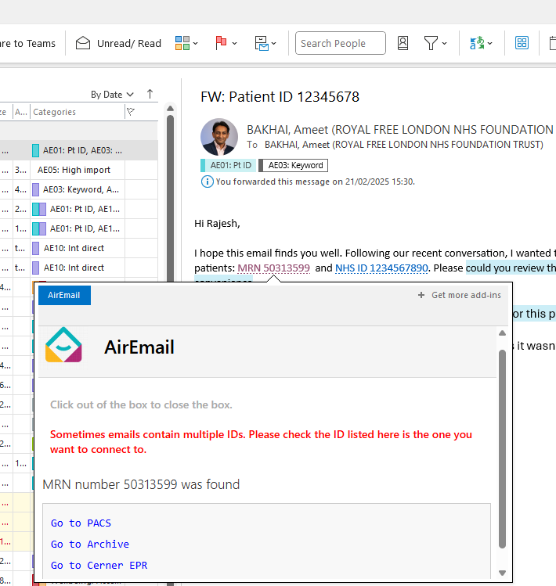
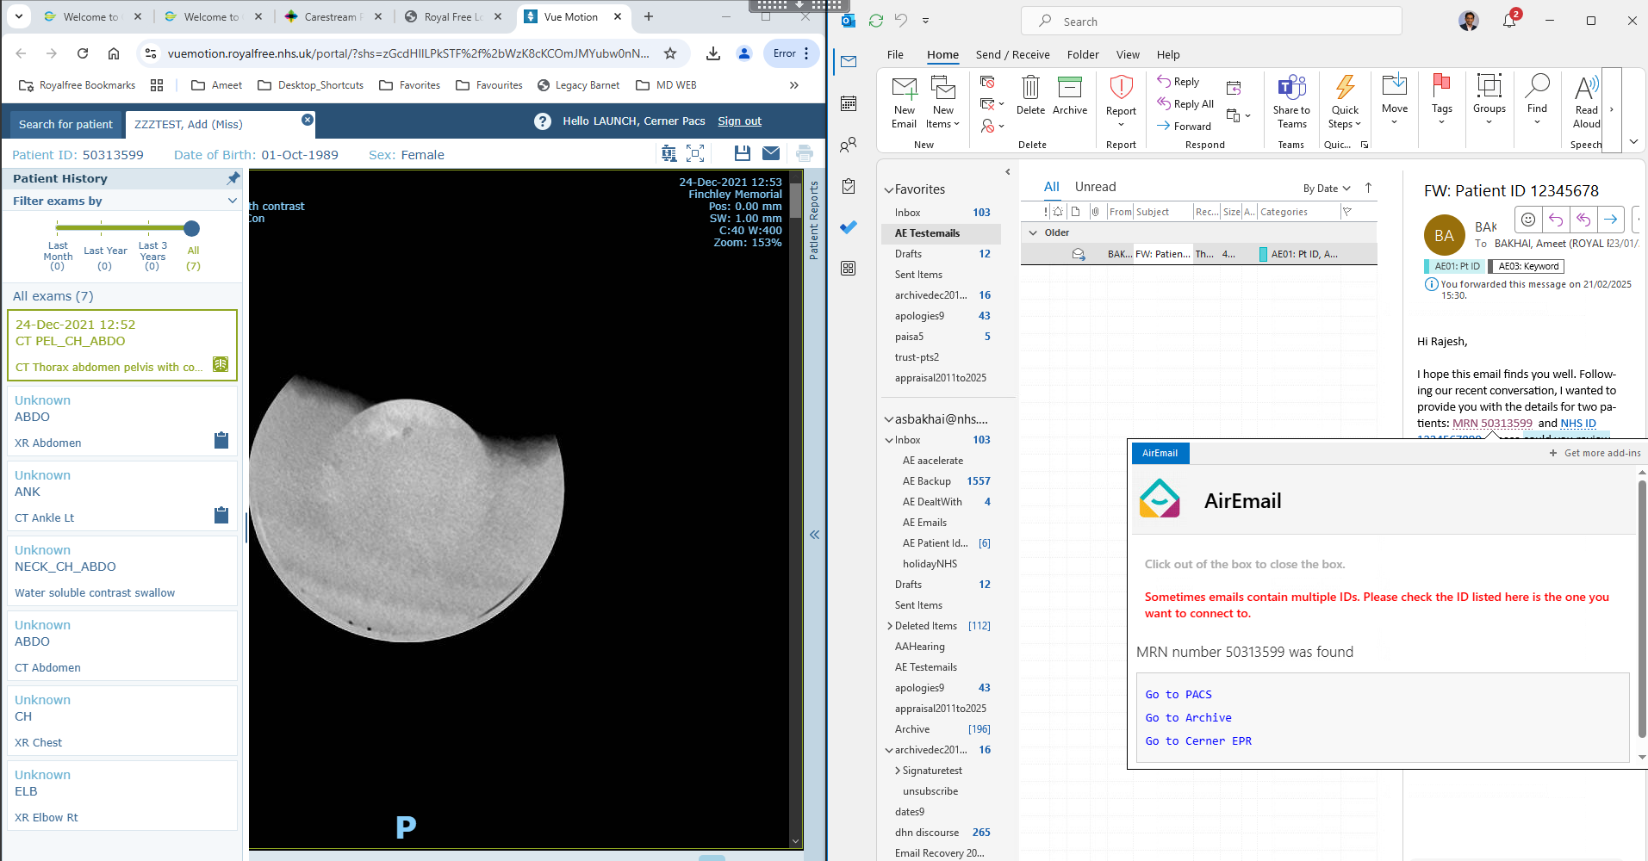
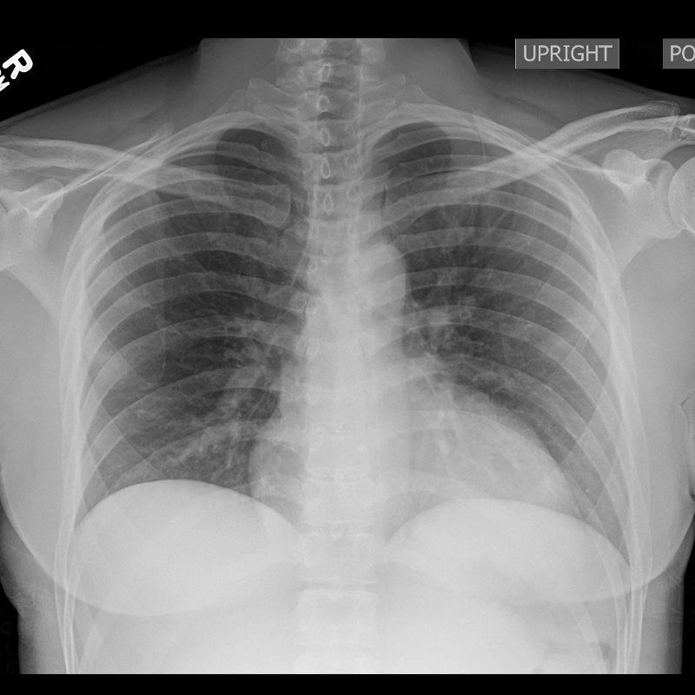
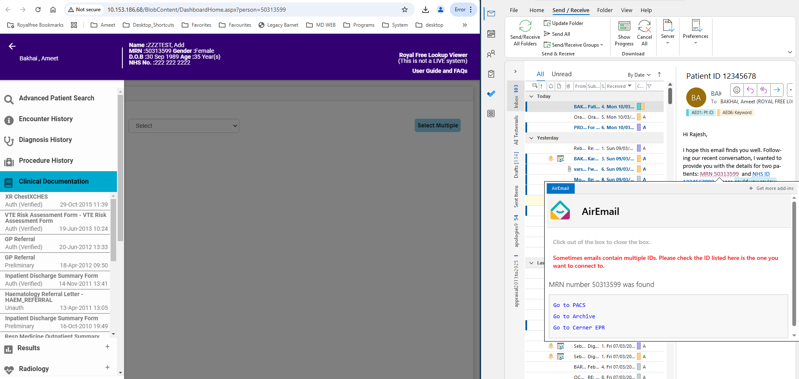
AirEmail is the 1st System to integrate Outlook to Clinical Systems such as Xrays (Top Right) and Medical Records (Bottom Right)
AirEmail has
Placed a hyperlink option on the patient Medical Record Number in the Email
Allows an options box to open up
AirEmail then allows you to open Xrays or Medical Records directly from the Email
Saves times and Prevents Human Errors
Outlook Email with
Patient Number
Xray System VuePACS
Improves
Productivity
Improves
Patient & Clinical Safety
Medical Records System - Nautilus
©2024 Proprietary and Confidential. All Rights Reserved.

Slide 9
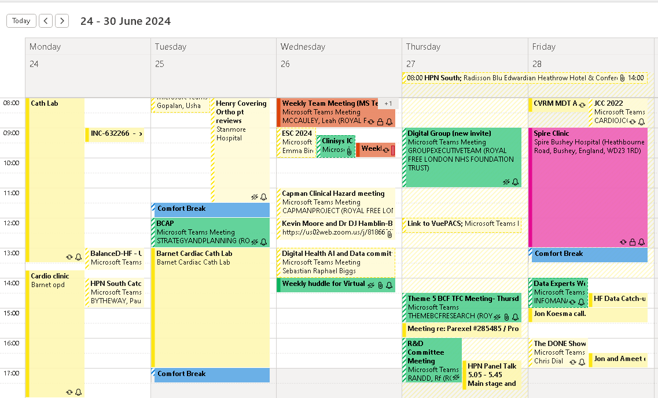
Outlook Calendar
Improves Wellbeing
AirEmail Comfort Break feature
Has automatically added comfort breaks in after 3 hours of meetings
©2024 Proprietary and Confidential. All Rights Reserved.

Slide 10
AirEmail Digital Tool
Protecting NHS patients and staff from email overload
Vision – give staff time back to care and share making email manageable and safe using intelligent automation (IA)
Innovation - 1st Healthtech Outlook addin evidenced to improve patient safety, staff productivity and reduce anxiety. 1 in 3 staff improved work life balance after 2 weeks
Originality
  1st Healthcare Email Triage and Assist Tool
  1st rigorous clinical trial: NHS DigiWell
  1st to Hyperlink to Clinical Systems ( Next: Admin, Finance, R&D…)
  Microsoft: Complimentary to Co-Pilot
Potential Impact
  1.7 Million NHSMail users, > 1.6 Million social care users
  > 49 Million healthcare staff USA and EU
  > 400 Million Outlook users & > 4 Billion Email users
©2024 Proprietary and Confidential. All Rights Reserved.

Slide 11
Estimated Cost & Return On Investment (ROI) AirEmail
AirEmail Cost¹:
100 users: £30,000 pa (£25 per user/month)
1,000 users: £48,000 pa (£4 per user/month)
10,000 users: £120,000 pa (£1 per user/month)
Hospital Savings (Y1): A typical mid-large hospital (10,000 users) has:
Litigation: £7M pa (75,000 per unresolved claim)
Email labour: £150M pa (2 hours on email per day on average)
Cost of replacing leavers: £4.8M pa (4% attrition rate, £12,000 per leaver)
5% improvement with AirEmail (Year 1): Estimated ROI ~£67x £1 (£4 x £1 cash releasing in Year 1)
Invest £120,000, Estimated Cash release: £590,000 Year 1 and Efficiency savings: £8M
¹Includes training, local configuration and application support. 10% discount in subsequent years.
©2024 Proprietary and Confidential. All Rights Reserved.

Slide 12
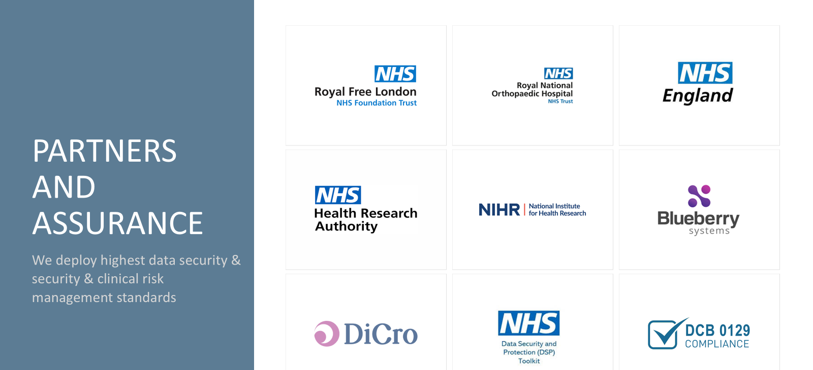




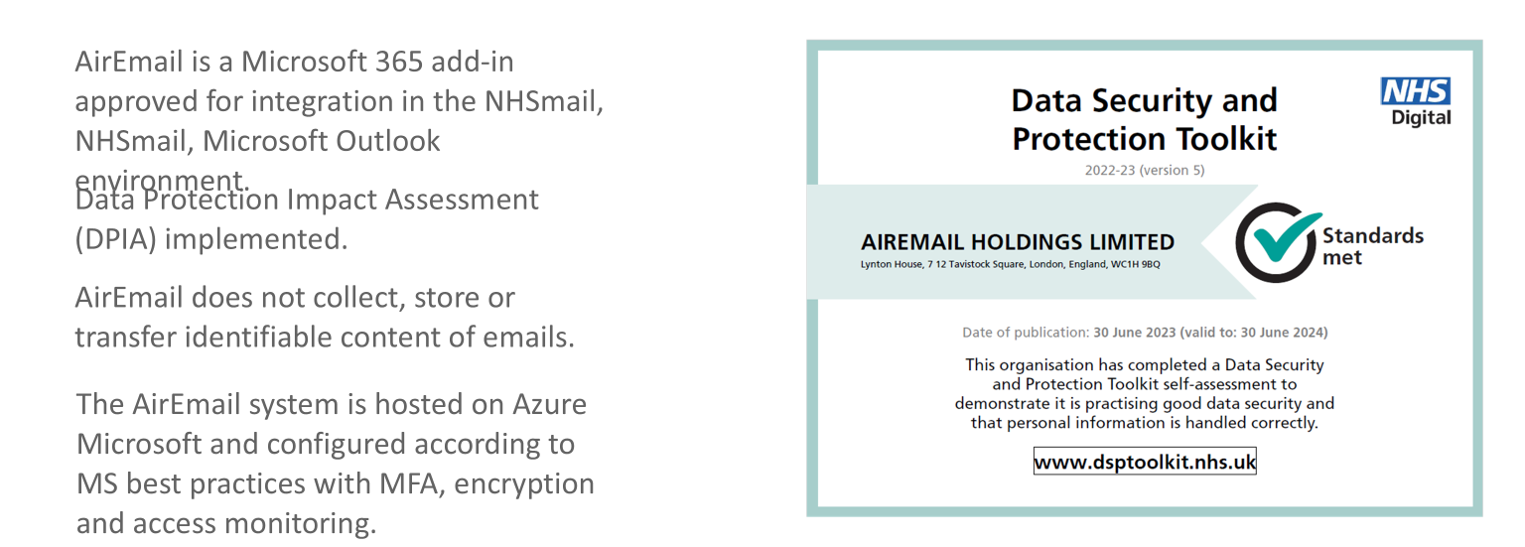
©2024 Proprietary and Confidential. All Rights Reserved.

Slide 13
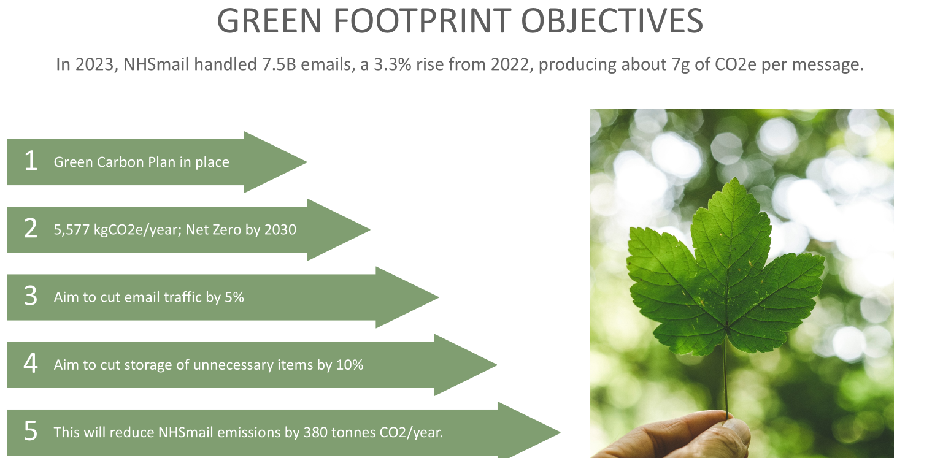
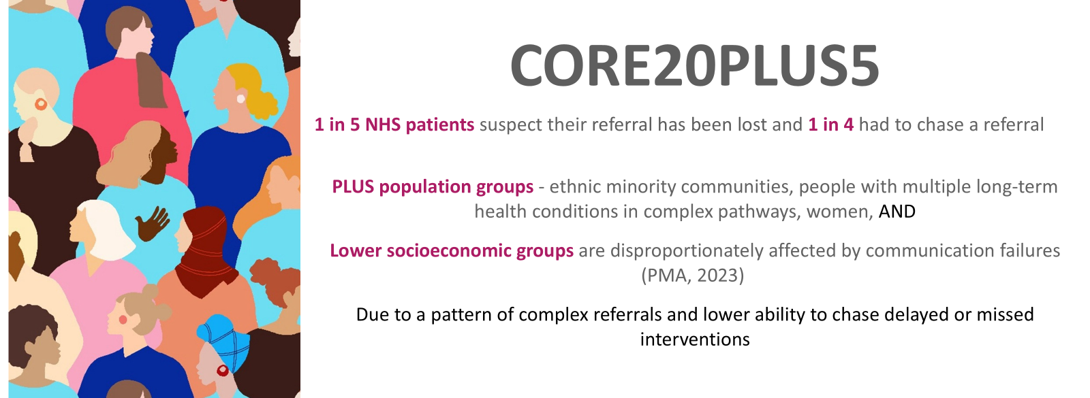
THE ASK
Ameet Bakhai
www.airemail.co.uk
Ameet@airemail.co.uk
We would like to speak with Digital Leaders, Transformation Managers, CIOs, CDO, CCIOs, CMIOs, CNIOs, PALS, Litigation and Communications teams
We can offer a sub-funded trial for <50 staff for 6 months (£10,000 pa)
Reduce the Email Dread of Holiday Return
Trial AirEmail
THANK YOU!
AirEmail could reduce unread emails by 10%
NHS Email growth is 3-4% annually
AirEmail can help NHS.net Connect reach Net Zero
AirEmail can be evolved to manage 2 way patient emails and encourage eHealth
Ref: Multimorbidity, eHealth and implications for equity: a cross-sectional survey of patient perspectives on eHealth BMJ Open 2019
©2024 Proprietary and Confidential. All Rights Reserved.

Slide 14
Back Up Slides

Slide 15



UNIQUE STUDY METHOD
Informed consent to take part in the study – NHS Staff
Participants load AirEmail into
"Silent Mode"
Email statistics data collection - without AirEmail
Participants use AirEmail features “Active Mode”
Email statistics data collection - with AirEmail
60-day prior to loading AirEmail
2-week Before-Study Control Period
2-week Onboarding Period
After-Study Control Period
Study consent
8-week Active Period
Retrospective email statistics data collection - without AirEmail
Participants complete AirEmail training (~30 minutes minutes)
Email statistics data collection - without AirEmail
“Offboard Mode”
Participants completed 5 surveys (Baseline, Onboarding, Active Period Weeks 2 and 8, and study end). NHSE approval obtained to collect NHSmail statistics data using Microsoft Graph permissions.
©2024 Proprietary and Confidential. All Rights Reserved.

Slide 16



AIREMAIL FEATURES
Function
Saves time
Improves safety
Improves wellbeing
Highlighter
Highlights key words and tasks
Patient ID detection
Detects and hyperlinks Patient IDs (NHS Numbers, MRNs)
Smart Categories
Assigns priority categories and colours to inbox emails
Don't Drop the Ball
Tracks progress on tasks
Daily Meetings Alert
If accepted meetings exceed 4 hours per day
Dealt With
Automatic filing of completed emails
Comfort Breaks
Schedules breaks between meetings
Meetings Invite Viewer
Displays emails from the meetings organiser
Templates
Creating and sharing of advanced email templates
Meeting Scheduler
Complex meeting scheduler with integrated poll
Going on Holiday
1-click decline of accepted meeting during leave
Auto Decline
Declines invites clashing with important commitments
©2024 Proprietary and Confidential. All Rights Reserved.

Slide 17
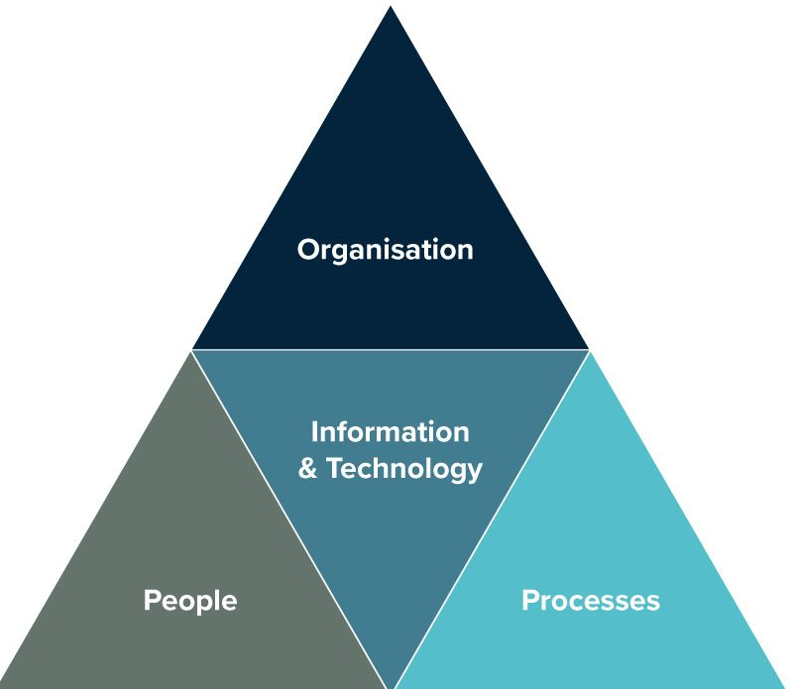
DEPLOYMENT
NHS Trust IT support requirement is limited – estimated at 0.5 days
People
AirEmail is deployed to:
  Individual users’ personal email addresses
  Shared mailbox accounts such as email addresses used to process patient queries and referrals
Training: online training resources and user training are provided, 20-minute training recommended
Organisation
AirEmail supports EPR-systems, providing back-up and connection between systems
Alignment with trust priorities:
  Deliver high quality-quality, patient-centred care; reduces the risk of patient emails being missed or response delayed
  Be the employer of choice; lowers email workload. a significant source of technostress and overtime
Staff productivity KPIs: efficient email handling
Funding sources: Educational funds can support efficient email practices training and AirEmail roll-out
Processes
AirEmail-detected Patient ID hyperlinks can integrate with local EPR-systems (such as EPIC, Cerner, Vue PACs, Archive)
AirEmail Clinical Safety Officers and pathway experts support pathway implementation, including referral and booking pathways and administrative pathways, such as R&D, complaints
Required ICB approvals: information governance (DPIA), clinical safety (DCB0129)
Support for NHS DCB0160 processes available
Information & Technology
AirEmail is approved for deployment by NHS England
Collaboration with Accenture and Avanade IT Teams allows for secure and rapid deployment
Microsoft Azure platform – scalable 1.7 M users
AirEmail is supported by a helpdesk, Monday – Friday, 9.00am – 17.00pm
NHS Trust IT support requirement is limited – estimated at 0.5 day at the start to set up an NHSmail Security User Group and whitelist access to airemail.co.uk
©2024 Proprietary and Confidential. All Rights Reserved.

Slide 18
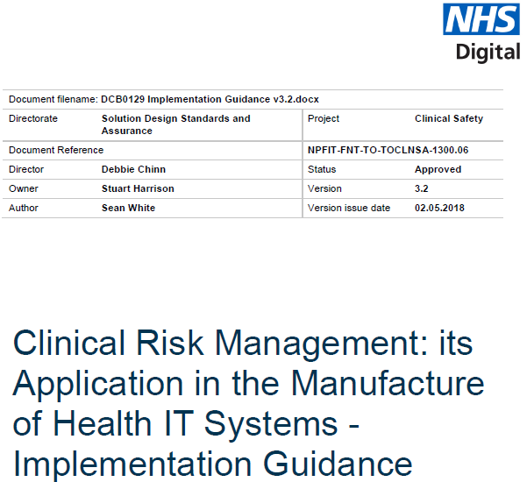






CLINICAL SAFETY & NHS DELIVERY
A Clinical Safety Officer oversees compliance with DCB0129
Hazard Log implemented, all risks ≤2 with current controls
2015 NHSMail contract: Accenture (Avanade Cloud)
~1.7 M users, 2.1 Mailboxes, 2 Petabytes Data
£160 M contract to 2023. Extended for 2 years
NHSMail > NHS.net Connect 2025 . MS and Avanade
AirEmail to become Avanade and Microsoft Partner
Clinical Safety Case Report produced
Incident reporting process implemented
DCB019 CLINICAL RISK MANAGEMENT STNADARD
©2024 Proprietary and Confidential. All Rights Reserved.

