Slide 1


Slide 2

Notes:
4. Literacy
Print Disabilities
Dyslexia – 10% of the population Specific Learning Dificulties
Mild Visual Impairment – ¼ million
English as a Second Language/Foreign Nationals – Over 500k, 1 in 9
Low Literacy – 17% of the population, 1 in 6
On average 10% of the working population have dyslexia and depending on your industry this increases in sectors such
Blue light services (police, fire, nursing, social care), creative arts, agriculture, NFU estimate 25% of farmers, and in areas such as architecture and engineering
This rises to an estimated 40%
In England 14.9% of adults aged 16-65 lack functional literacy skills. This equates to 5.1 million people.
The challenge is intergenerational and closely linked to poverty. Up to 40% of the adult population in the UK’s most deprived wards lack the literacy skills expected of an 11-year-old.
A report by the National Literacy Trust "Understanding the role of literacy in public health", shows that these people with low literacy are "up to 18 times more likely to take their prescriptions incorrectly, are significantly less likely to understand the symptoms of a medical condition such as diabetes or asthma and are more likely to rate their health as 'very poor' than people with better literacy skills."
Whereas people with good literacy skills "are more likely to have higher self-esteem, better health, better jobs and higher wages than those with poor literacy skills. They are more able to take advantage of the opportunities that life may offer them,“
Illiterate people earn 30%-42% less than their literate counterparts and do not have the literacy skills required to undertake further vocational education or training to improve their earning capacity (World Literacy Foundation)
The cost of illiteracy in Ireland is around 3.2Billion per year to the Irish Economy, (WLF)

Slide 3
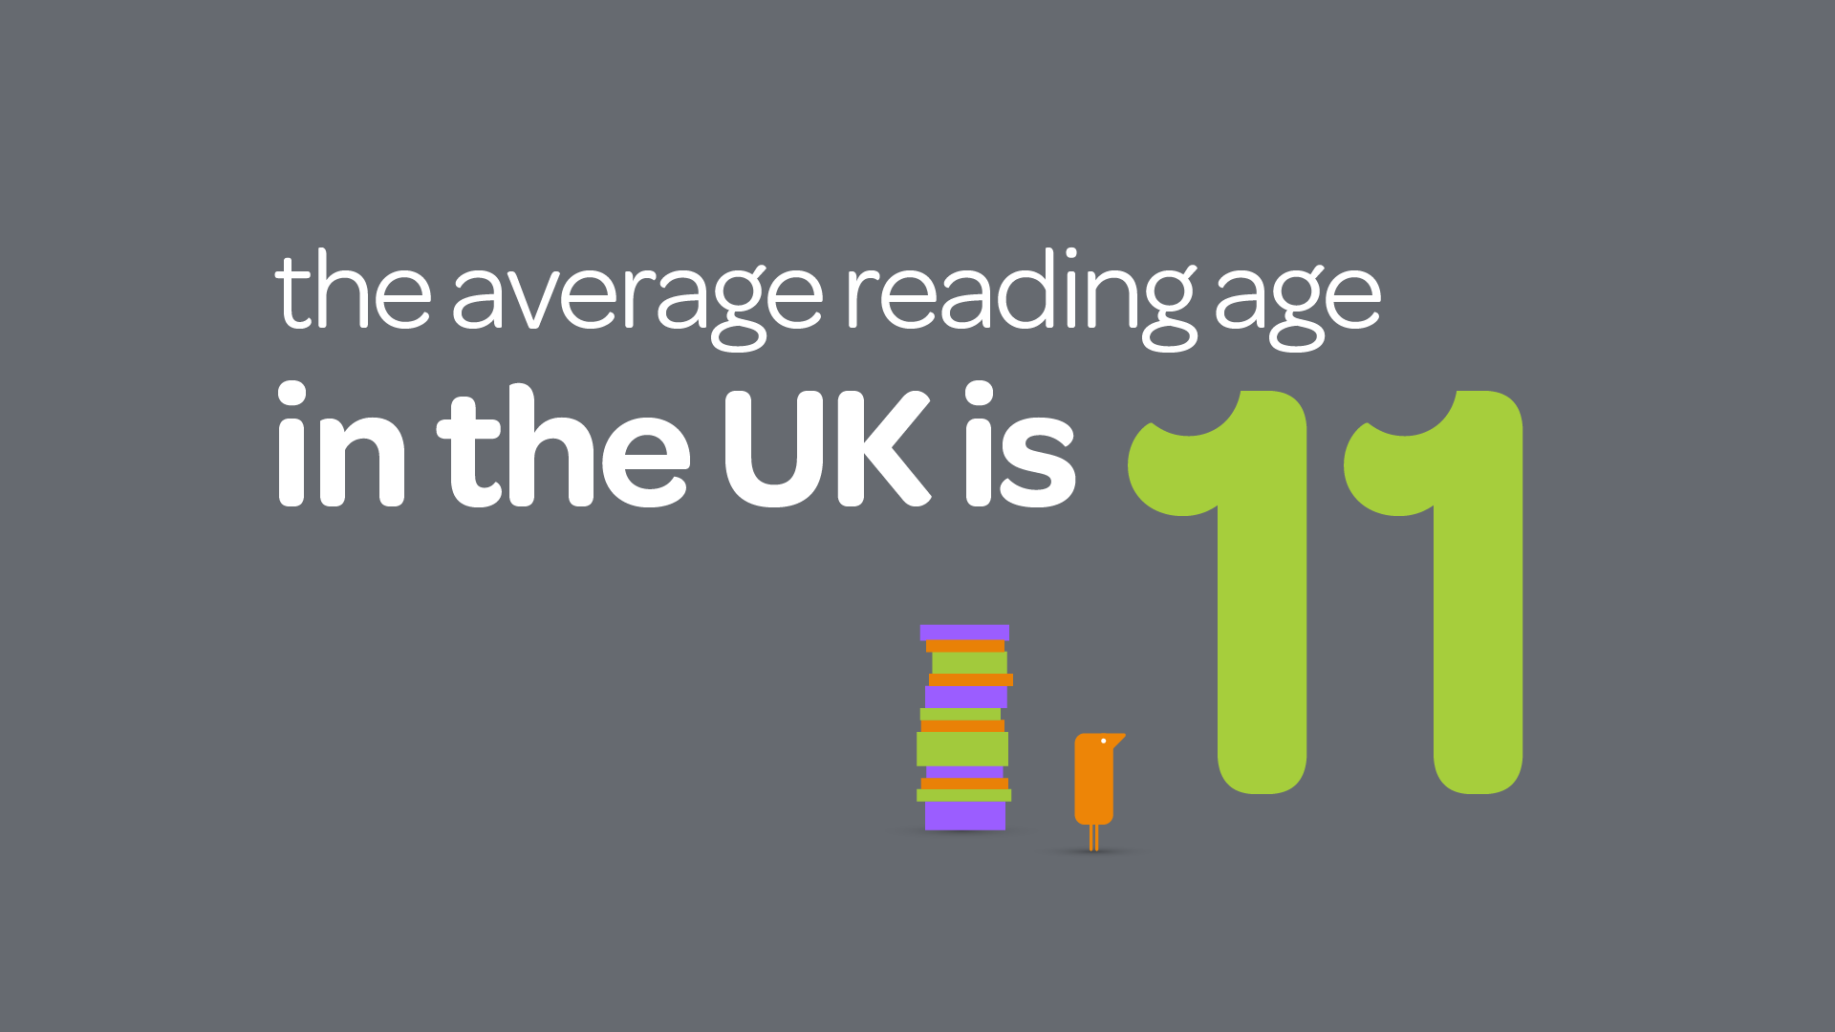

Notes:
Prison stats

Slide 4

Dyscalculia
Excellent verbal communicators,
Intuitive
Dyspraxia
Dyslexia
Innovative, with good social awareness of others
Visual thinkers,
with Creative Ability
Sound Processing
Neurodiversity
3D mechanical ability
ASD
ADHD
Autism Spectrum Disorder
High levels of concentration,
Fine detail processing &
Sequencing
Attention Deficit-Hyperactivity Disorder
Creative ability, Novel Thinkers with
Energy & Passion
Tourette’s
Creative ability, with good Cognitive control
Notes:
Neurodivrse talent brings a number of strengths to your organisation

Slide 5
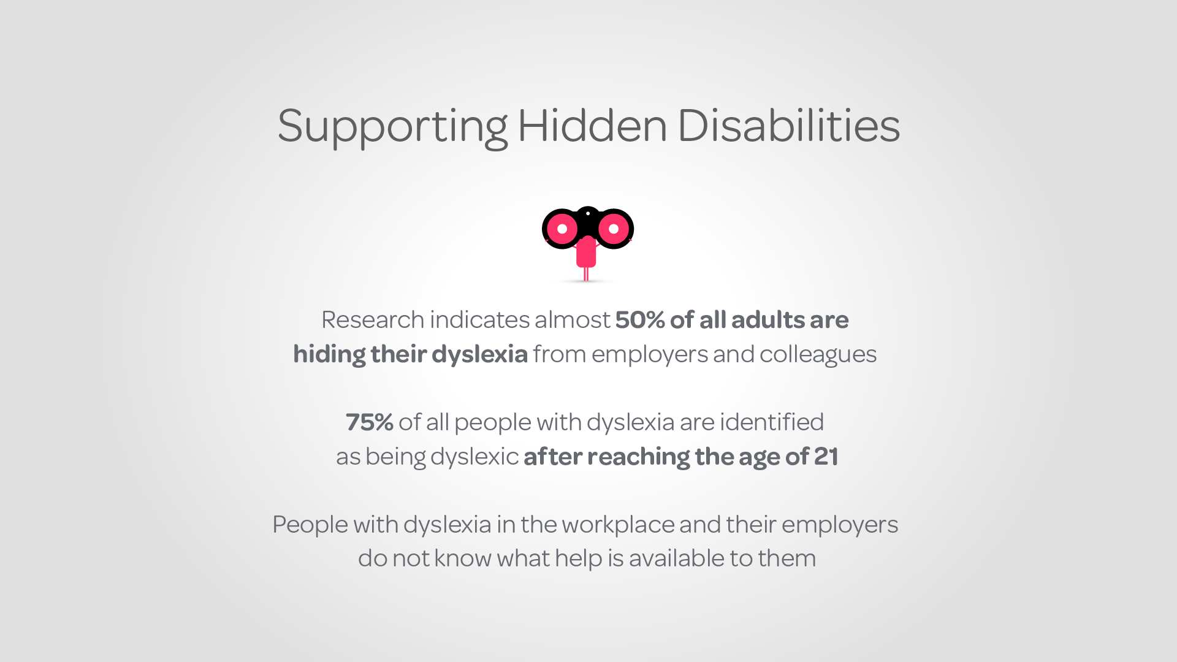

Slide 6



time spent on emails
Emails received per day (on average) | 30
Extra time needed to process email | 3 minutes
Total time spent processing information per day | 90 minutes
Total time spent processing information per week | 7.5 Hours per week
Notes:
That is

Slide 7


a software solution for everyone
Notes:
With this in mind we have developed a solutions called RW

Slide 8


at work
at home
on the move
Notes:
One licence lets customers use read&write on multiple devices - use it on a PC at work, the laptop at home and on iPad or Android tablets on the move

Slide 9


helping everyone to work smarter
Composing
emails
Writing reports
Undertaking research
Notes:
Helping everyone to work smarter...
… with everyday tasks like composing emails, writing reports or undertaking research

Slide 10
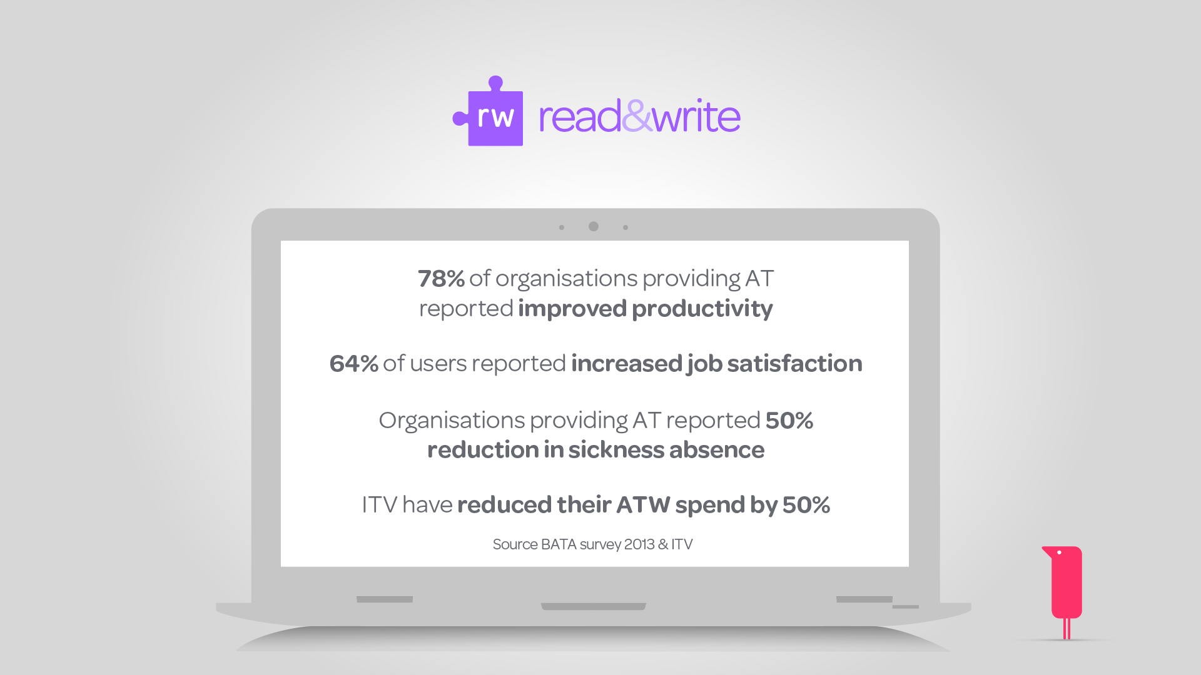
Notes:
VIDEO NEXT

