Slide 1


100% online CBT
for depression, anxieties, and psycho-trauma
Vision: “Support when it matters”
80% of all online treatments
in The Netherlands
Strategic collaboration with Parnassia

Slide 2
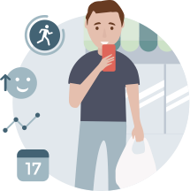
>30%
Of ALL clients treated 100% online

Slide 3


>30%
NPS 43
Of ALL clients treated 100% online
Great user
experience

Slide 4

>30%
NPS 43
OQ 45
Of ALL clients treated 100% online
Great user
experience
As effective as
traditional care

Slide 5

>30%
NPS 43
OQ 45
30%
Of ALL clients treated 100% online
Great user
experience
As effective as
traditional care
More efficient than
traditional care

Slide 6
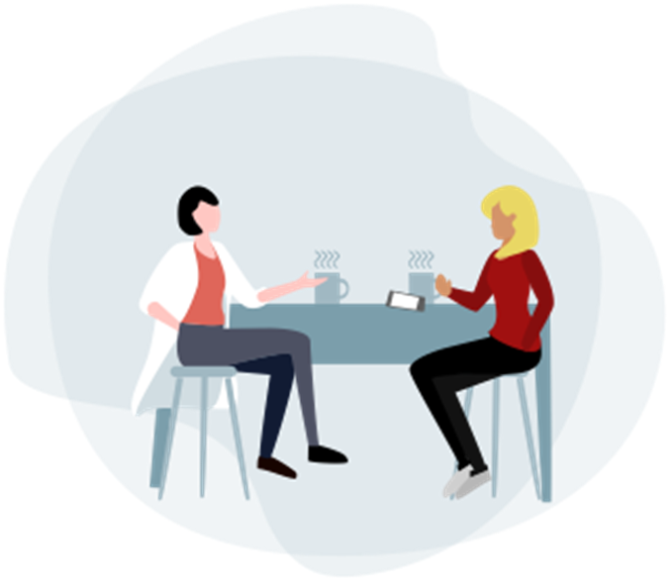

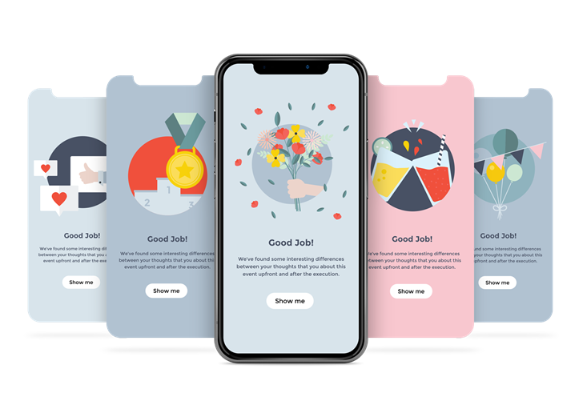
Successful in the Netherlands, now looking for partnerships in UK!
Proven Concept
Your Own Team
Operational in < 3 months

Slide 7

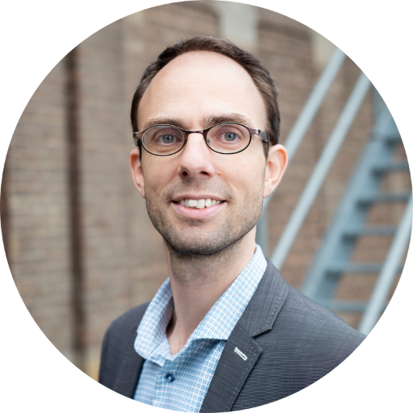
 | Jan Peter Larsen CEO Sense Health B.V. Lloydstraat 5 | 3024 EA | Rotterdam +31 (0)6 15091362 jp@sense-health.com www.sense-health.com | www.niceday.app

