Slide 1

MyCognition PRO
A Digital Technology in Mental Health* and IAPT
* Incl Physical Health
Copyrighted 2019

Slide 2

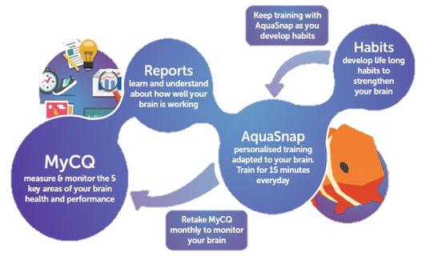
How it works
Measure and track cognitive fitness using a clinically validated cognitive assessment ‘MyCQ’ in just 15 minutes
Play the AquaSnap training video game to strengthen cognition fitness for 15 mins a day
Encourage good behaviours and healthy habits with the learning programme
Link to Video
https://www.youtube.com/watch?v=u1QqifDOdZ4

Slide 3
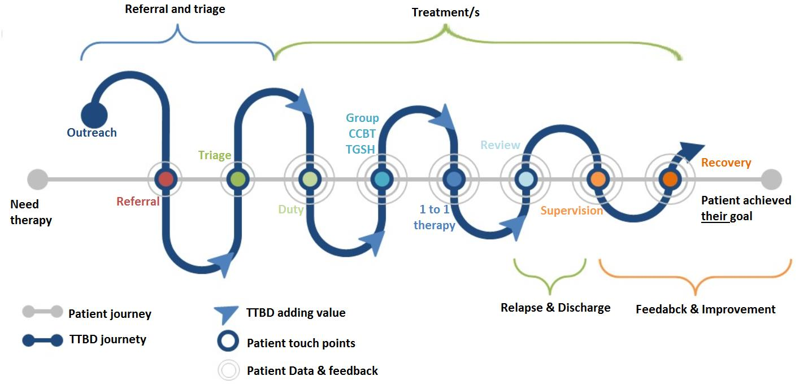
MyCognition PRO can be introduced along patient journey through IAPT
ccc

Slide 4
MyCQ correlates with Quality of Life dimension (feeling anxious, worried or depressed) in primary care patients with chronic conditions.

Slide 5
AquaSnap produced a ”dose-related” psychosocial ability improvement in a mixed psychiatric patient population (depression, schizophrenia and OCD)
Randomised-controlled trial measuring cognitive and functional outcomes (WSAS - Work and Social Adjustment Scale)
Source: https://www.gamesforhealtheurope.org/speaker/anna-domen/
Domen AC, van de Weijer SCF, Jaspers MW, Denys D, Nieman DH (2019). The validation of a new online cognitive assessment tool: The MyCognition Quotient. Int J Methods Psychiatr Res. 2019;e1775. https://doi.org/10.1002/mpr.1775.
Nieman, D. H., Domen, A.C., Kumar, R., Harrison, J., De Haan, L., & Denys, D. A. (2015). Cognitive remediation in psychiatric patients with an online cognitive game and assessment tool. European Neuropsychopharmacology, 25, S344-S345.
Domen A. C., Jaspers M., Denys D., Nieman, D. H. (in publication). A new cognitive training game for psychiatric patients: Results of a randomized controlled trial.

Slide 6
In Summary
Costs as little as 23 pence a day
Builds mental resilience
Reduces stress
Improves and protects anxiety & depression
Improves psychosocial function, activity and relationships
Improves physical health
Scalable for large populations on any device
Suitable for patients and staff
Remote monitor app use and cognitive changes

Slide 7





Our achievements demonstrate rigour of our approach
Built by cognitive scientists and codesigned with patients
CE Marked (Class 1a Medical Device)
NHS Digital and ORCHA approved for clinical use
Regulated by MHRA (Medicines and Healthcare products Regulatory Agency)
Participating in several NHS funded Accelerator Programmes
Validated in clinical and real world trials
Optimised with live user data with >20,000 user cases across all ages and different health conditions

Slide 8
Join us & request a demo
Michael Morgan-Curran
m.curran@mycognition.com

