Slide 1
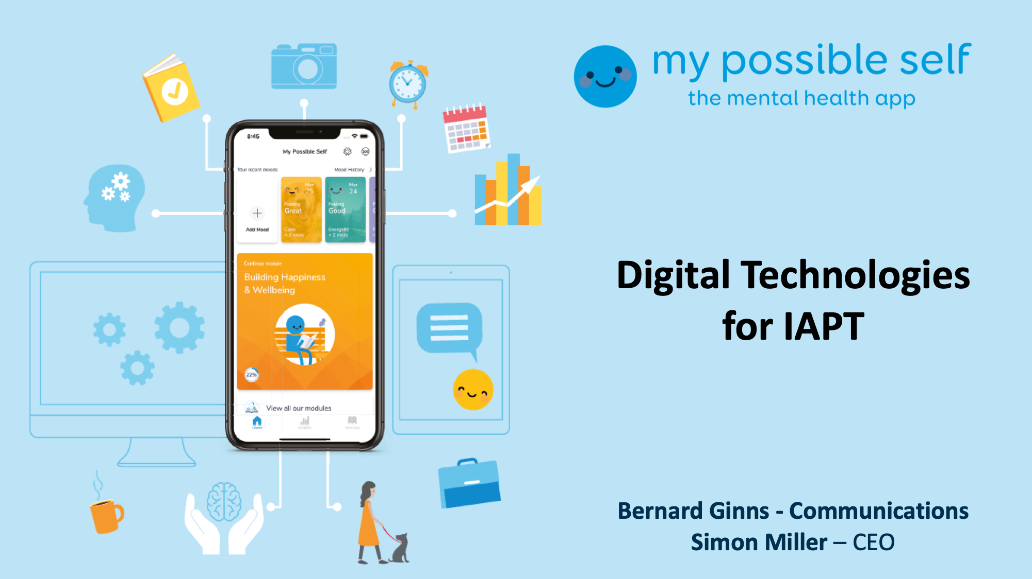

Slide 2
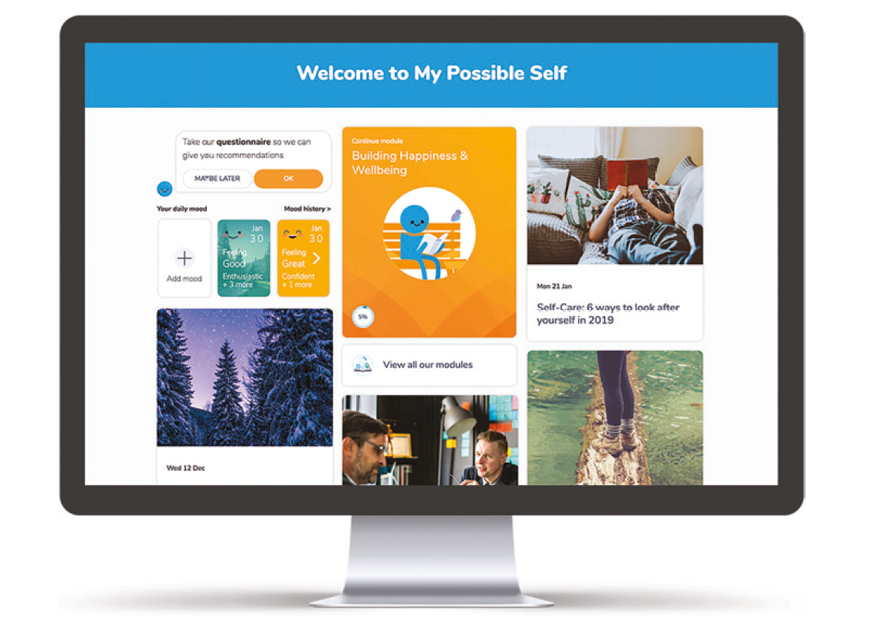
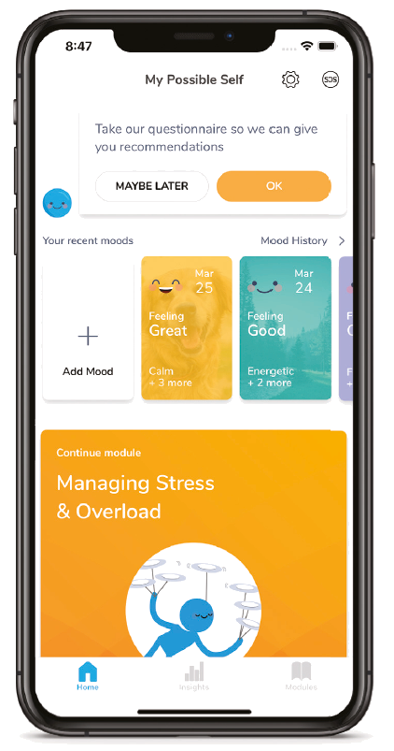



MPS App: the mental health app
App & Desktop based
Self-help, available 24-7
Designed to reduce stress, anxiety and low mood
5 Guided Series
Single point of access for interventions
Mood tracker
Chat bot on-boarding
45k users, 4k new users every month
Notes:
My possible self is an app available on app store & google play, but it is also desktop based too and will allow users to log in and complete the series from a desktop or laptop PC 24 hours a day 7 days a week.
It is designed, and clinically proven to reduce stress, anxiety and low mood through the guided series which are designed to be engaging and effective.
The app can also serve as the single point of access for other interventions, allowing users to potentially self refer to face to face or group therapy. It can also hold crisis resource information such as emergency helplines and clinics.
The built in mood tracker prompts users to record how they are feeling each day, and also some contributing factors whats making them feel that way. The app then starts to recognise trends, and recommend some self help resources where appropriate.
Users are on boarded via a friendly chat bot, which then tailors the app and resources accordingly.
To date, we’ve had over 45k users and receive around 4k new users each month.

Slide 3
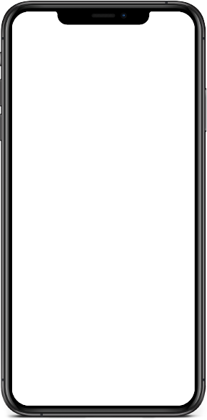
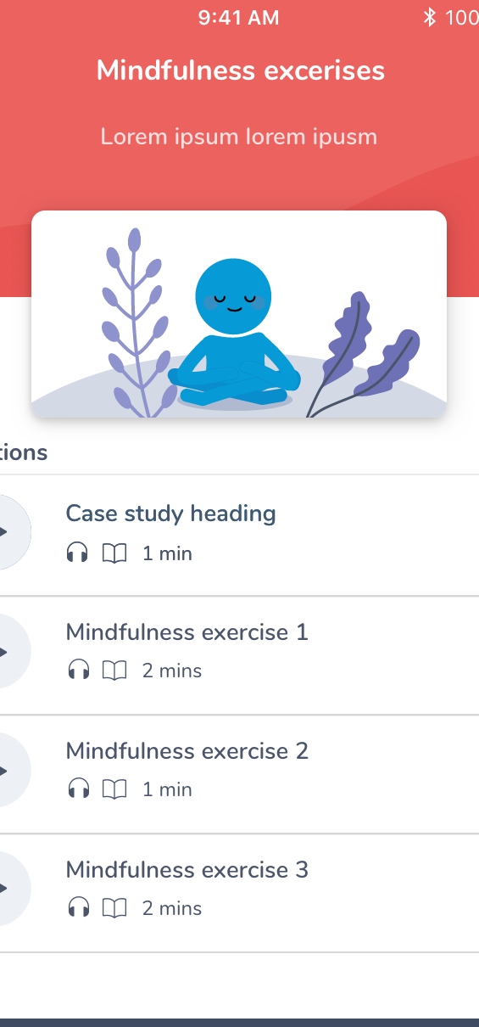
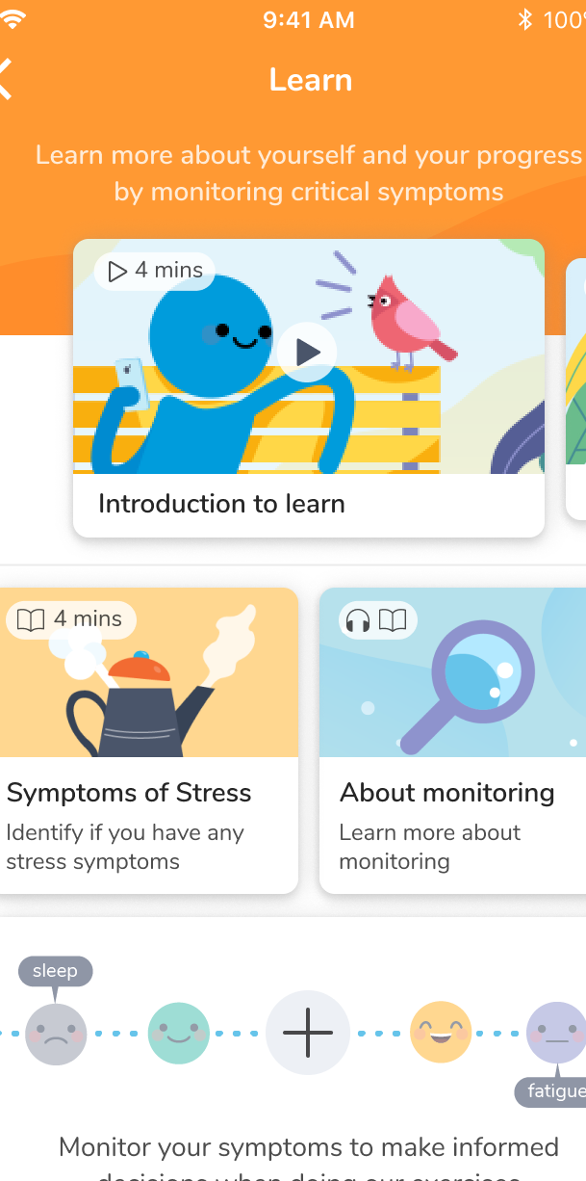
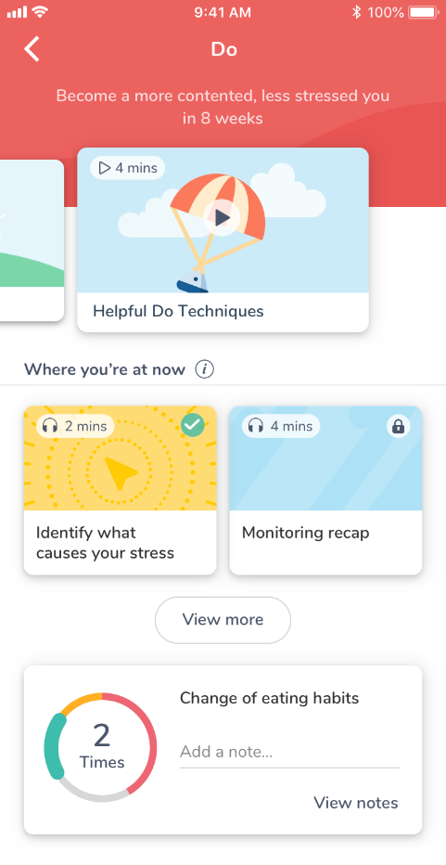
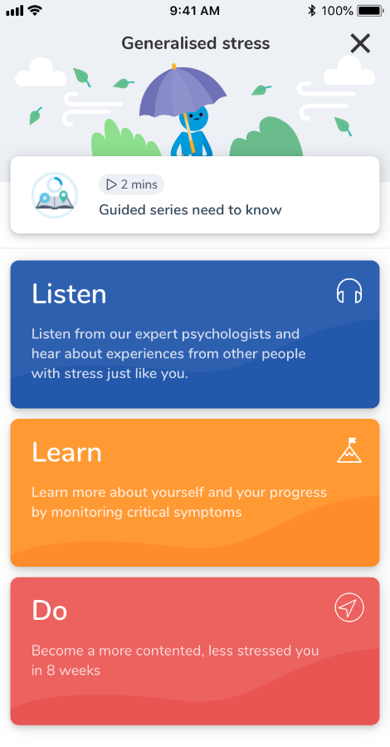
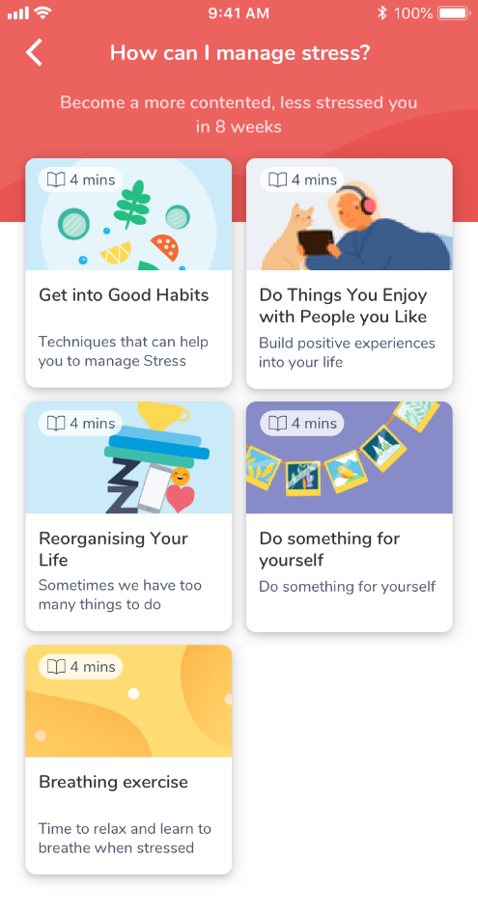
MPS App: Guided Series
Happiness
Self-esteem
Low mood
Anxiety
Stress

Slide 4
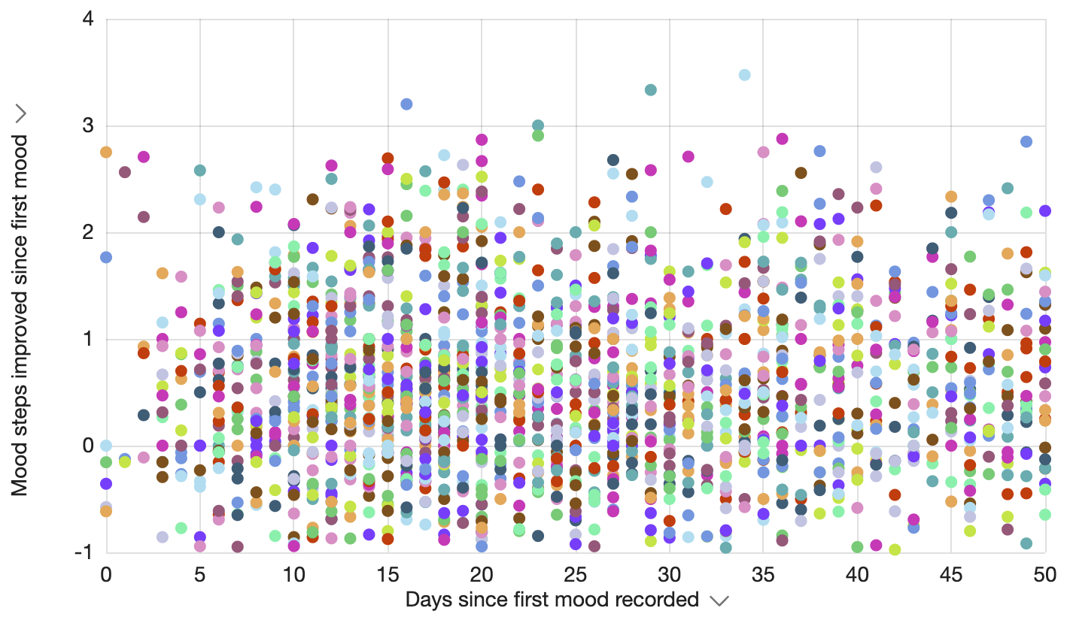
Effectiveness – Improvement in Mood
Improved Mood
Decreased Mood
Days of Usage
Notes:
This shows the dramatically higher number of users who recorded improved mood

Slide 5
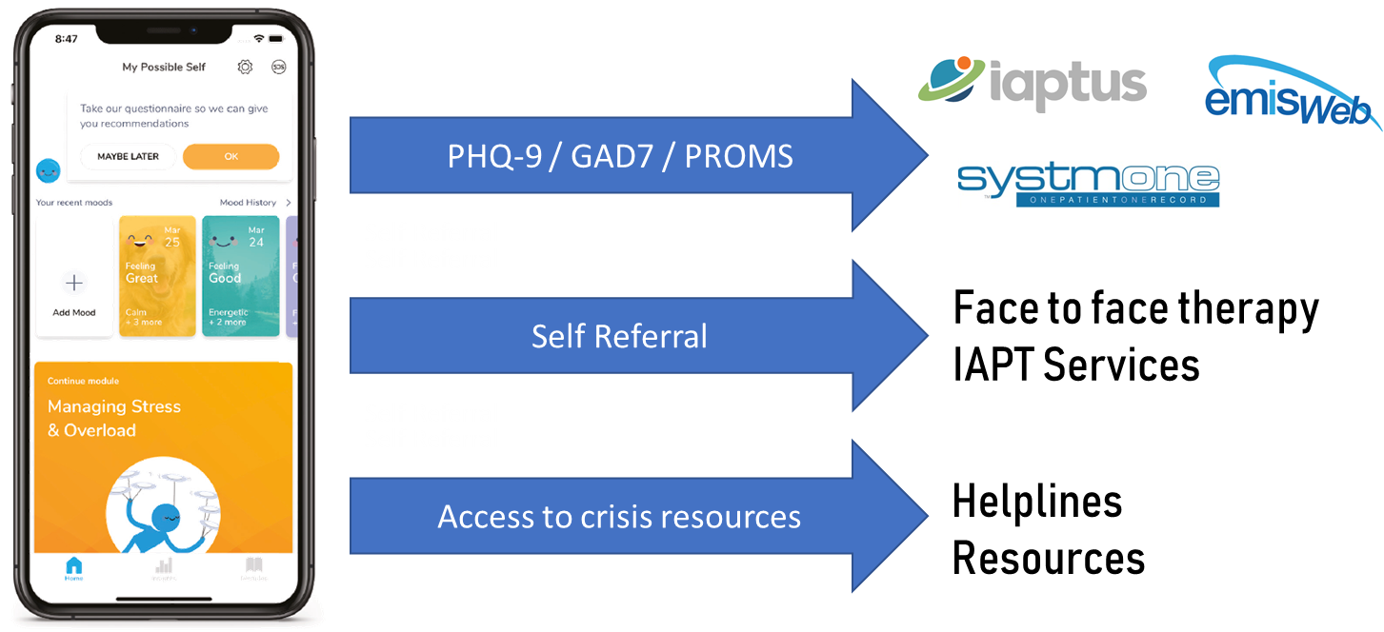
MPS Connect
Features
Interoperability
Single point of access
Show a users journey across multiple Mental Health services
Collect PHQs & GADs
Send appointment reminders
PEQ Responses
PROMs / CROMs
IAPT referral gateway
Notes:
MPS connects users to multiple touchpoints in the NHS.
It is fully interoperable with all NHS systems which allows us to gather information from users and send it into the NHS. We can also receive information from the NHS.
This allows us to manage the mental heath of populations of users and communicate with the NHS about it.
For example, we can collect GAD 7 and PHQ 9 scores from users and send that to the patient record in GP surgeries.
We can also create a single point of access for the managers of populations which are struggling with their mental health. Eg IAPT providers, or Primary Health care providers – we can do this whilst users receive the self help material in the app.
We can also act as a gateway to IAPT services.

Slide 6
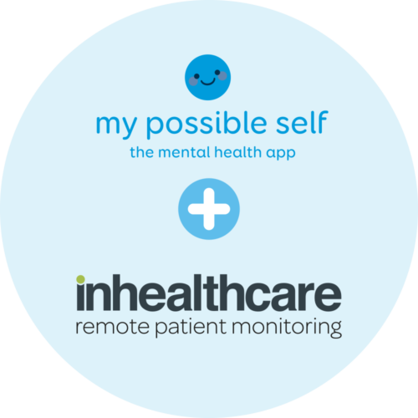



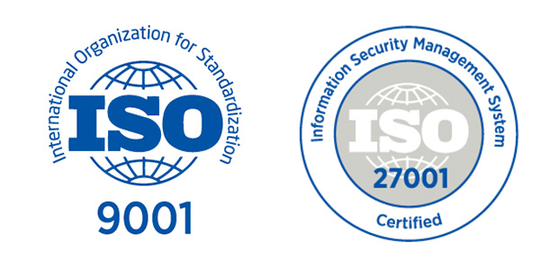



MPS + Inhealthcare partnership
We’ve partnered with our sister company Inhealthcare, the UK’s leading digital interoperability and remote patient monitoring specialists.
Our partnership allows any organisation to remotely collect PROMs and integrate responses back into existing NHS systems.
Six of our combined 50+ NHS customers:
Notes:
It is unusual for an app like My Possible to be able to provide the connectivity which it does.
How can it do this? It has partnered with InHealthcare, its sister company to provide this service.
IHC provides remote patient monitoring services to over 50 NHS customers.

Slide 7

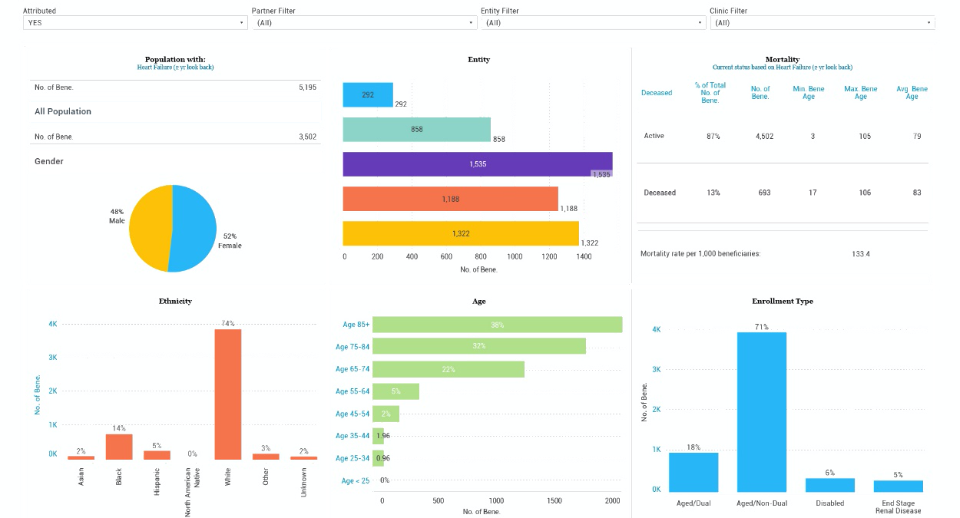
MPS Analytics: delivering valuable insights
Technical competencies:
PROMs / CROMs
PEQs
App Analytics
IAPT Referral
Crisis interventions / alerts
Waiting list
At risk groups
List size
Targets
Relapse rate
Prescriptions
MPS Analytics

Slide 8
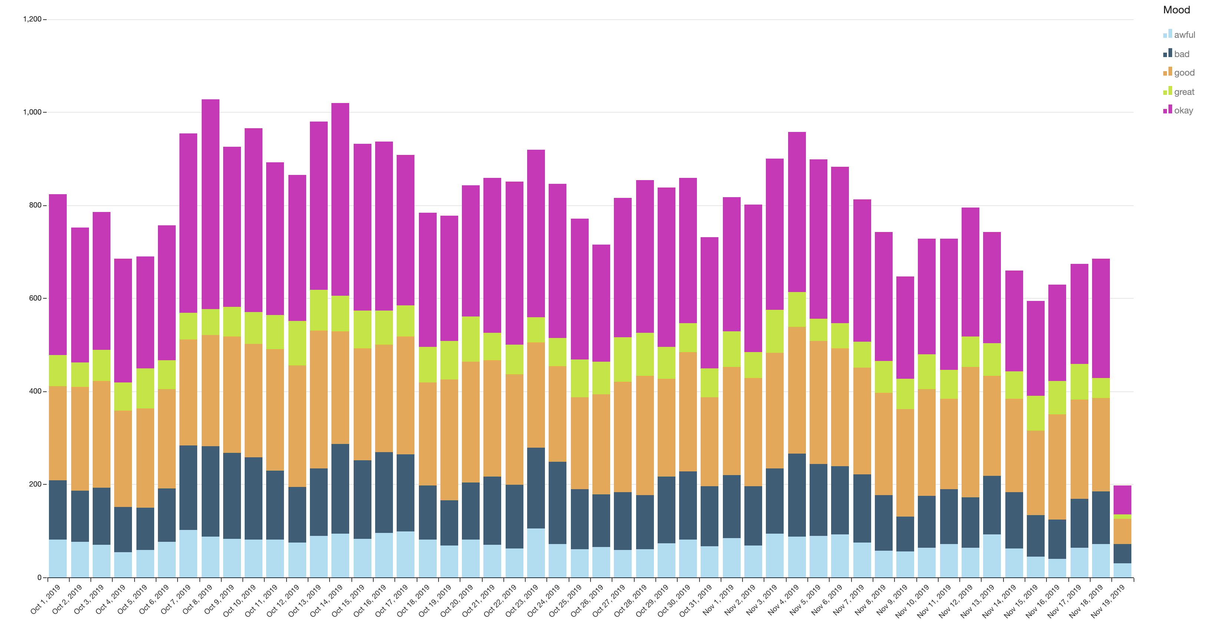
Usage - Number of moods recorded per day

Slide 9

Thank you for listening… now try us out!

