Slide 1

My Internal World
Julian Hall and Bregje Fisk
Co Founders

Slide 2
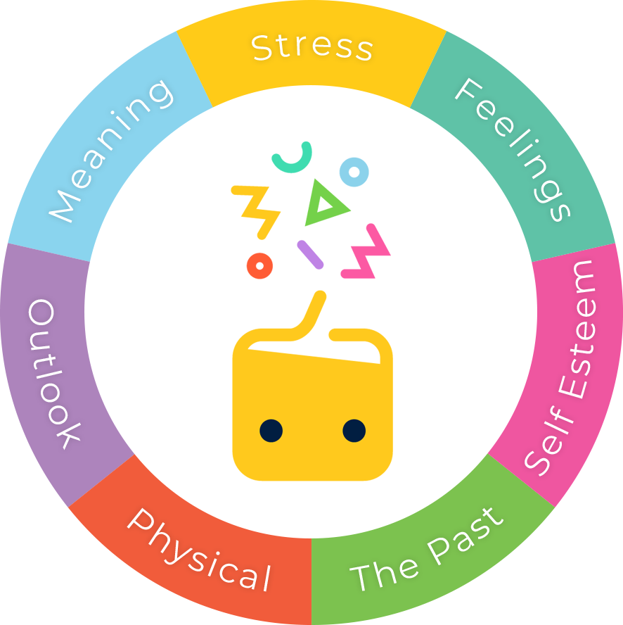
My Internal World
Developing your emotional health so that you don’t have to focus on your mental health

Slide 3

My Internal World
Taking responsibility in order to reduce dependency

Slide 4
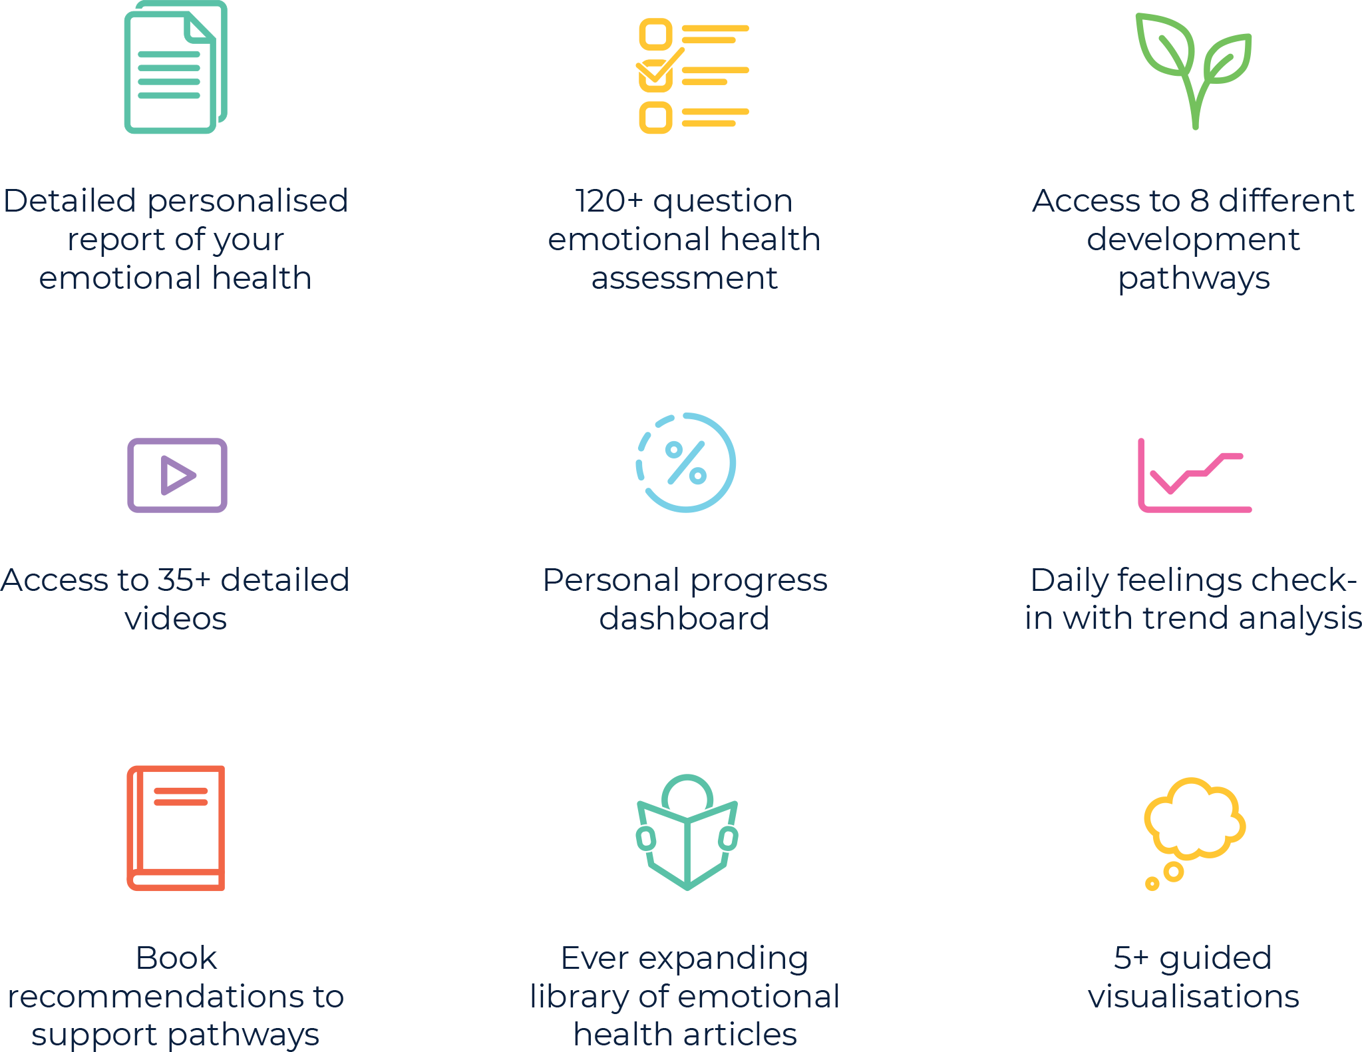
My Internal World
Developing your emotional health so that you don’t have to focus on your mental health

