Slide 1










Making eHealth a Reality
Florence and the Simple Telehealth Community of Practice
Karen Moore
Advanced Capability Lead– Simple Shared Healthcare Social Enterprise
Scottish, Welsh
& English NHS
@NHSFlo
www.simple.uk.net
Karen.moore@simple.uk.net

Slide 2
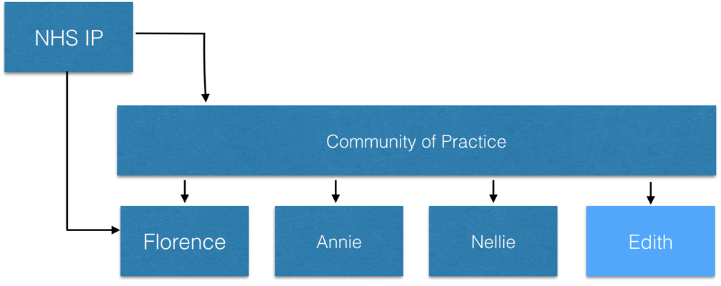






National Health Service unique innovation
“For patients, not profit.”
Mandatory IG Compliance - Level 2 – NHS Business Partner

Slide 3

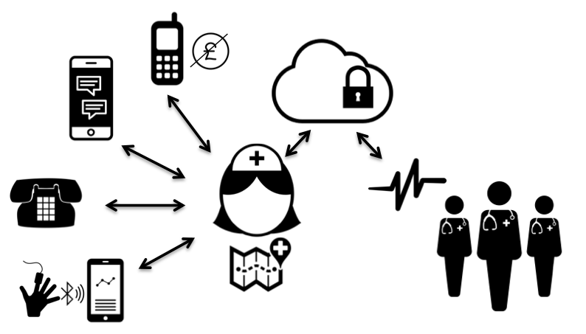
Flo: A Straight Forward Concept
“NHS owned; for patients, not for profit”
No need for a physical base or a smart phone
Familiar, freely available and easily accessible
Simple self-management: patients are at the heart of their own care
Easily configured to augment existing best practice
Established evidence base in over 60 areas of clinical interest
Notes:
It’s Simple and Scaleable:
It’s a straight forward concept. You don’t need physical base or even a smart phone. You just need to be able to send and receive text messages. In terms of breadth of patients you can reach it is much wider than using apps as we are using familiar technology – 98% of the population have a mobile phone.
No data needed and doesn’t take up memory on phone compared to downloading an app.
The technology is freely available. A lot of innovations are app based and used data.
It’s simple and gives patients a more active role/increasing their locus of control– they are at the heart of their own care. Thus, minimal clinician input.
-------------------
The technology isn’t new but it can make the biggest difference where there isn’t that much use (tractors) Also, VR can be effective but expensive. Also it cannot be integrated into the fabric of their lives as they can’t take the technology home.
Simple self-management for patient – using familiar tech, low cost. Psychology of texts – the msg is personable/informative and can help to motivate individual for behavioural change – and the rx they have with their phones which you don’t get with app.
Each category has a specific and unique set of criteria based against five key elements.
All the categories below have their own individual criteria which can be viewed by clicking on the category. There are 5 areas which our judges will be reviewing against.
Ambition
The challenge and context within which your project, person or organisation is set alongside your goals and targets whether quantitative or qualitative.
Outcome
The benefits realised from the point of view of patients, organisation, leadership, value creation, efficiencies and cost.
Spread
The dissemination of your success in terms of how your work has been picked up and replicated elsewhere.
Value
The creation of value from the point of view of patient satisfaction and experience, reduction in bureaucracy, time saved for staff at any level.
Involvement
The stakeholders buy-in and contribution toward the project initiatives and outcomes. How have the relevant staff, patients and partnerships worked together to realise the success?

Slide 4
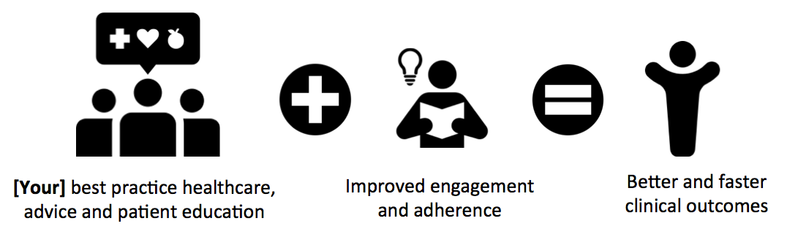
“NHS owned; for patients, not for profit”
Unique; Personalised, targeted behavioural psychology-based messaging, interacting with patients as their non-judgemental friend
Evidenced; Extensive independent evidence base covers 100’s of conditions for uses in England, Scotland, Wales, Ireland, USA and Australia
Used by over 70 UK health and care organisations with over 100,000 patients having been supported by Flo nationally.
The King’s Fund; “Florence is a low-cost, low-risk innovation with a strong track record”
Nuffield Trust; "Flo has been formally evaluated, with positive results”
The Health Foundation; "Flo has had a huge impact on people’s lives, revolutionising the way patients manage their own health”
Notes:
Introduction - Karen
Explain that it is one of the top priorities in digital mental health to be able to integrate (or blend) digital innovations with existing therapeutic approaches. The key point is that use of digital mh interventions is often framed as either/or i.e. use digital or use traditional. But patient perspectives research suggest people want both integrated. I’d have a different image maybe something Karen thinks summarises how great Flo is?
Karen (or someone) should emphasise some of the plaudits Flo has received in NHS care (e.g. King’s Fund commendation).
Flo is a smart messaging intervention, well established generally within medical settings. Recommended by Kings Fund
We have collaborated together to use Flo to enhance the psychological wellbeing of people with comorbid issues - MH and PH problems.
This has never been done before and so we decided to apply Flo in this novel way.

Slide 5
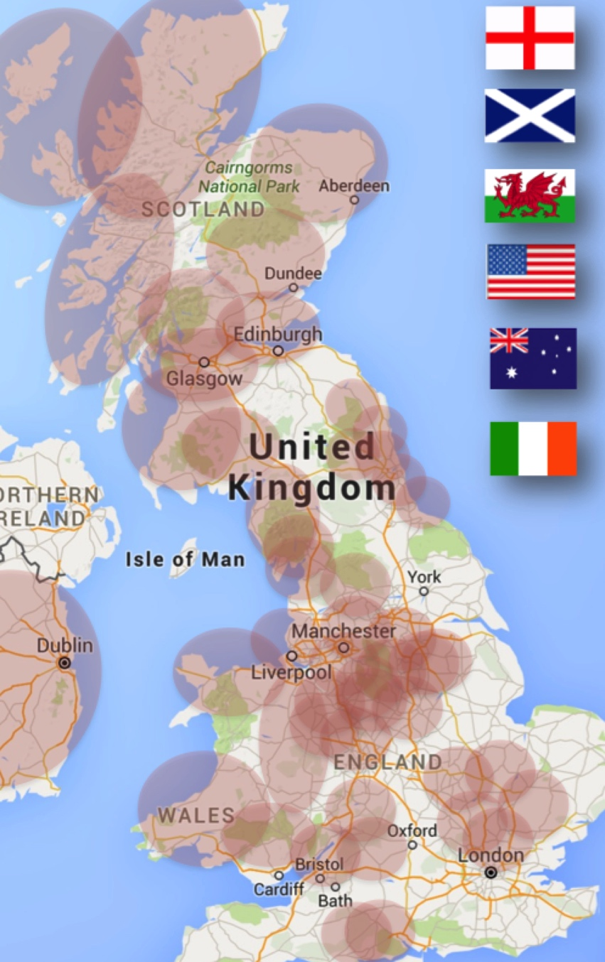
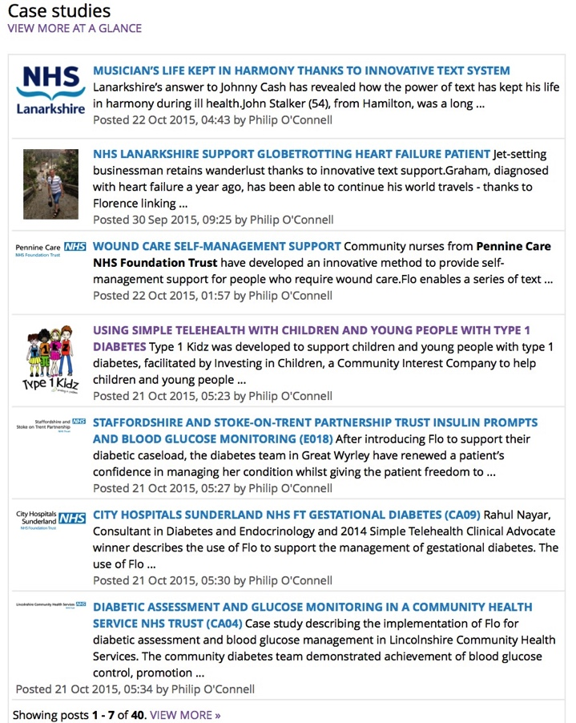
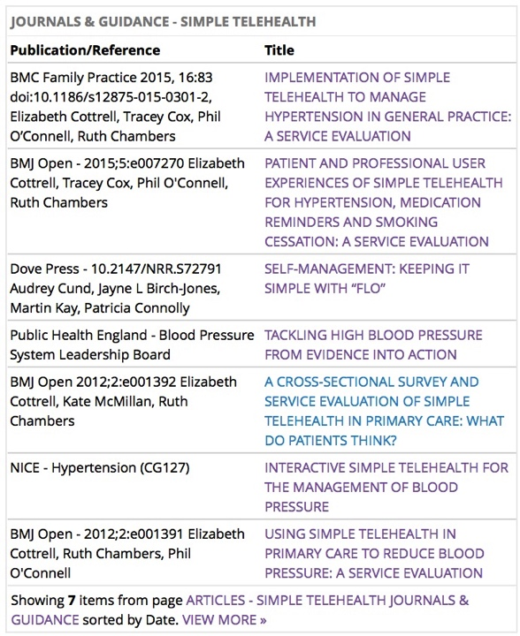
Community
100,000+ patients
evidence, studies, peer review, collaboration, shared learning, evidence, studies, peer review, collaboration, shared learning, evidence, studies, peer review, evidence, shared learning, evidence, studies, peer review, collaboration, shared learning, evidence, studies, peer review, collaboration, shared learning, evidence, studies, peer review, collaboration, shared learning, evidence, studies, peer review, collaboration, shared learning, evidence, studies, peer review, collaboration, shared learning, evidence, studies, peer review, collaboration, shared learning, evidence, studies, peer review, collaboration, shared learning, evidence, studies, peer review, collaboration, shared learning, evidence, studies, peer review, collaboration, shared learning, evidence, studies, peer review, collaboration, shared learning, evidence, studies, peer review, collaboration, shared learning, evidence, studies, peer review, collaboration, shared learning, evidence, studies, peer review, evidence, resources, evidence, studies, peer review, collaboration, shared learning, evidence, studies, peer review, evidence, shared learning,

Slide 6

What does the Community of Practice model offer?
Simple Telehealth Methodology (including Capability Maturity) support, assistance and consultancy
Shared IP and resources
Remote Florence product assistance, training, support and consultancy
Regional events and direct peer networking

Slide 7






The Partnership
Notes:
This intervention is a collaboration between industry, healthcare professionals, research and patient advisors

Slide 8

The Team
Recently established Clinical Psychology Cancer Service
Challenges:
  Drop-out from group programmes
  Relapse prevention
Notes:
Our service was set up in 2014 and we offer support to adults affected by cancer. We recently won a national macmillan award for integrating excellence, where collaborating with members of the cancer MDTs is core to our model of psychological provision.
However, despite our high level of clinical effectiveness, we noticed that not all patients were benefitting from psychological therapy due to dropping out, especially in group programmes. This was largely due to cancer related barriers.
We also wanted to prepare patients for future challenges when they finished therapy given that future health challenges were likely for some.
Over the last few years we have liaised with Simple Telehealth to provide a free automated text support system (known as Florence) to patients for use as a relapse prevention recovery package – patients rate their emotional wellbeing and receive support/advice through their mobile phone to manage their difficulties outside of hospital appointments. The text messages received are collaboratively designed with the patient during therapy (i.e., it is the patient’s own words of advice sent to them in the form of a text message).
One of the many challenges we face is XYZ and so Flo was considered as an option to overcome some of these (link to our vision)
We have integrated this into the mindfulness groups that we run for cancer patients where texts are sent reminding them of mindfulness exercises and any preparation that is required in between the sessions – patients have welcomed this novel approach and it is one of the first groups in the country to use it.

Slide 9
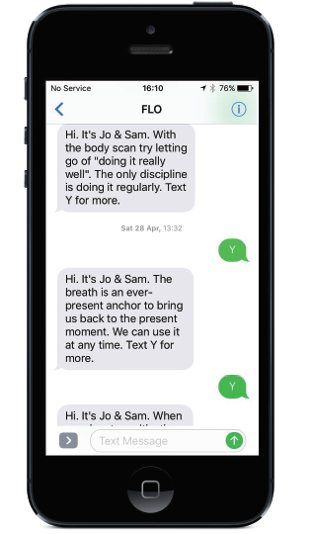
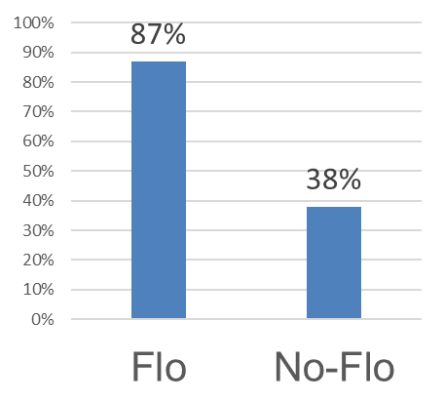
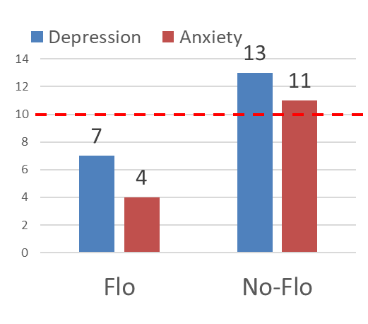
Smart Messaging for Group Psychological Therapies in Cancer Care
3 Messages a week:
Reminder of session content
Reminder of home practice
Reminder of the next session
Can request up to 13
50% more completers
50% greater improvement
Notes:
We tested the effectiveness of using Flo within an MBCT group, with the aim of supporting attendance and engagement. This is the first application of Flo within a group setting of cancer patients.
Text messages were sent the day after each session, reminding patients of the home practice
Patients could request up to four further texts which offered more information.
The texts also reminded them of details for next session
There were 51 patients in this study (from 6 groups between 2015 and 2018), 30 chose to receive Flo, 21 did not.
The odds of completing the group programme was eight times higher for flo users than non flo users. We have 50% more completers and 50% greater improvement in terms of psychological wellbeing

Slide 10

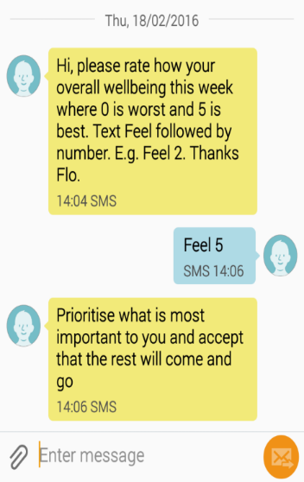
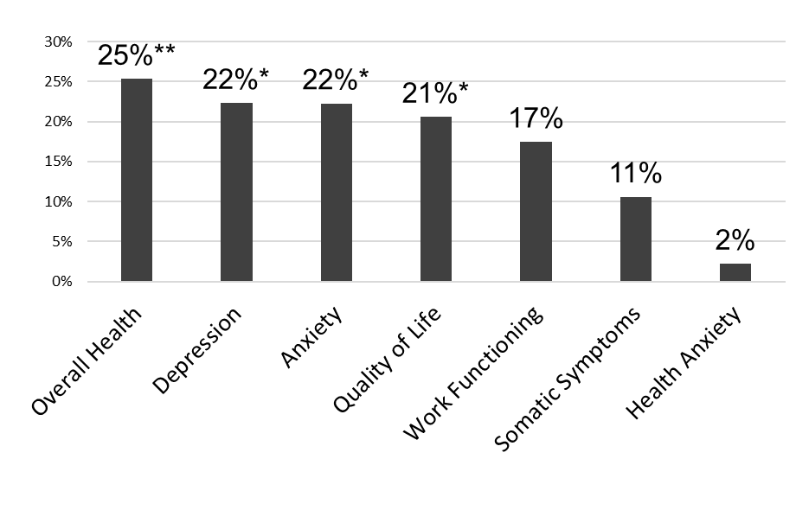
Smart Messaging to Prevent Relapse :
Write advice you’d like to receive if:
Doing well
Early warning signs of relapse
In full relapse
Personalised messages tailored to your mood
Up to 25% Greater improvement over 12 month follow-up on all outcomes
Notes:
We also explored the effectiveness of using Flo in relapse prevention
Collaborated with patients to recognise signs of doing well, early warning signs of relapse and full relapse (“downward spiral”)
Messages were personalised. Flo would send texts asking patients to rate their mood, and would send tailored messages accordingly
Over a 12 month follow up of X patients, we found up to 25% greater improvement in overall health, psychological wellbeing, QOL, work functioning and somatic symptoms.

Slide 11




Examples of text messages from Flo
You cannot change the past - or the future and you are a strong person for all that has been dealt with. You will continue to be the best you can be.
Take some deep breaths before responding to people/ situations. Remember we are all human and make mistakes, forgive other people for theirs. Don't get mad at other people’s differences - embrace them
You are getting there; you have never been so close. Don’t worry you have gone through this before you can do it again.
Remind yourself you are still here.
Count your blessings.
Take up a new activity
Pat yourself on the back.
Be grateful to be alive
Going outside is really helpful for you. Listen to the birds or a do a walking practice. Take your time. Take time to look at the stars when you next can.
Notes:
One of the pitfalls of other smart messaging interventions is the high drop out rate and this is largely because it’s not personalised enough – it’s like a machine.
We developed a relapse prevention protocol, in collaboration with patient advisors. The key to this was making the text message responses in the own words of the patient.
Despite the texts being bite sized, they have a bigger impact because of the level of personalisation
When interviewing flo-users about it, they felt a “personal connection” to Flo, as if somebody was thinking about them – reducing feelings of isolation
Patient involvement is a key aspect of this intervention and also for modifying it e.g. after interviewing more than 30 flo-users, we agreed to modify the protocol as they felt it would simplify it further (e.g. changing from 5 levels to 3)
Put together a set of example responses that other patients can use (e.g. if people struggle to think of their own)
Patient video

Slide 12
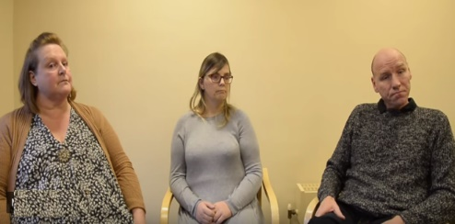
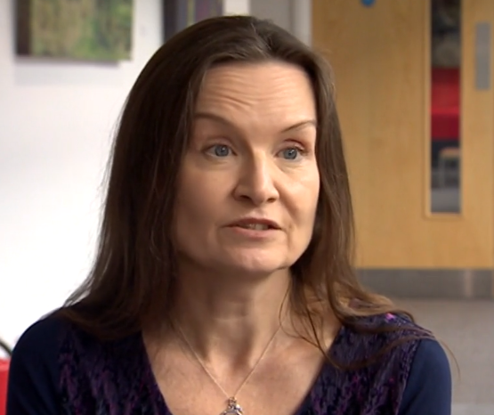
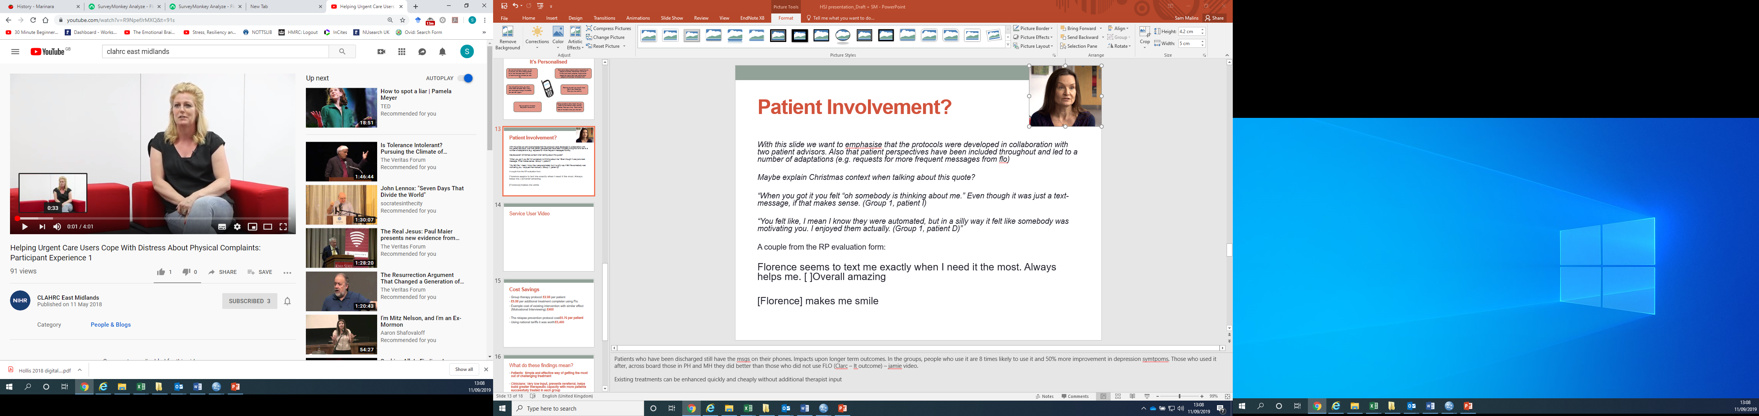
Patient Involvement
“When you got it you felt “oh somebody is thinking about me.” Even though it was just a text-message, if that makes sense. (Group 1, patient I)
“You felt like, I mean I know they were automated, but in a silly way it felt like somebody was motivating you. I enjoyed them actually. (Group 1, patient D)”
“Florence seems to text me exactly when I need it the most. Always helps me. Overall amazing” (Individual A)
“[Florence] makes me smile” (Individual B)
Notes:
The protocols we developed were in collaboration with two patient advisors. We have also asked patients to feedback on these protocols which has led to a number of adaptions e.g. requests for more frequent messages from Flo.
Here is some feedback from individuals attending the group and those who used flo for RP in one to one therapy.
Some of the themes that came out of patient feedback was that it helped motivate them to attend/practice techniques, and offered a personal connection – reduced feelings of isolation

Slide 13
Cost Savings
Group therapy protocol: £2.88 per patient
£5.88 per additional treatment completer using Flo.
Example cost of existing intervention with similar effect (Motivational Interviewing): £400
The relapse prevention protocol cost £5.76 per patient
Using national tariffs it was worth £3,400
Notes:
The MBCT protocol cost an average of £2.88 per patient. from our evidence it would cost £5.88 per additional treatment completer using the flo protocol. Could compare to another evidence-based means of improving retention: four sessions of motivational interviewing – which would cost approximately £400.
In the relapse prevention protocol the improvement in quality of life gained by those using the protocol compared to those who did not would be worth £3,450* per patient but actually cost a maximum of £5.76.
*Using the established willingness to pay threshold of £30,000 for 1 year of perfect health set by NICE.
Both are very initial evidence and we should say this, but it makes the clear point that this is dirt cheap for what you get in return.

Slide 14
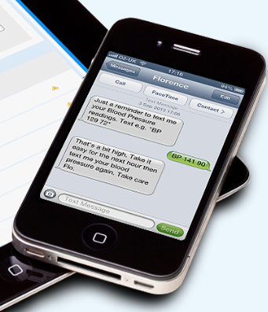
Smart-Messaging for Mental Health:
This Time It’s Personal
Effective
Simple and Scalable
Personalised
Psycho-Oncology Journal Article
Using smart‐messaging to enhance mindfulness‐based cognitive therapy for cancer patients: A mixed methods proof of concept evaluation
https://onlinelibrary.wiley.com/doi/full/10.1002/pon.5256

