Slide 1

Online Therapy in IAPT Services
Paul Clarke, Director, Dr Julian Medical Group Ltd.
Notes:
My background

Slide 2
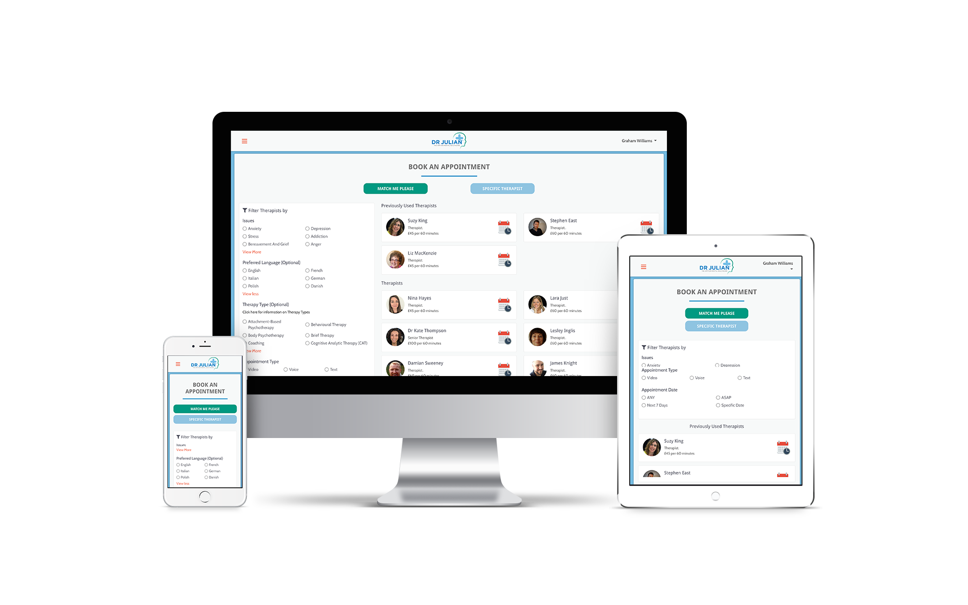
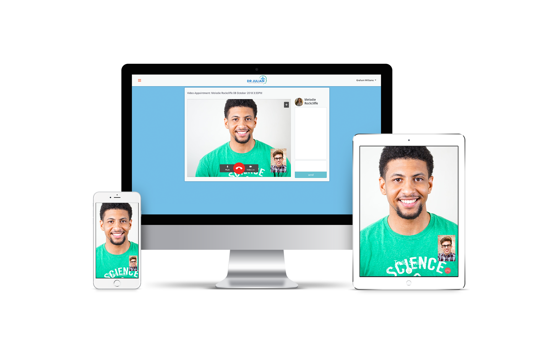
What is Dr Julian?
Platform and app connecting patients via secure video/ audio or instant message to fully qualified, vetted and online trained therapists.
Notes:
We worked with inclusion thurrock to develop a solution.
We have produced a platform connecting patients via video/audio/ instant message etc and are mainly focussing on IAPT level 3 services but have the capacity to provide so much more.

Slide 3
Evidence Base for Online Therapy
Chakrabarti’s meta-analysis of over 200 Randomised Controlled Trials on video online therapy and psychiatry concluded:
“ Treatment of depression delivered by videoconferencing is equivalent to face-to-face treatment on symptom reduction”
“ Superior to face-to-face treatment on depression outcomes”
“CBT well suited to videoconferencing as are other forms of therapy”
“75-100% of the users reported considerable satisfaction with tele-psychiatric care”
Chakrabarti, S. (2015). Usefulness of tele psychiatry: A critical evaluation of videoconferencing-based approaches. In: World Journal of Psychiatry. 2015 Sep 22; 5(3): 286–304. 10.5498/wjp.v5.i3.286. [Last accessed 07/06/2019].
Notes:
Hulsbosch, A., et al.(2016). Videoconferencing in a mental health service in The Netherlands: A randomized controlled trial on patient satisfaction and clinical outcomes for outpatients with severe mental illness. Journal of Telemedicine and Telecare
Carlbring, P., Andersson, G., Cuijpers, P., Riper, H., & Hedman-Lagerlöf, E. (2018). Internet-based vs. face-to-face cognitive behavior therapy for psychiatric and somatic disorders: An updated systematic review and meta-analysis. Cognitive Behaviour Therapy, 47(1), 1-18. doi:10.1080/16506073.2017.1401115
Pslylyk-Colwell, E., Argaez, C. (2018). Telehealth for the assessment and treatment of depression, post-traumatic stress disorder, and anxiety disorder: Clinical Evidence:
https://www.cadth.ca/sites/default/files/pdf/htis/2018/RC0980%20TelePsychotherapy%20Final.pdf

Slide 4
How Does it Work/ Process
Referral through IAPTUS
PRISM from IAPT service
Dr Julian receives referral patient data populated in Dr Julian
Patient receives email with information on service, how to login and have appointments
Notes filled out by therapist once clinical contact complete data captured by IAPTUS and inputed into IAPTUS
Patient completes assessments prior to appointment then has appointment on system
Patient can rebook with same therapist
Patient chooses therapist for them using filters and books through calendar booking system

Slide 5
Small Scale Evaluation with Inclusion Thurrock
Notes:
Patient engagement is key by booking their own appointments we have found they are more likely to turn up.

Slide 6
Now Working With
Midlands Partnership NHS Foundation Trust - Inclusion Thurrock
Lancashire Care NHS Foundation Trust – Mindsmatter
Oxleas NHS Foundation Trust
Central and NW London NHS Foundation Trust (Milton Keynes)

Slide 7
What our patients say
"This was my first time to try a session with a therapist online, and although I wasn't sure how it would feel, I wanted to try it because the idea of speaking to someone from home without having to track to London was just soooo appealing! And I can honestly say, it was so good. I had my cup of tea in my favourite mug with my slippers on, I cried and my mascara ran and nobody was there to see me except the kind therapist! I didn't have to get in the car or on the tube afterwards with red eyes, I just lay down on my bed and tried to take it all in.” Justine 37

Slide 8
Dr Julian Nesbitt
Chief Executive & Founder
julian@dr-julian.com
+44 7824 903 433
https://dr-julian.com/
Notes:
My background

