Slide 1


Slide 2



Notes:
That is

Slide 3
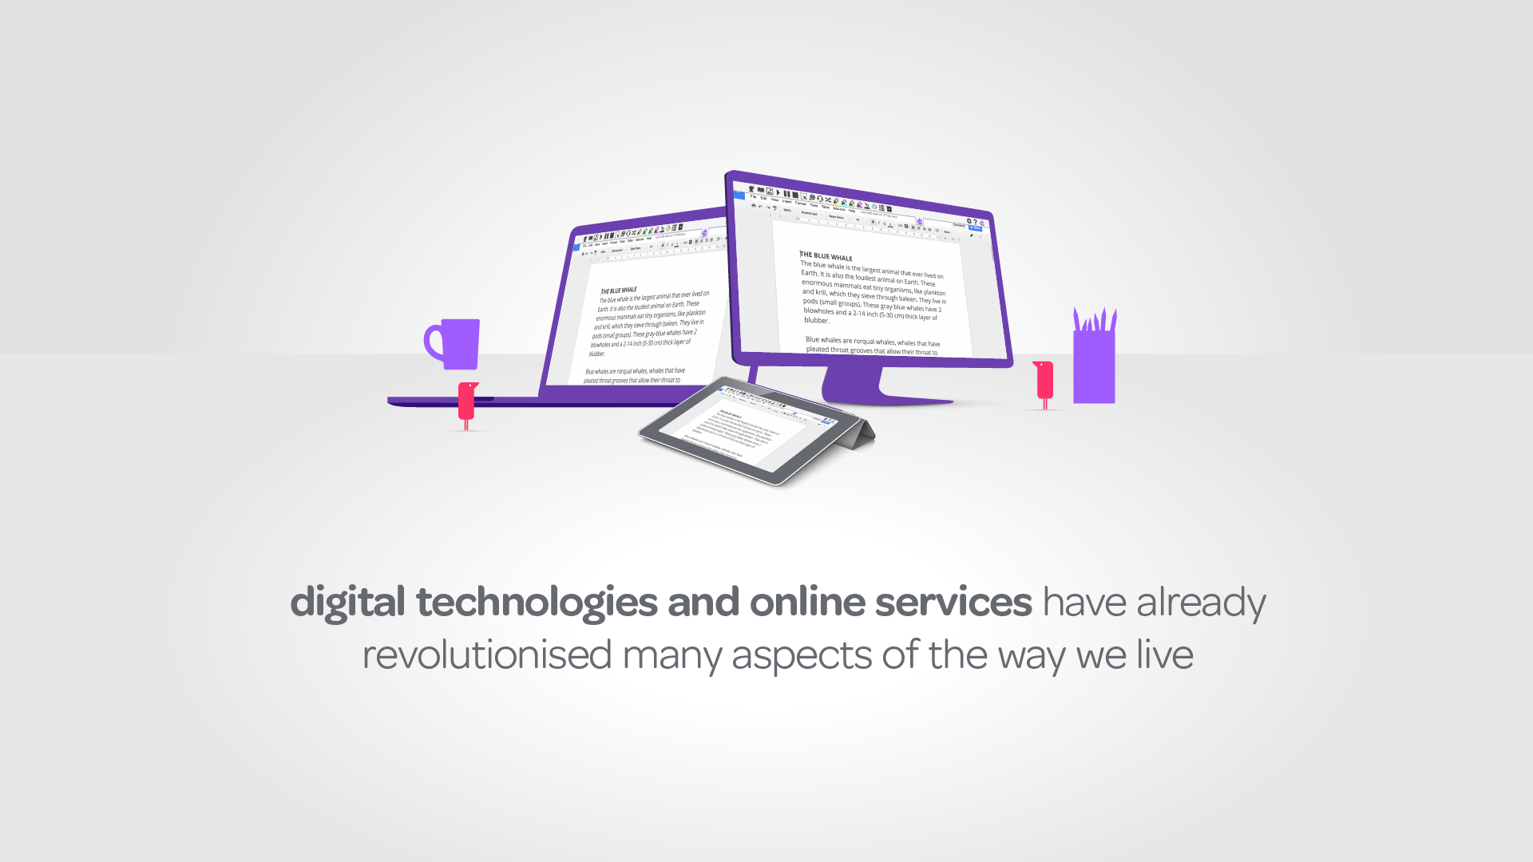
Notes:
Digital technologies and online services have already revolutionised many aspects of the way we live and we are heading towards a future where they will play an even bigger part of our lives.
What was the first thing you reached for this morning? 80% of 18-44 yr olds reach for their smartphones. 35% of people thought of their smartphone compared to 10% SO. The smartphone if your pocket is more powerful than the Apollo Guidance Computer and technology can now beat humans at games like Chess and Go, as well as driving cars and all manner or AI interactions.
We book flights online, secure hotel reservations, apply for jobs, research the web for offers and information that is relevant to us.
Businesses, Government, Healthcare Organisations and the Third Sector are keen for us to ‘self-serve’, not just for the obvious cost savings but to deliver a more convenient service to users and to promote independence and empowerment.
There is a significant gap emerging between what we are asked to do to serve ourselves online and our capabilities and capacity to successfully do so. There are all sorts of potential barriers to overcome in even the simplest transactions, and the number of people this affects is huge and the number is growing all the time.
Watch

Slide 4




Slide 5


Accessible Information Standard
“It is vital that everybody understands the information they receive about their health and wellbeing. The Accessible Information Standard will mean that people with disabilities are not left in the dark, leaving them with the peace of mind to fully focus on their care.”

