Slide 1


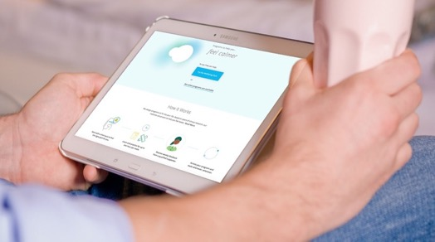
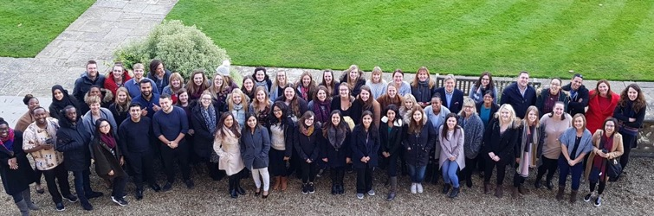

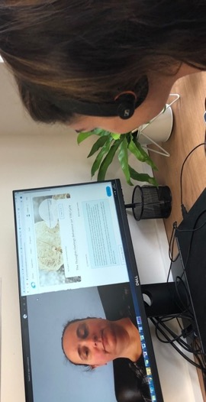
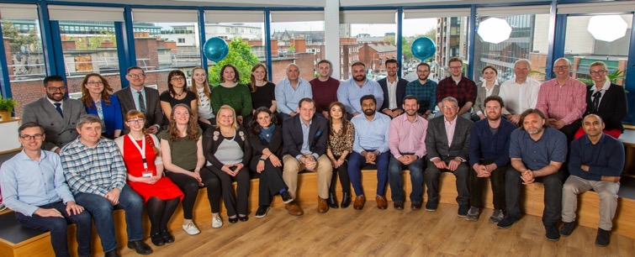


Working Together to Deliver Excellence in Mental Health
@silvercloudh

Slide 2



Our partnership has changed service delivery and impacted 21,439 lives across Berkshire since 2012

Slide 3


How it started - The drivers for change
Ambition of Berkshire Clinical Leader to keep pace with the growing needs of the Berkshire wide population suffering with common mental health problems after a successful service launch of self referral within two IAPT services in 2010
Service demand higher than service therapist capacity to deliver
Unhappy with digital availability of Computerised Cognitive Behavioural therapy (cCBT)
Sudden pressure of 30% of staff on maternity leave in 2011
Retention issues with staff (national difficulty) contributing to fluctuations in recovery outcomes and patient experience needing to identify a sustainable solution to reduce impact of retention difficulty
Waiting lists growing and patient satisfaction declining
The search for a digital solution was born, Berkshire Clinical Director meets SilverCloud Health CEO at an innovation event and the rest is history…
The journey begins to innovate and develop clinical digital solutions together…

Slide 4




The collaborative solution
Partnership between SilverCloud and Berkshire Talking Therapies 2012
  SilverCloud developed the online platform for Dublin University students
  Berkshire Talking Therapies developed the clinical content to ensure fidelity to clinical protocols within IAPT in the UK
Used our joint expertise to design new products together for our service and the wider NHS and pilot new programmes and conduct shared research
Providing a testing and implementation site for all new products and ensure patient involvement with development, testing and feedback
Berkshire GDE Blueprint has showcased this partnership , clinical and operational delivery so others can learn and increase digital maturity within the NHS to find their own digital solutions.

Slide 5


What is SilverCloud?
SilverCloud Programs
Flexible, access on computer, laptop or phone
Clean, modern user interface
Research driven
Developed combining the digital expertise of SilverCloud health and the clinical and practical expertise of Berkshire Talking Therapies
Online asynchronistic support sessions (15 mins) save time and costs
Can be used flexibly by patients and clinicians to create personalised support

Slide 6
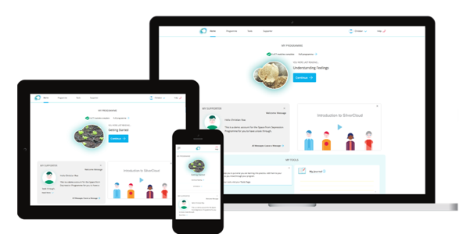
Scaling the innovation through partnership
30+
Mental Health
Programs and modules
Space from Anxiety
Space from GAD
Space from Health Anxiety
Space from Social Anxiety
Chronic Health
Wellbeing
Space from OCD
Space in CHD from Depression & Anxiety
Space for Sleep
Space for Phobia
Space in COPD from Depression & Anxiety
Space for Resilience
Space for Panic
Space in Diabetes from Depression & Anxiety
Space from Money Worries
Space from Depression
Space in Chronic Pain from Depression & Anxiety
Space from Stress
Space from Depression & Anxiety
Space for Positive Body Image
Bipolar Toolkit
Substance misuse
Space from alcohol
Space from opiates
2019 roadmap
Children’s and Young Person’s
Perinatal mental health

Slide 7
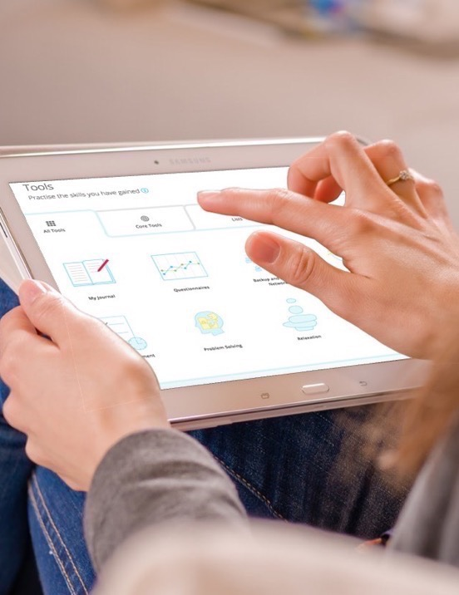

Measurable Benefits in Berkshire
Number of patients treated with online therapy cCBT
  Supporting an extra 4,000 patients per year using digital
Clinical quality – High recovery rate maintained
  Average 57% year 1, 63% in year 2,
  now 70% against 50% NHS recovery KPI
Patient engagement rate
More effective than individual traditional therapy at this level of need
Transparency on programmes supports engagement & follow up
Available for patients 24/7
Patient journey improved with no waiting time
Discreet and flexible
70%
Average Recovery Year 3

Slide 8


Measurable Benefits in Berkshire
Service delivery supported
  NHS Mental Health wait time standards are delivered
  Service delivered within budgetary constraints at times of high service demand or expansion
  PWPs can hold significantly higher caseloads
  Consistent delivery during PWP shortages, recruitment and maternity leave
  Systems interoperability - reduces therapist administration time
  Relapse and re-entry to service reduced by access to programmes for 12 months
Wait time standards met

Slide 9
Real World Results:
SilverCloud Directly Compared To Traditional Therapy
DIGITAL MENTAL HEALTH PLATFORM
SilverCloud
NHS Traditional
Therapy
Source: SilverCloud Platform and Berkshire NHS IAPT Data

Slide 10
The partnership has changed the way therapy is delivered across the entire NHS

Slide 11
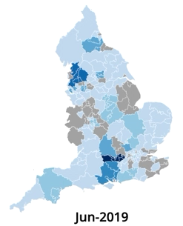


Spread of innovation:
From Berkshire to across the NHS
322,899
People have used SilverCloud
1,178,150
Hours of therapy delivered
 |  | Very High
 |  | High
 |  | Medium
 |  | Low
 |  | No coverage

Slide 12
SilverCloud RCT:
Scalable Model, Lasting Effectiveness & Impact
Depression Symptoms
Anxiety Symptoms

Slide 13
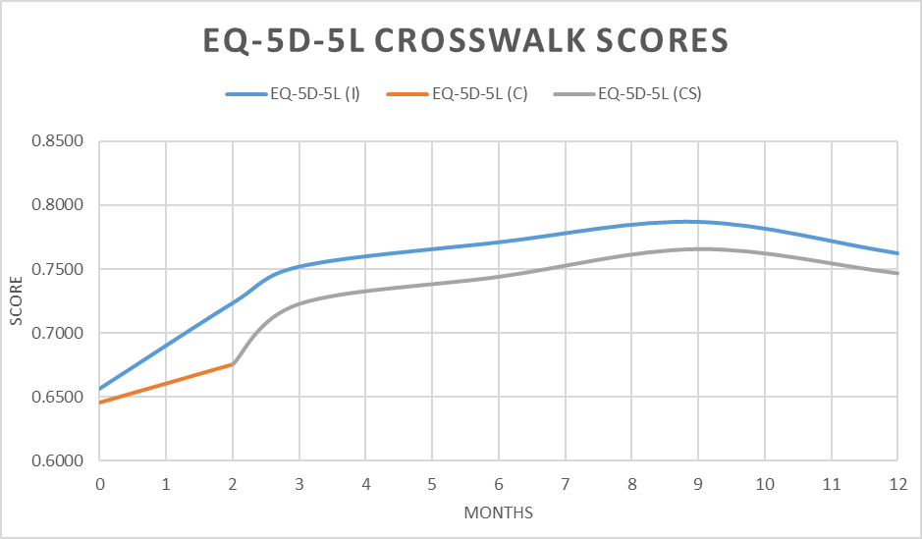
SilverCloud RCT:
Health Economics
 | Total – 8 weeks (95% CI) | 8 weeks – 12 months (95% CI)
Number of logins | 13.1 (11.7 – 14.5) | 22.3 (20.0 – 24.5)
Total time spent (min) | 238.4 (210.6 – 266.3) | 355.3 (312.6 – 398.1)
Time per login (min) | 19.2 (17.6 – 20.8) | 16.7 (15.4 – 18.0)
Activities done | 94.2 (82.8 – 105.7) | 126.1 (109.1 – 143.1)
% prog. Viewed | .41 (.38 - .44) | .56 (.52 - .59)
PC use % | .46 (.41 - .50) | .45 (.41 - .50)
Tablet use % | .09 (.06 - .12) | .09 (.06 - .12)
Mobile use % | .45 (.40 - .50) | .45 (.40 - .50)
Economic evaluation: cost per quality-adjusted life year (QALY) focusing on NICE’s reference case: Cost-effectiveness judged at being ≤ £20,000 (£20k) or ≤ £30,000 (£30k) per QALY
Probability of cost effectiveness @£30k per QALY increases to 91.2% when outcomes and costs were extrapolated over 12-month

Slide 14




Outcomes
Scalability
Cost Effectiveness
65%
Of users show a
clinically significant reduction
in symptom scores ¹
4-6x
1 person can support
six times as many people using SilverCloud – ‘one-to-many’
92%
Cost effectiveness at 12 months
¹ Real-world data using SilverCloud pre and post PRO via PHQ9 and GAD7
² Based on initial assessment of 45 minutes and 5 follow-up sessions of 30 minutes. https://clearhealthcosts.com/blog/2013/12/much-mental-health-care-cost-part-2-finding-affordablepsychotherapy/

Slide 15

The future of digital mental health
Taking a population approach

Slide 16
“
If it is no longer a question of whether digital therapy is effective, the question becomes…
...where else can it add value?
”

Slide 17











A organisational approach to wellbeing
Enabling seamless integrated care
Inpatient care
(discharge care planning)
NHS Staff
Community services
(long term conditions)
SilverCloud used across multiple pathways as part of a digital first approach
Embed as part of other digital initiatives
Improves access, increase efficiencies, capacity and reduces waiting list
Reduces costs (such as mileage) that can deliver in-year cash savings
Subscription allows cost-effective implementation and scale
Children and young people
mental health
Primary Care
Crisis teams
IAPT
(Step 2)
Maternity
mental health
IAPT
(Step 3)
Residential care
SMI
(Step 4)
Specialist services
Alcohol and substance
misuse services

Slide 18
Examples of services implementing or planned
A organisational approach to wellbeing
SilverCloud used across multiple pathways as part of a digital first approach
Embed as part of other digital initiatives (e.g. GDE, PHRs)
Improves access, increase efficiencies, capacity and reduces waiting list
Reduces costs (such as mileage) that can deliver in-year cash savings
Subscription allows cost-effective implementation and scale
75% of all IAPT services

Slide 19






A population approach to mental health
Enabling citizen empowerment
SilverCloud available across all public services as part of digital first approach
Embed as part of digital ecosystem, e.g. personal health records
Improves access, increase efficiencies, capacity and reduces waiting list and eases referral pathways and service burden
Reduces costs (such as mileage) that can deliver in-year cash savings across different services
Subscription allows cost-effective implementation and scale at a citizen level
Apps and devices
(NHS app, PHR)
Adult mental health
Community services
Children and young people
mental health
Primary Care
Schools and Colleges
Acute (hospital) care
Third sector
Social care
Residential care
Substance Misuse
Public services
Pharmacies

Slide 20
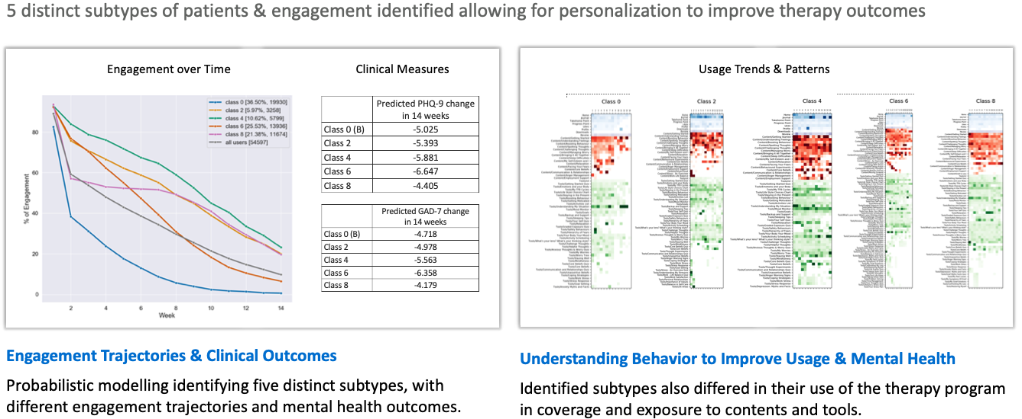
The Future:
With AI and MBL we can personalise treatment

Slide 21
It’s time to take a population approach to digital therapy

Slide 22

How can we work together
@silvercloudh
@Lloyd_Humph
lloyd.Humphreys@silvercloudhealth.com

